Slide 1
DIGITAL CITIZENSHIP | GRADE 2
That's Private!

Slide 2
WARM UP
What kinds of things should we not tell a stranger?

Slide 3
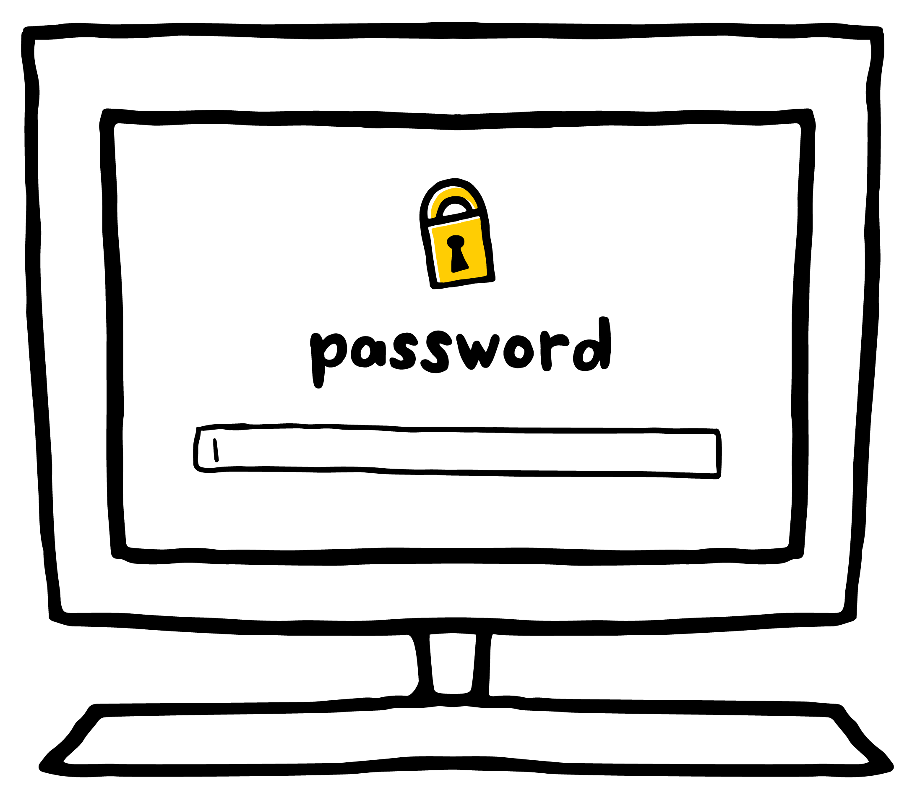
KEY VOCABULARY
Private
Something that you should keep to yourself

Slide 4
GAME
Thumbs Up, Thumbs Down
OK to share
NOT OK to share

