Slide 1
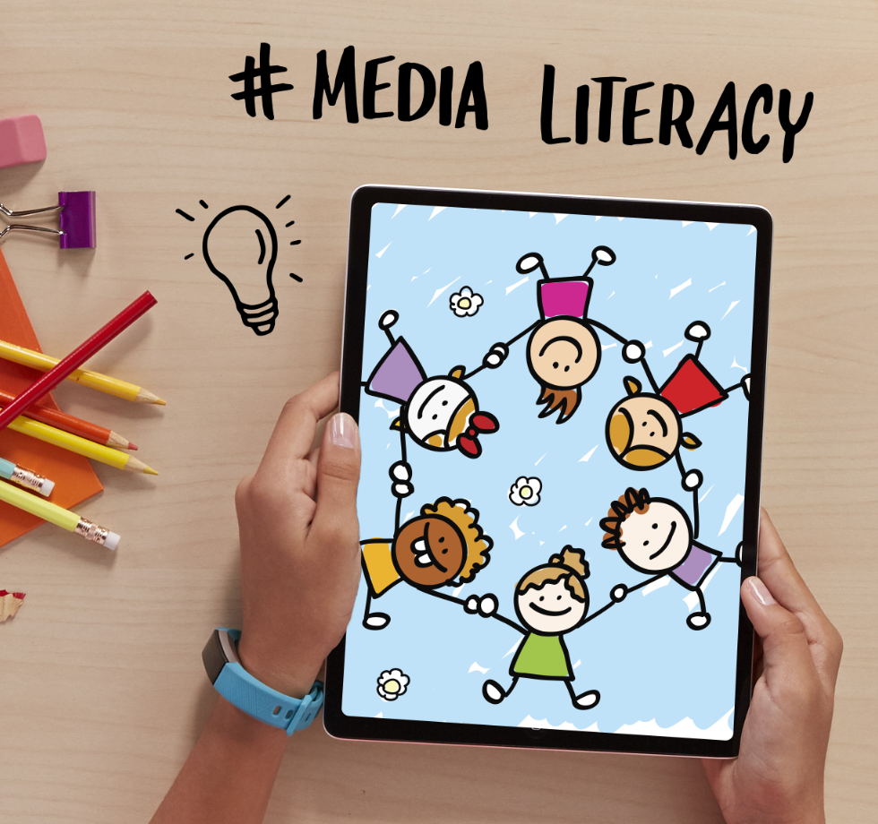
DIGITAL CITIZENSHIP | GRADE 4
A Creator's Rights and Responsibilities

Slide 2
Essential Question
What rights and responsibilities
do you have as a creator?

Slide 3
WARM UP: THINK, PAIR, SHARE
What does the word "creator" mean?

Slide 4
KEY VOCABULARY
Copyright ©
Legal protection that creators have over the things they create.

Slide 5
ACTIVITY: GROUP WORK

Slide 6
DISCUSS: ASK & ATTRIBUTE
Ask | Attribute
What kind of copyright license does the creative work have? Do I need to get permission from the creator to use it? | Have I provided attribution to the creator?

Slide 7
DISCUSS: ASK & ATTRIBUTE
Ask | Attribute
Do a reverse-image search to try to find the original creator of the image. If the photo has a regular copyright, email or get ahold of the creator to ask permission. | If you get permission, provide attribution by listing the author and date. Also add a link back to the photo's source. You might also use a citation.

