Slide 1
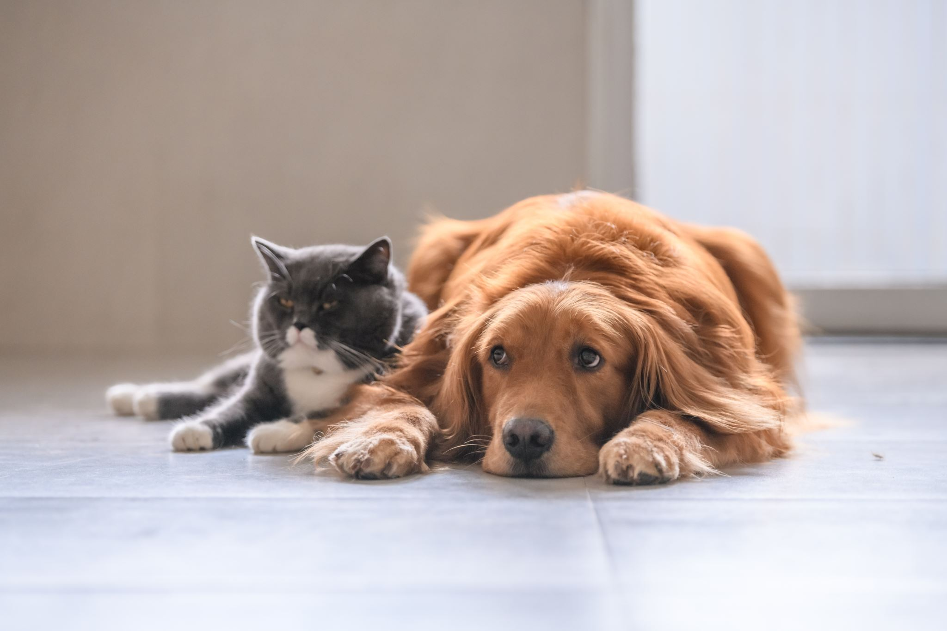
Symbiotic Animal Relationships
Working together!

Slide 2
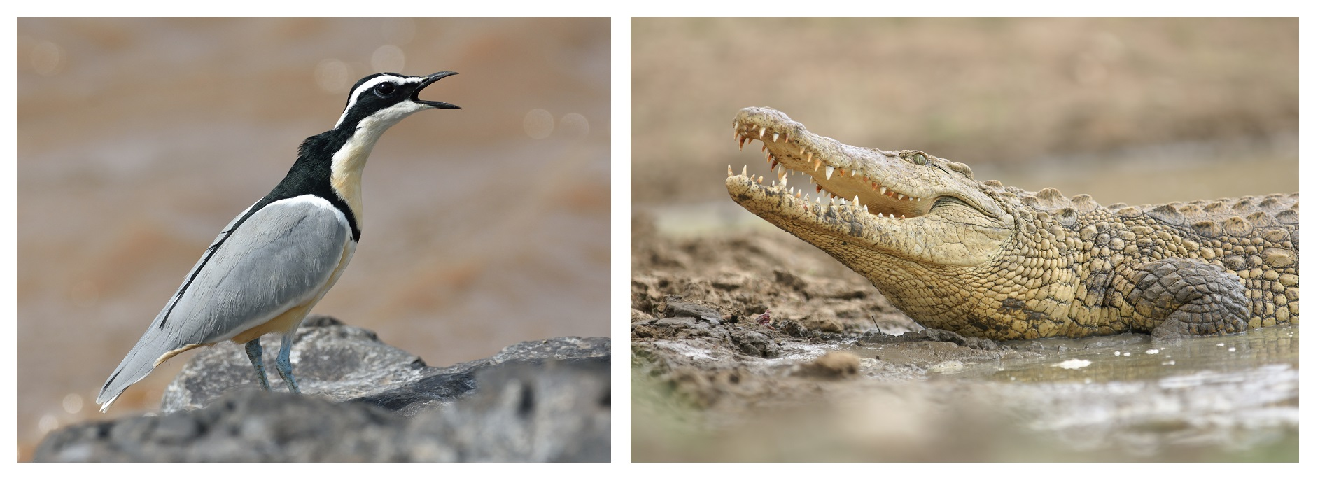
Nile Crocodile and Egyptian Plover
The Egyptian Plover aka “Crocodile Bird” will fly into the crocodile’s open mouth and feed upon the decomposing meat stuck between their teeth. The plover gets a not so scrumptious meal while the crocodile gets a little free dental work!

Slide 3
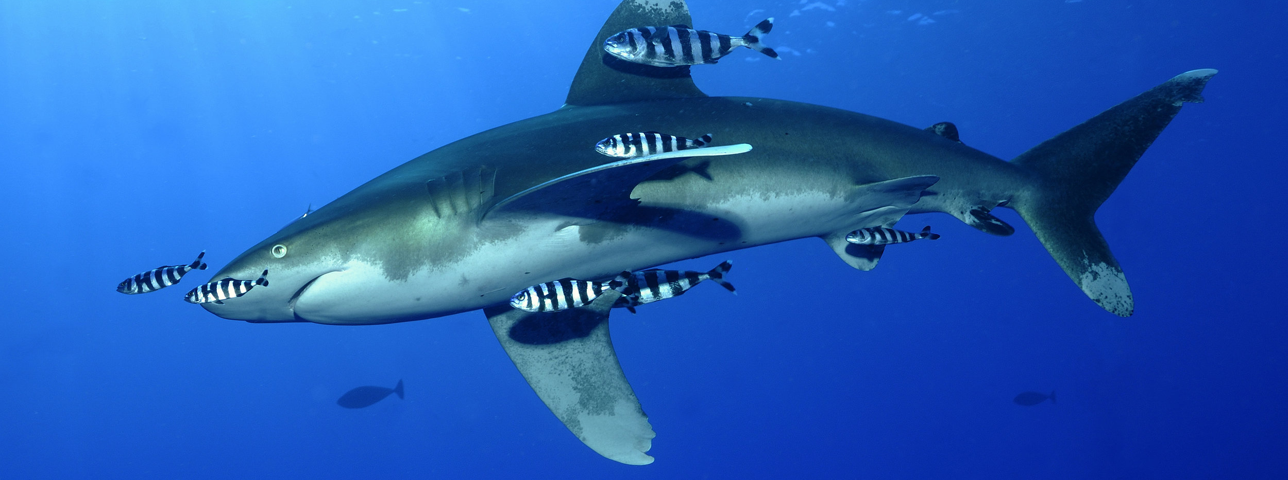
Sharks and Pilot Fish
While the pilot fish helps to rid the shark of parasites and clean away fragments of food caught between their teeth, it benefits from protection against other predators. The companionship between these two species is said to be so strong that there are even tales of distressed pilot fish following trawler vessels months after catching “their” shark.

Slide 4
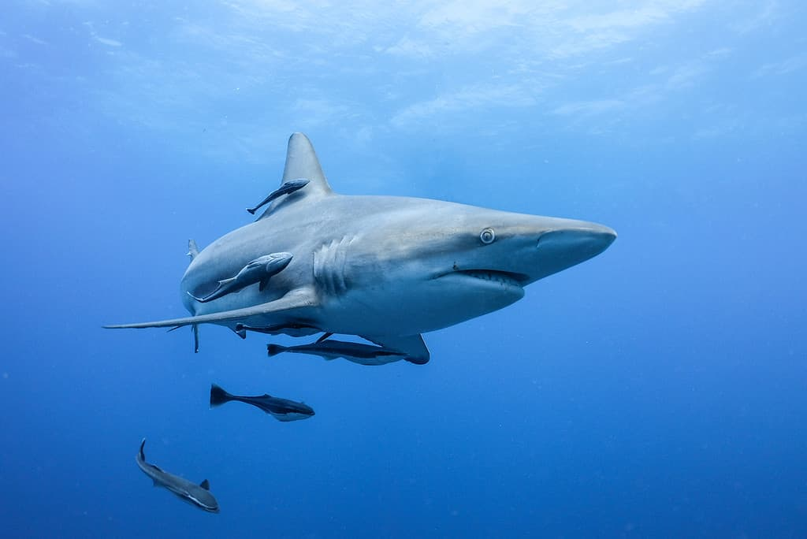
Sharks and Remora
Sharks are one of the most perfect predators in nature, but they too are vulnerable to parasites and disease. Remoras are willing to aid the sharks, benefiting both species. It is quite common to find pictures of sharks swimming in the ocean with one or more remora swimming alongside its fins. The remora swims alongside sharks, feeding on excess scraps and parasites latching onto the shark’s cartilage. Sharks allow the remora to feed because it strengthens the larger animal’s cartilage.

Slide 5
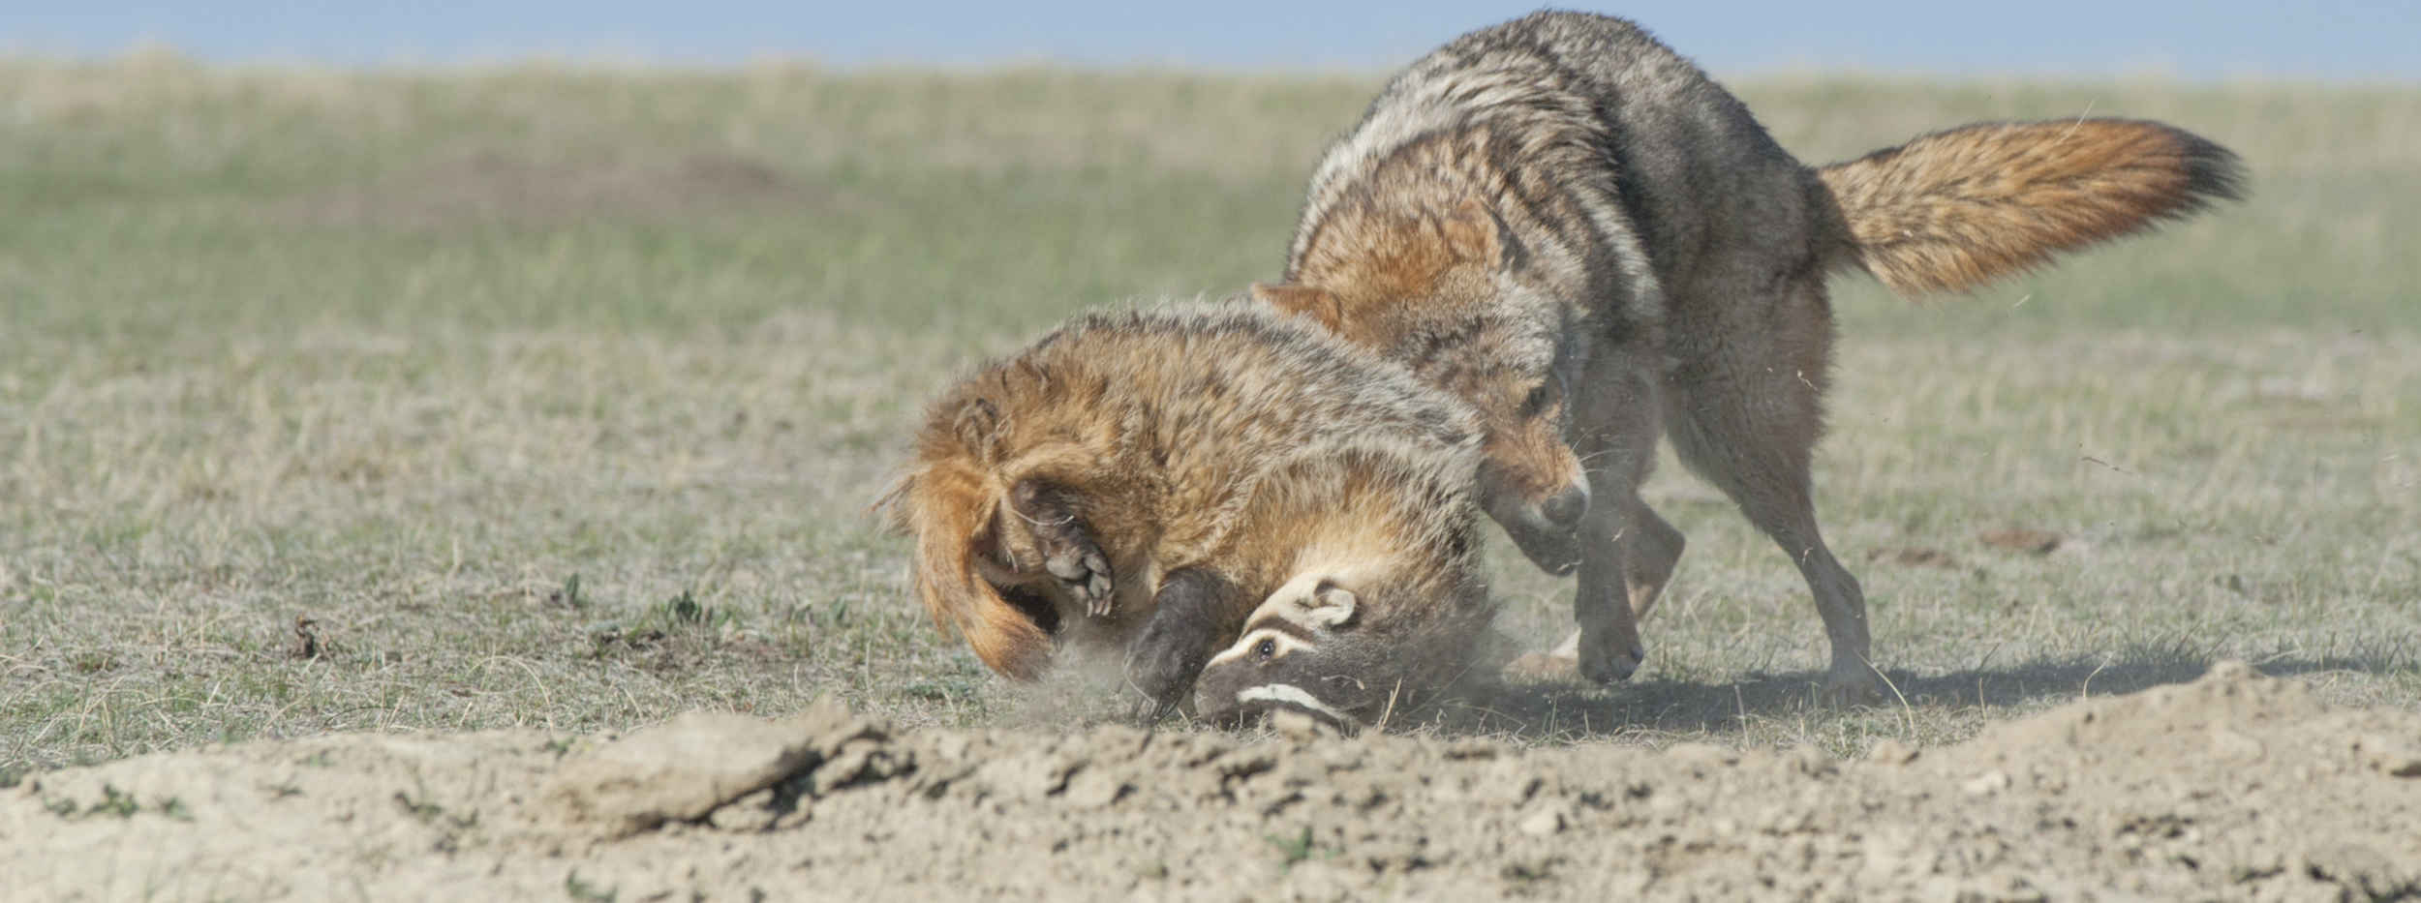
Coyote and Badger
In some parts of North America, coyotes have been observed waiting outside burrows for ground squirrels fleeing from an attacking badger. Sensing the danger posed by the coyote, some animals remain in their burrows, allowing the badger a greater opportunity to catch them.

Slide 6
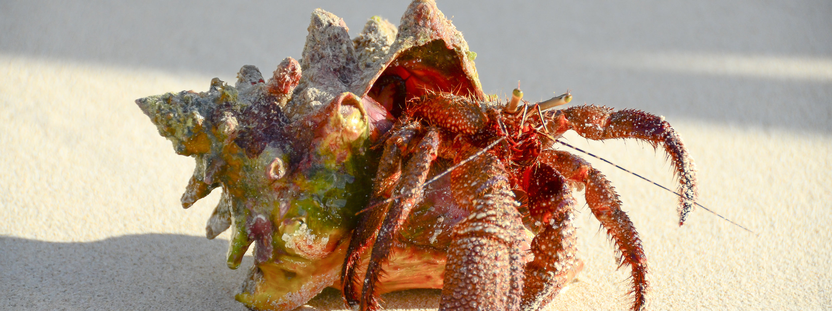
Hermit crab and sea anemone
By poking the anemone with its pincers and holding it in place, the crab encourages it to attach to its shell. While the anemone bags itself a free ride across the seabed upon the hermit crab's back, they effectively serve as bodyguards, providing shelter and using their barbed tentacles to actively fend off hungry hermit predators.

Slide 7
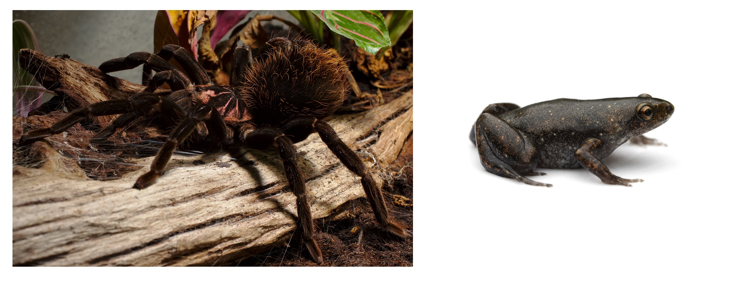
Colombian Lesserblack Tarantula and Dotted Humming Frog
The large creepy crawly even allows the tiny frog to share its burrow! While the plucky little amphibian enjoys protection from fierce predators, the spider benefits from the frog devouring carnivorous ants that attack and eat the tarantula’s eggs.

Slide 8
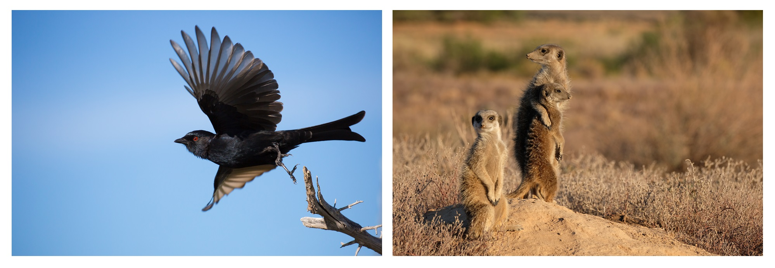
Drongos and Meerkats
The drongo serves as a lookout for hunting meerkats, giving a warning cry whenever a predator is within the vicinity. Upon hearing the alarm, the spirited little mammals scuttle back to their burrows, often dropping any prey they have captured in order to speed up their escape. Most of the calls made by the drongo are genuine. However, the mischievous drongo has learned that by raising false alarms, it can swoop down and pick up a free meal dropped by a fleeing meerkat. A master of mimicry, the drongo has even been witnessed making warning calls made by meerkats!

Slide 9
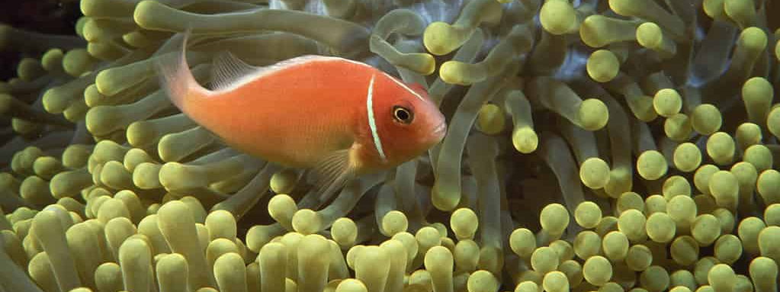
Clownfish and Anemones
Clownfish feed on algae, zooplankton, and small crustaceans, which they share with the anemone. Sea anemones do not move, so having a companion to bring it algae and other nutrients is beneficial. In turn, the sea anemone protects the clownfish from predators by allowing it to live in its tentacles without being stung.

Slide 10
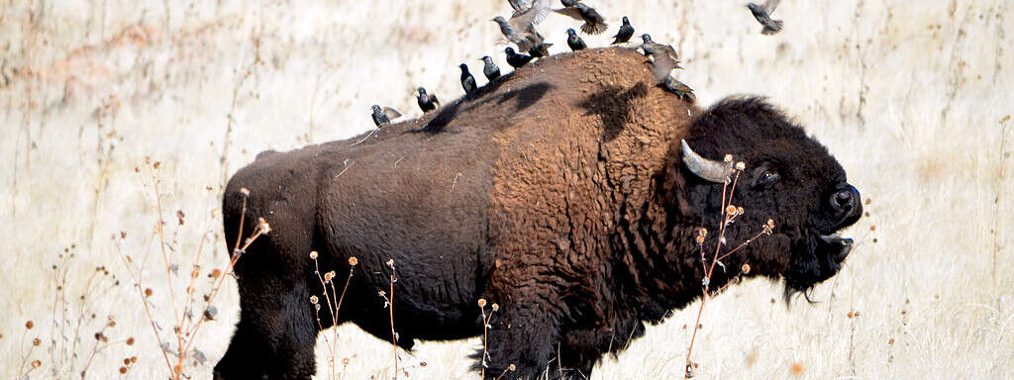
Egrets and Water Buffalo
Large mammals like buffalo and bison attract annoying insects and parasites that feed on their blood and dead skin cells. Buffalo cannot protect themselves from these pesky pests, which is why they seek aid from other animals like the egret.
Egrets sit on a buffalo’s back and feed on the insects. The buffalo has a lower chance of catching a lethal disease from tick or insect bites. In turn, buffalos protect the egrets from predators like hawks or coyotes.

Slide 11
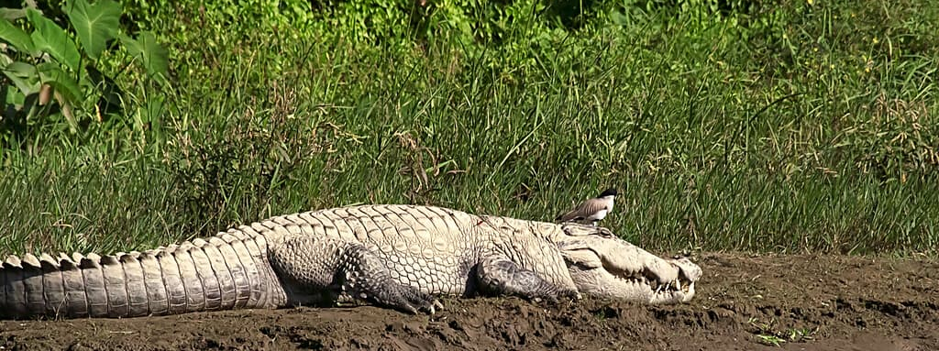
CROCODILES AND PLOVERS
Plovers land inside a crocodile’s large mouth, picking out food and other gunk between the croc’s teeth for a free meal. Crocodiles allow the plover to clear their scraps because it keeps their teeth healthier for longer periods of time. A crocodile can regrow their teeth when one falls out, but they know the value of good dental hygiene.

Slide 12
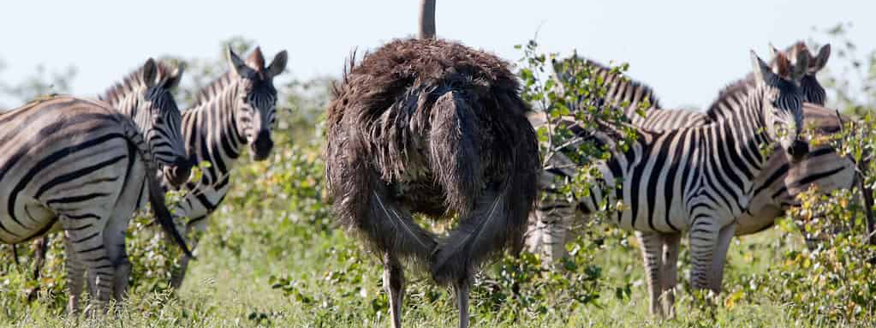
OSTRICHES AND ZEBRAS
Ostriches have an excellent sense of smell, but poor eyesight. Meanwhile, zebras have excellent eyesight, but a poor sense of smell. By staying together, zebras act as eyes for the ostrich, while the ostrich smells predators on behalf of the zebra. When a predator is detected due to these combined senses, they flee together and allow the zebra’s patterns to disorient predators from an easy catch.

Slide 13
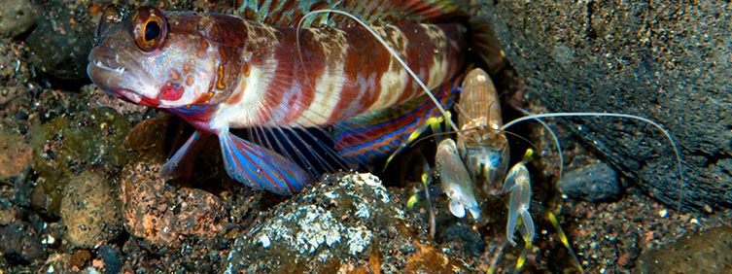
PISTOL SHRIMPS AND GOBIES
Pistol shrimp are burrowers, digging holes in the sandy seafloor that they will maintain and sometimes share with a goby. Outside the burrow, the pair stay close together, often with the shrimp maintaining physical contact by resting its sensitive antennae on the fish. When the goby spots a potential predator, it uses chemical cues and bolts for cover in the shared burrow. The shrimp relies on these tactile and chemical cues to know when it needs to hide, too. When the goby is active, it signals to the shrimp that it's relatively safe to be outside the burrow.

Slide 14
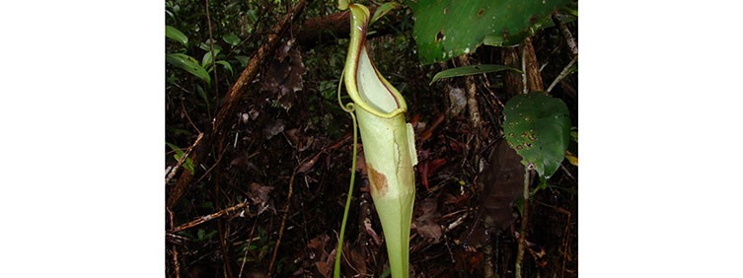
WOOLEY BATS AND PITCHER PLANTS
Woolly bats are known to roost in a tropical pitcher plant found in Borneo. While the bat gets a hidey-hole to rest in, the plant benefits by catching the guano (faeces) that the little mammal produces. This provides the plant with the nutrients it needs to survive.

Slide 15
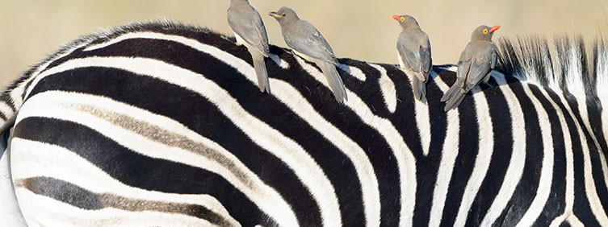
OXPECKERS AND LARGE MAMMALS
The birds pick at parasites on the mammal's body, including ticks and blood-sucking flies. Like a number of other species, oxpeckers will raise the alarm and warn their hosts of impending danger.For example, the birds will help hosts such as rhinos (which are short-sighted) evade humans.
However, the birds can harm their hosts. The birds remove parasites and seem to prefer hosts with large numbers of them, but they will also dig into wounds. While the mammals appear relatively tolerant of this behaviour, it's not beneficial to them.

Slide 16
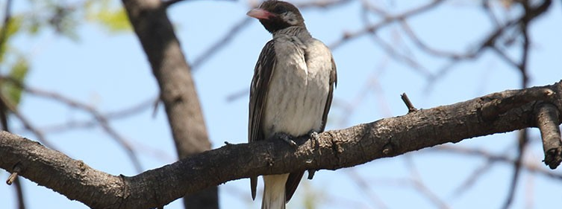
HONEYGUIDES AND HUMANS
One of the ways these birds gain easy access to a nutritious meal is by leading other honey-coveting species to a bee nest and allowing them to do the hard work of breaking into it. The human-honeyguide relationship is the best-documented of these partnerships. The wild honeyguides recruit people with a demanding call, indicating that they have found a bee nest. The honey-hunting humans reply with calls passed down through generations and follow the bird.
When they reach the nest, the humans subdue the bees, such as with smoke, break into the nest and help themselves to the sugar-rich honey contained within. The Hadza people of Tanzania are one group known to work with honeyguides. It has been estimated that up to 10% their diet is acquired with the help of the birds. With the bees dispatched and the humans satisfied, the honeyguides are left to dine on the beeswax, eggs and larvae left behind.

Slide 17
Reference List
https://wildlifewoods.net/blog/2018/8/23/6-surprising-symbiotic-relationships
https://a-z-animals.com/articles/animals-species-that-work-together-in-the-wild/
https://www.nhm.ac.uk/discover/mutualism-examples-of-species-that-work-together.html

