Slide 1
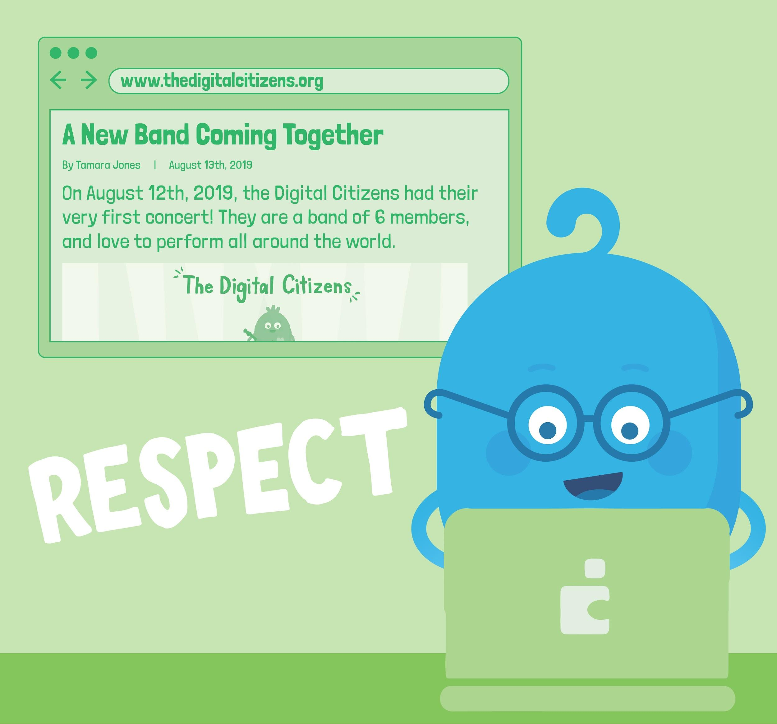
DIGITAL CITIZENSHIP | GRADE 2
Let's Give Credit!

Slide 2
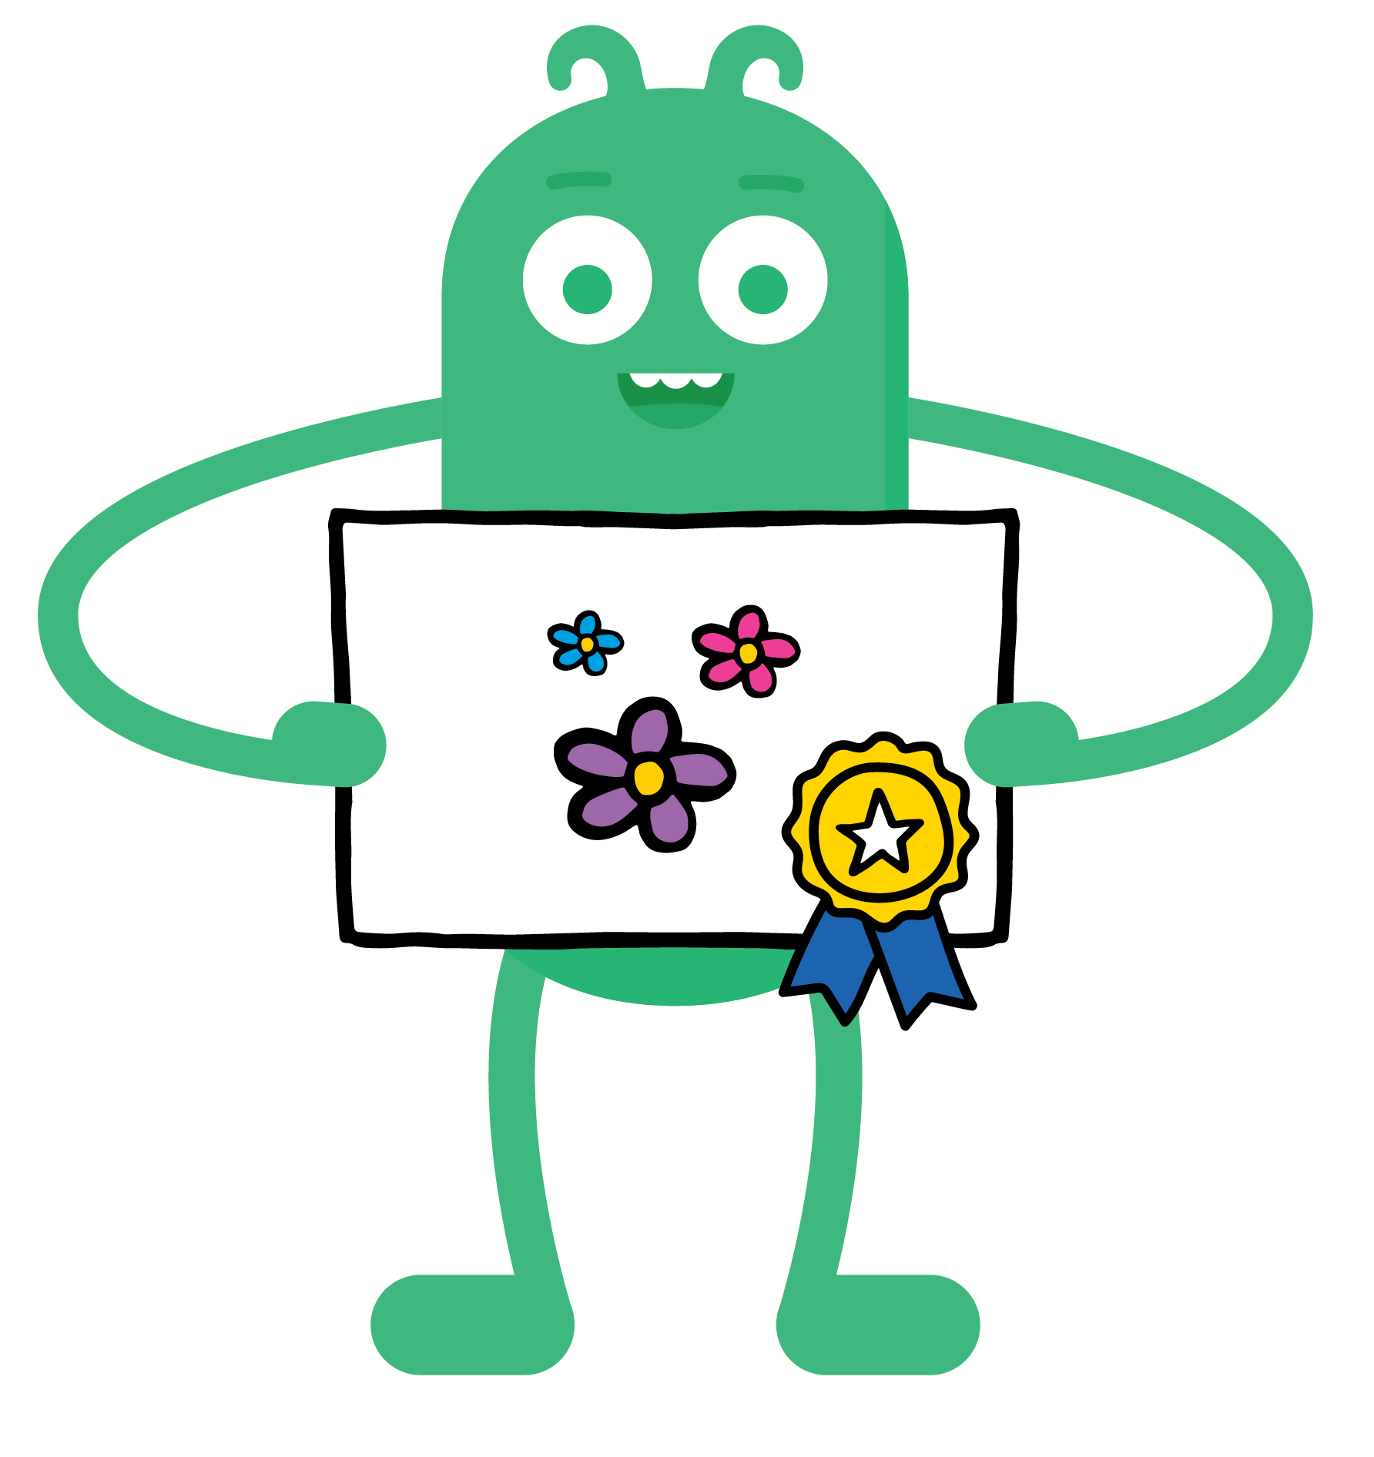
KEY VOCABULARY
Credit
Giving recognition to a person
that created something

Slide 3
KEY VOCABULARY
Respect
Showing that you appreciate someone

Slide 4
Update slide template so it has a more fun and friendly feel.
Have monster holding up as sign with the EQ.
How can you give credit for other people's work?
DSN: Have monster holding up as sign with the EQ.

Slide 5
REVIEW
How to give credit:
Author
Title
Website

Slide 6
ACTIVITY

Slide 7
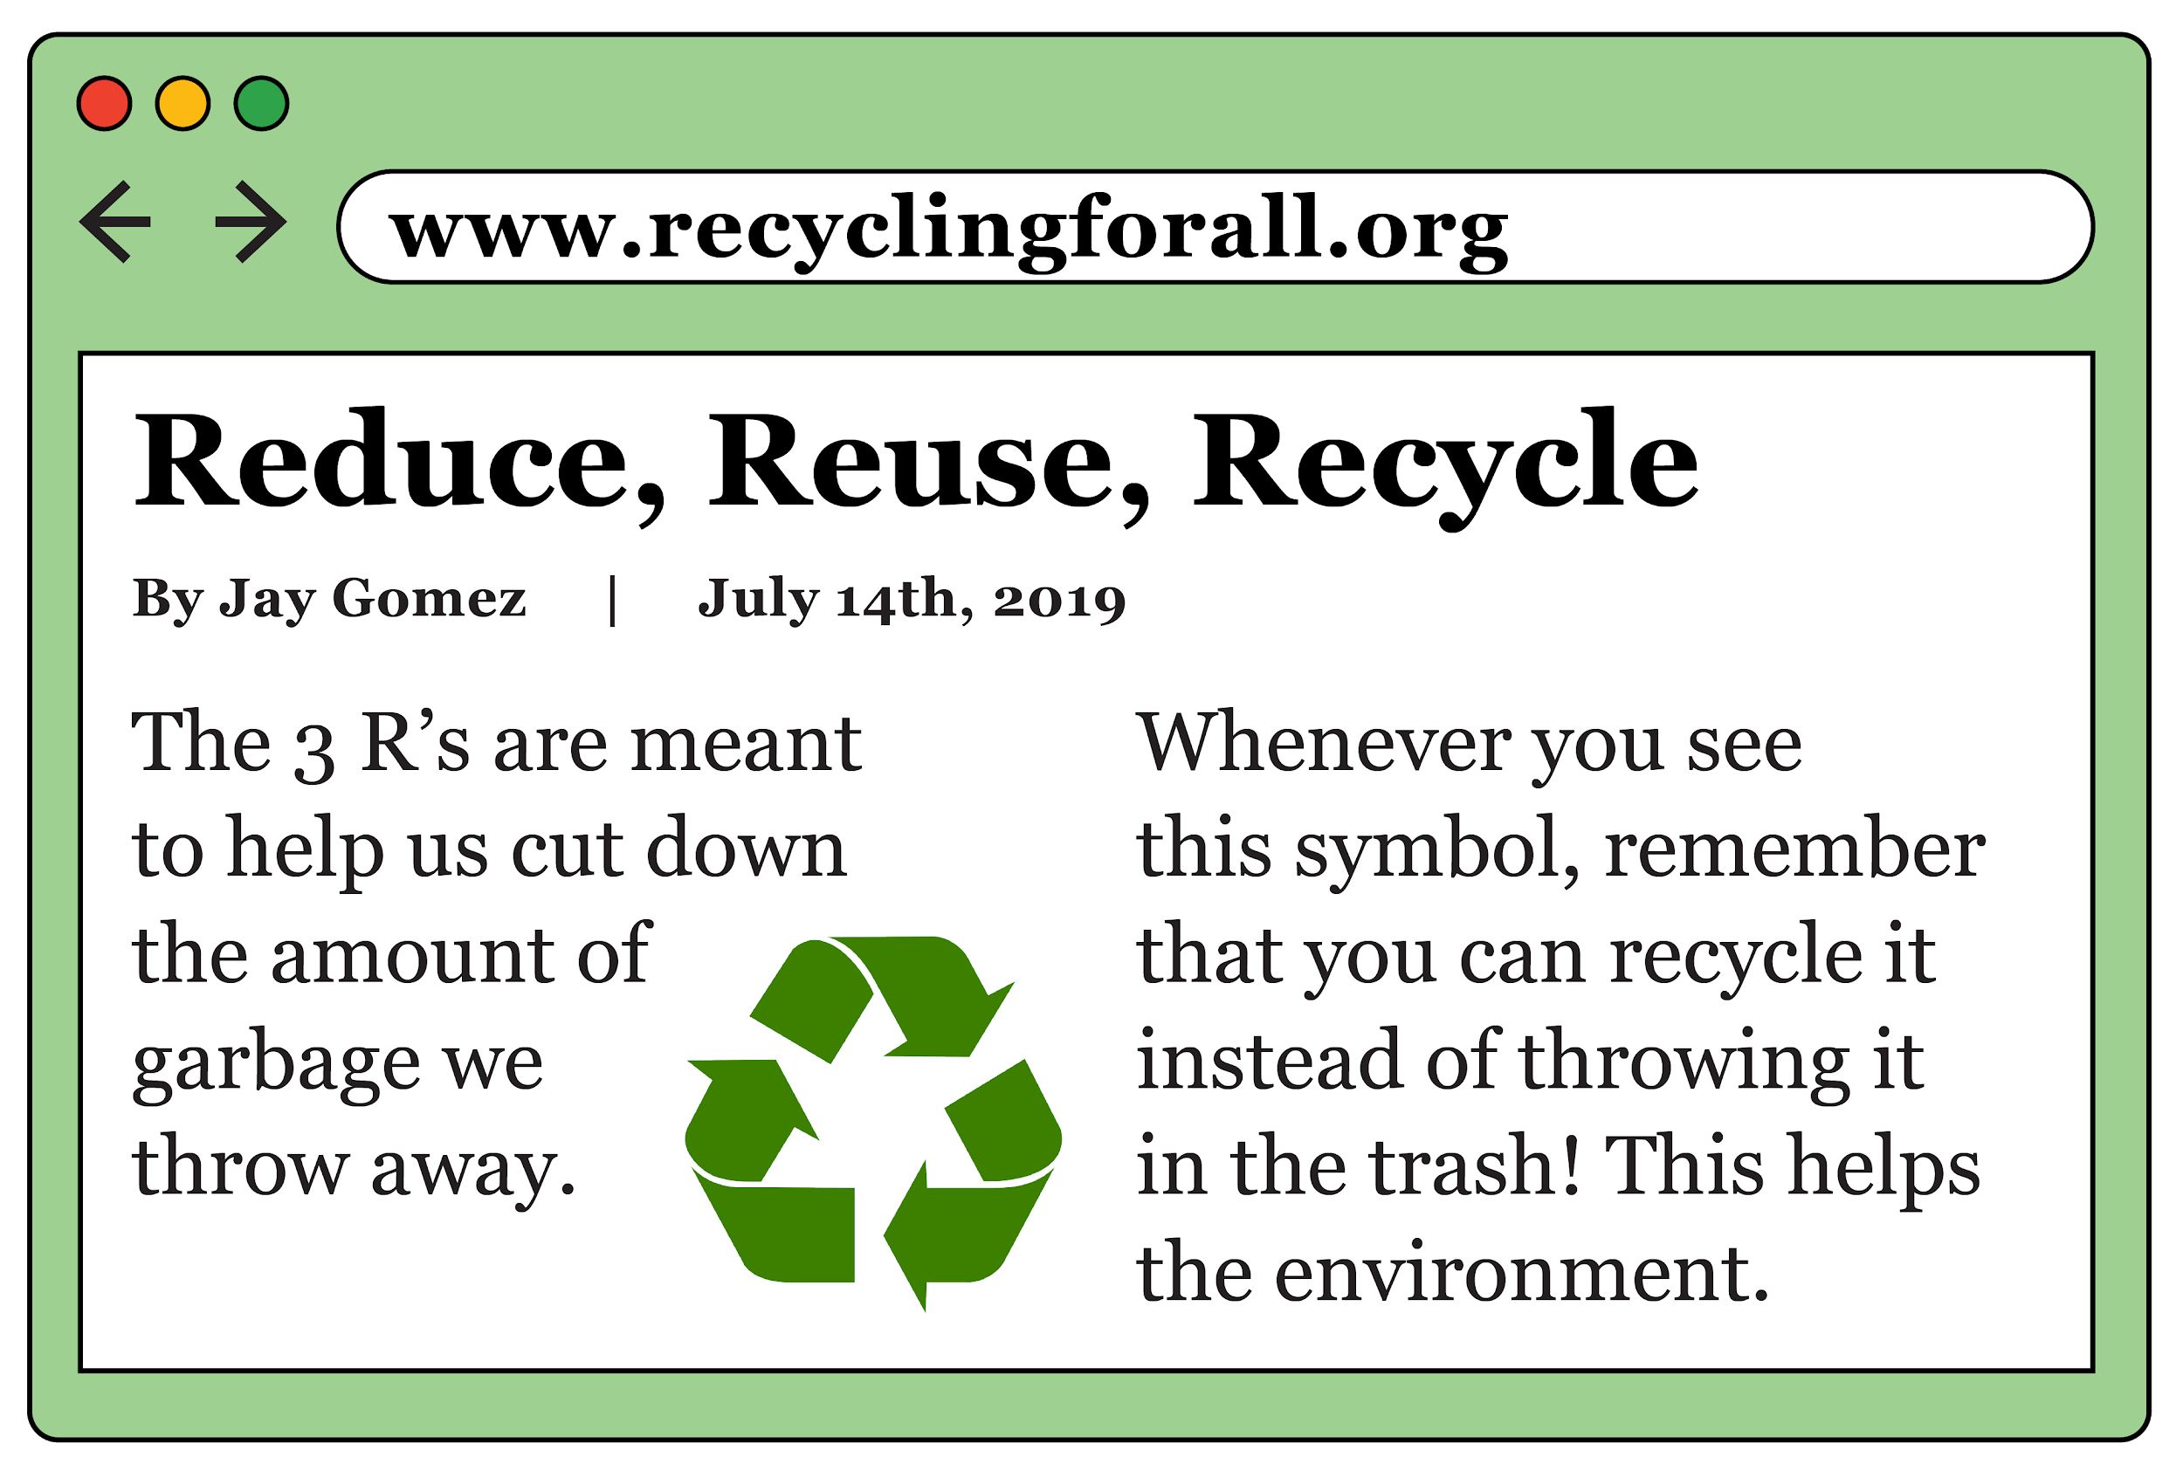
ACTIVITY

Slide 8
ACTIVITY

Slide 9
REVIEW
How to give credit:
[Author], [Title], [Website]

