Slide 1
Yoshi and the Ocean
What happened next?

Slide 2
Vital stats
1,003 days
More than 40,011km – over 24, 855 miles
23,509 satellite messages
6,282 satellite passes
2 Ocean basins
2 Continents
1 Legend. Greatest of all time. YOSHI.

Slide 3
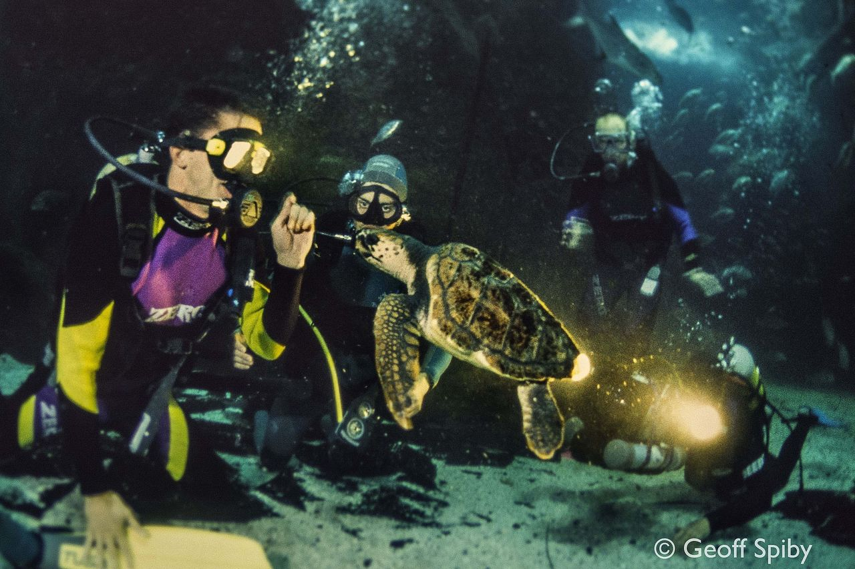
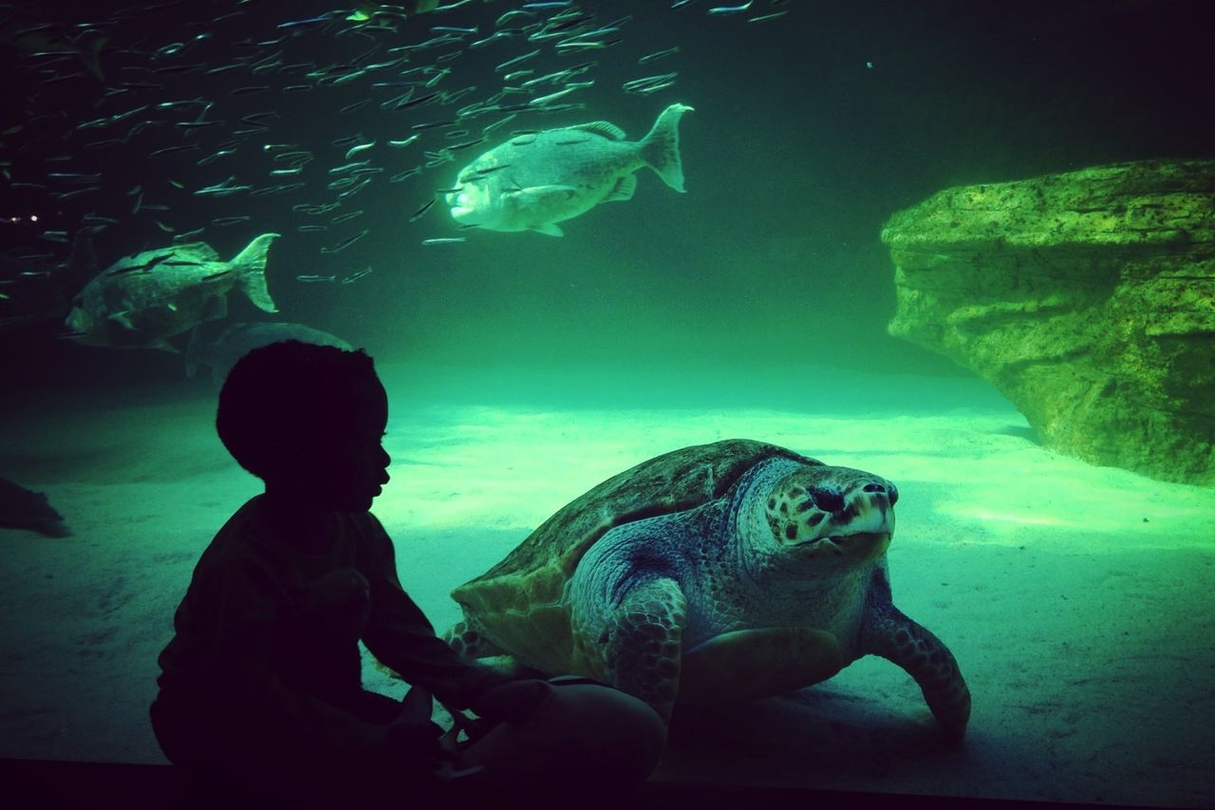
Then….and now….
Early life – size of a dinner plate
At release – about 403 ½ pounds

Slide 4
Yoshi the loggerhead turtle sends her last transmission after 40,000 km swim!
October 28, 2020
Released 2017
Swam 24,855 miles
https://www.aquarium.co.za/news/yoshi-the-loggerhead-turtle-sends-her-last-transmission-after-40-000km-swim

Slide 5
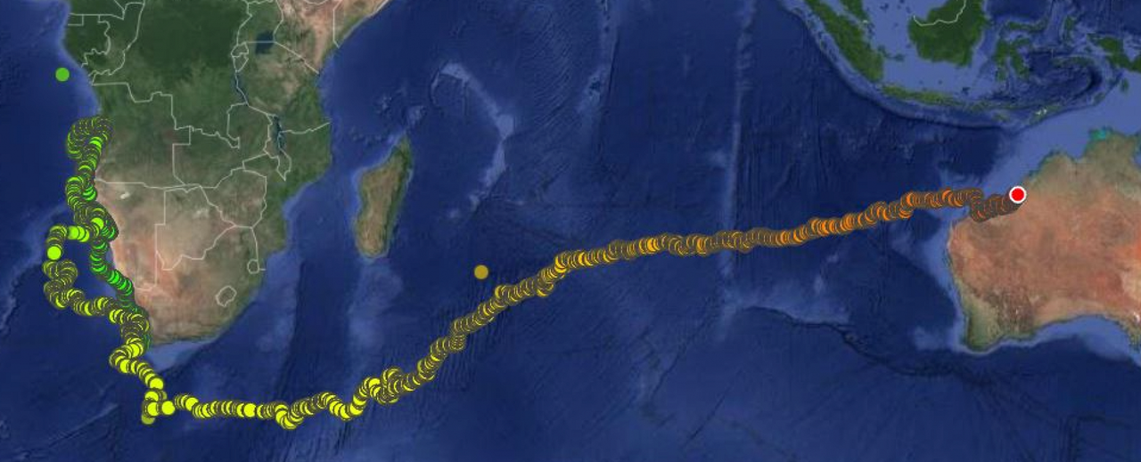
Yoshi’s Journey to the La Grange area of Western Australia’s Eighty Mile Beach

Slide 6
