Slide 1
DIGITAL CITIZENSHIP | GRADE 5
Reading News Online

Slide 2
Essential Question
What are the important parts of an online news article?

Slide 3
KEY VOCABULARY
News
New information about recent or important events

Slide 4
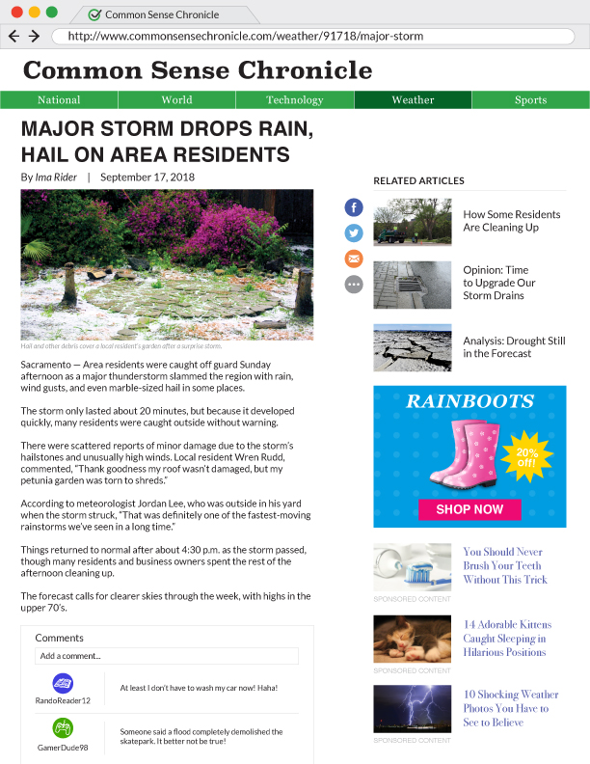
OBSERVE + ANALYZE IMAGE

Slide 5
OBSERVE + ANALYZE IMAGE
headline
The headline is the title of a news article. It's usually printed in big, bold letters near the top of the article.
The headline tells readers what the article is about before they start reading.

Slide 6
OBSERVE + ANALYZE IMAGE
byline
The byline is the name of the article's author.
It tells readers the name of the person (or people) who wrote the article.

Slide 7
OBSERVE + ANALYZE IMAGE
date
The date is the exact day (and sometimes time) when the article was published or last updated.
It tells you how recently the article was published and how current the information is.

Slide 8
OBSERVE + ANALYZE IMAGE
URL
The URL is the unique, one-of-a-kind address of an article on the web.
It helps you know exactly which webpage you're looking at. It might also help you share the article with someone else.

Slide 9
OBSERVE + ANALYZE IMAGE
section title
The section title is the category or section of an article on a news website.
It tells you what type of article you're reading and how the article is categorized by the website.

Slide 10
OBSERVE + ANALYZE IMAGE
image
The main image is a photograph (or video) that's usually near the top of an article, under the headline.
The image or video helps introduce the article and sometimes shows details that words can't.

Slide 11
OBSERVE + ANALYZE IMAGE
related articles
Related articles are links to more articles from the same website. They may be similar to the one you're reading.
They help show readers more articles that might be interesting or important.

Slide 12
OBSERVE + ANALYZE IMAGE
advertisements
Advertisements (or ads) are links to other websites that are usually selling something.
They help the news website make money by selling space on their article pages.

Slide 13
OBSERVE + ANALYZE IMAGE
sponsored content
Sponsored content is a link to another website. This content is usually not news (even though it might be disguised to look like news).
It helps the news website make money by selling space on their article pages.

Slide 14
OBSERVE + ANALYZE IMAGE
comments
Comments are thoughts and opinions about the article that any reader can post.
They give readers a public place to post reactions, thoughts, and questions. The comments section is also a place to have a discussion or debate about the article.

