Slide 1

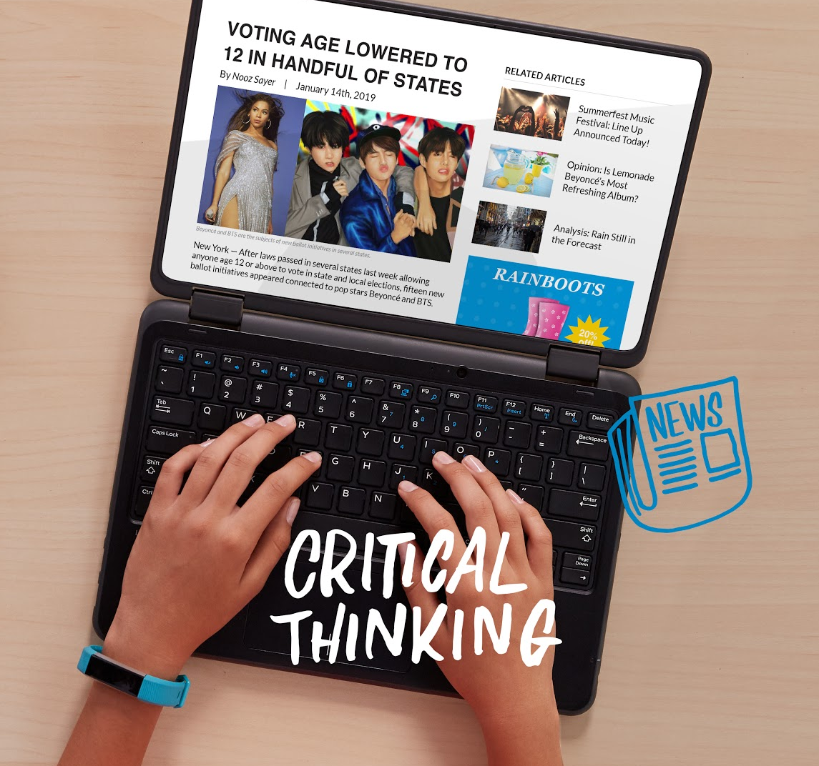
DIGITAL CITIZENSHIP | GRADE 6
Finding Credible News

Slide 2

Essential Question
How do we find credible information on
the Internet?

Slide 3

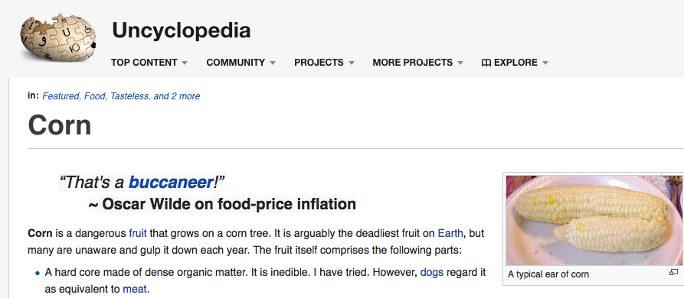
OBSERVE + ANALYZE IMAGE
Notes:
Screenshot from http://uncyclopedia.wikia.com/wiki/Corn

Slide 4


Credible
KEY VOCABULARY
Able to be believed; trustworthy

Slide 5

Why might information you find on the Internet not be true?
WARM UP: TRICKY WIKI
Editorials
Satire
Hoaxes
Articles or blogs that are meant to persuade the reader of the author's opinion and which may include bias or leave out important facts
Websites or articles that are meant to be funny by making fun of a subject and which often include statements that are untrue
Articles that are meant to fool the reader into believing something that isn't true by trying to be as realistic as possible

Slide 6
Evaluate
KEY VOCABULARY
To carefully examine something to figure out its value

Slide 7
Bias
KEY VOCABULARY
Having preference for one thing over another in a way that’s unfair

Slide 8
Corroboration
KEY VOCABULARY
An additional source that confirms or supports a news story, article, or piece of information

Slide 9
Internet Investigator Checklist
KEY VOCABULARY
Internet Investigator Checklist
✓ Read closely. Does it make sense? Is it believable? Identify the main idea by analyzing the text features and webpage and by reading the text. Take note of anything that is surprising or hard to believe or that gives you a strong emotional reaction.
✓ Analyze the source. Does it come from a credible, unbiased source? Find out information about the site owner and author by exploring the site and searching the web.
✓ Look for corroboration. Do other credible sources say the same thing? See if the main idea and key points of the article are also reported by other credible sites.

Slide 10

How credible is it?
ACTIVITY: NEWS OR FAKE NEWS?
Fake News
Questionable
Credible News
Information is very surprising—even unbelievable.
Website is biased or is not part of a credible news, academic, or governmental organization.
Author's bio or previous articles show a bias on the issue.
Key points cannot be corroborated by other credible sites.
Information may be surprising but is not unbelievable.
Website is not part of a credible news, academic, or governmental organization.
Author's bio or previous articles may show bias, or the article is an editorial or opinion piece.
Most key points can be corroborated.
Information may or may not be surprising but makes sense.
Website is part of a credible news, academic, or governmental organization.
Author has no clear bias on the issue, and article is not an editorial or opinion piece.
All key points can be corroborated by other credible sites.

Slide 11
News or
Fake News?
KEY VOCABULARY

Slide 12


KEY VOCABULARY
Official news?
Imagine that you see a message that says, “Due to an emergency, school has been canceled until next Monday. Please share immediately.” The message looks official, but you’re not sure. How can you find out more?
Check the school website and have your parents call the school to see if the school officials confirm the message.
Check the source.
Look closely for clues that something is not right.
All of the above.

Slide 13
KEY VOCABULARY
Official news?
Imagine that you see a message that says, “Due to an emergency, school has been canceled until next Monday. Please share immediately.” The message looks official, but you’re not sure. How can you find out more?
Check the school website and have your parents call the school to see if the school officials confirm the message.
Check the source.
Look closely for clues that something is not right.
All of the above.

Slide 14
KEY VOCABULARY
To share or not to share?
Imagine that you see a message that says, “Due to an emergency, school has been canceled until next Monday. Please share immediately.” and were about to share it. Is it OK or not OK to share the message?
It is OK to share the message because it says, “Please share immediately.”
It is OK to share the message because it looks official and you want others to know about an emergency school closure.
It is not OK to share the message because you’re not sure it’s true, and spreading fake news can cause confusion.
It is not OK to share the message because you want to wait for others to share it first.

Slide 15
KEY VOCABULARY
To share or not to share?
Imagine that you see a message that says, “Due to an emergency, school has been canceled until next Monday. Please share immediately.” and were about to share it. Is it OK or not OK to share the message?
It is OK to share the message because it says, “Please share immediately.”
It is OK to share the message because it looks official and you want others to know about an emergency school closure.
It is not OK to share the message because you’re not sure it’s true, and spreading fake news can cause confusion.
It is not OK to share the message because you want to wait for others to share it first.

Slide 16
KEY VOCABULARY
Oops!
Imagine that you see a message that says, “Due to an emergency, school has been canceled until next Monday. Please share immediately.” You shared the message and realized afterward that it was fake. What should you do if you shared false information?
Tell a responsible adult so they can contact the school right away.
Spread the fake news further to see who would fall for it.
Delete your post and post a correction.
Flag or report the fake message if possible.

Slide 17
KEY VOCABULARY
Oops!
Imagine that you see a message that says, “Due to an emergency, school has been canceled until next Monday. Please share immediately.” You shared the message and realized afterward that it was fake. What should you do if you shared false information?
Tell a responsible adult so they can contact the school right away.
Spread the fake news further to see who would fall for it.
Delete your post and post a correction.
Flag or report the fake message if possible.

Slide 18
