Slide 1
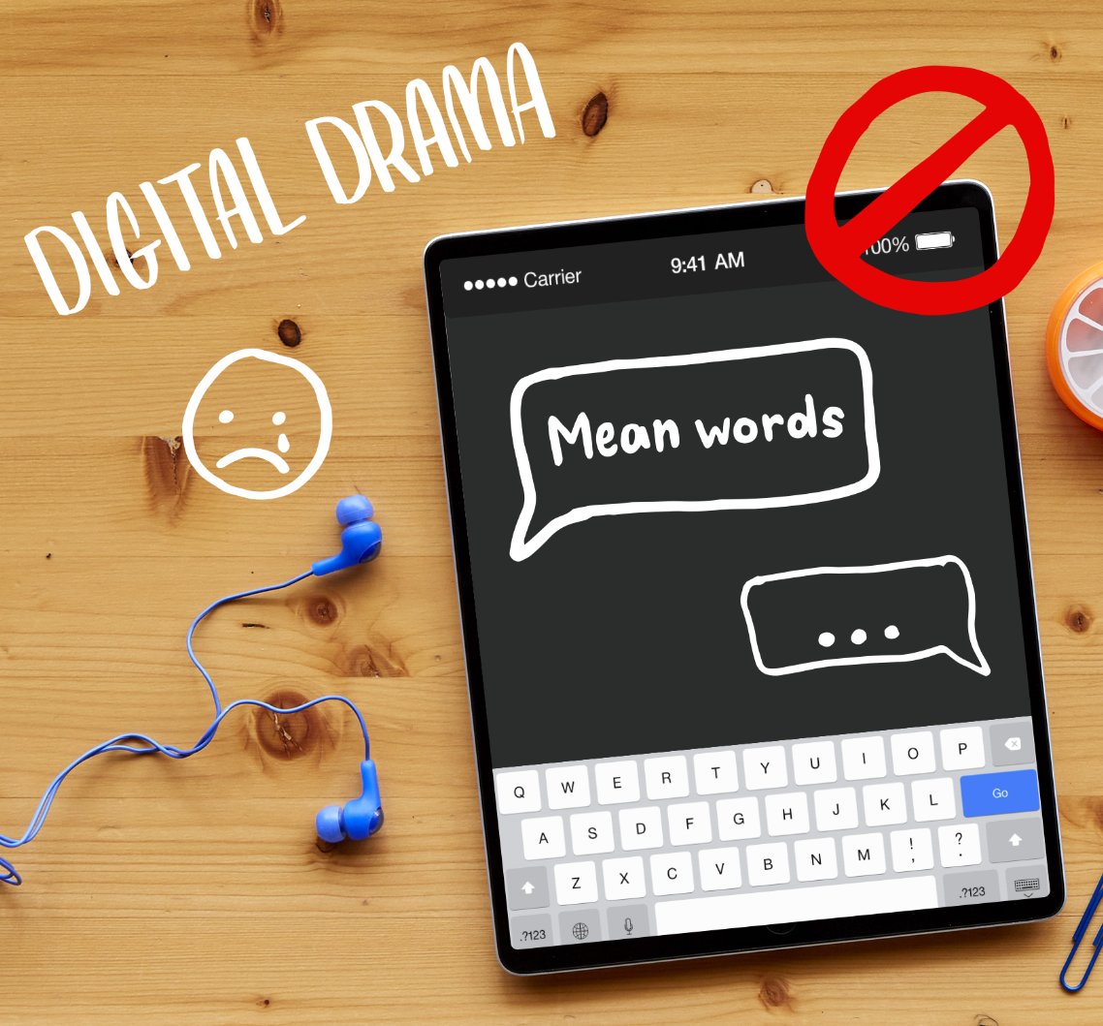
DIGITAL CITIZENSHIP | GRADE 3
The Power of Words

Slide 2
WARM UP: CLASS DISCUSSION
Which emoji fits?
1
2
3
4

Slide 3
WARM UP: CLASS DISCUSSION
Hello.
1
2
3
4

Slide 4
KEY VOCABULARY
Interpret
To understand something based on your point of view

Slide 5
Essential Question
What should you do when someone uses mean or
hurtful language on the internet?

Slide 6
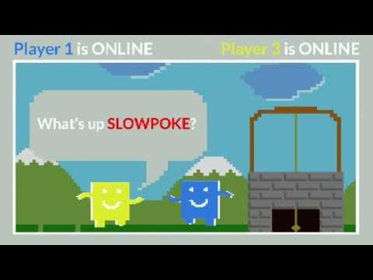
WATCH + ANALYZE
Power of Words
Why do you think those other players said those things to Guts?
To watch this video on the Common Sense Education site, click here.

Slide 7
KEY VOCABULARY
Empathy
To imagine the feelings that someone else is experiencing

Slide 8
Step away.
Tell a trusted adult.
OK sites first.
Pause and think online.

Slide 9
WRAP UP: CROSSING THE LINE
"You are an idiot."

Slide 10
WRAP UP: CROSSING THE LINE
"I'm having a party and
you're not invited."

Slide 11
WRAP UP: CROSSING THE LINE
"I like your new haircut."

Slide 12
WRAP UP: CROSSING THE LINE
"Thanks for the advice. Next time, would you mind telling me in
person rather than by texting?"

Slide 13
WRAP UP: CROSSING THE LINE
"Did you finish your
homework?"

Slide 14
WRAP UP: CROSSING THE LINE
“I can’t believe you like superhero shows. Only first-graders do."

Slide 15
WRAP UP: CROSSING THE LINE
“You are weird."

Slide 16
WRAP UP: CROSSING THE LINE
“Why are you wearing THAT shirt?"

Slide 17
