Slide 1
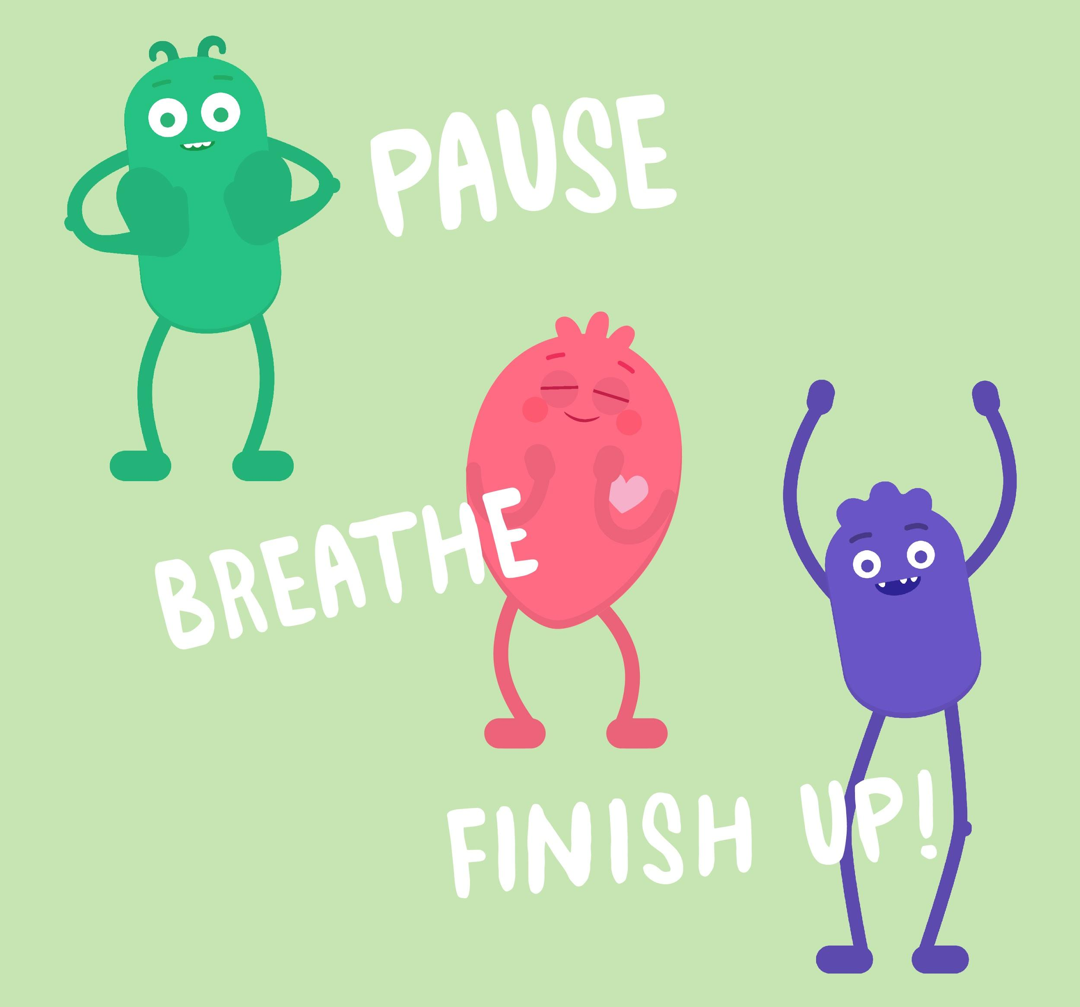
DIGITAL CITIZENSHIP | GRADE K
Pause for People

Slide 2
WARM UP
Time’s up!

Slide 3
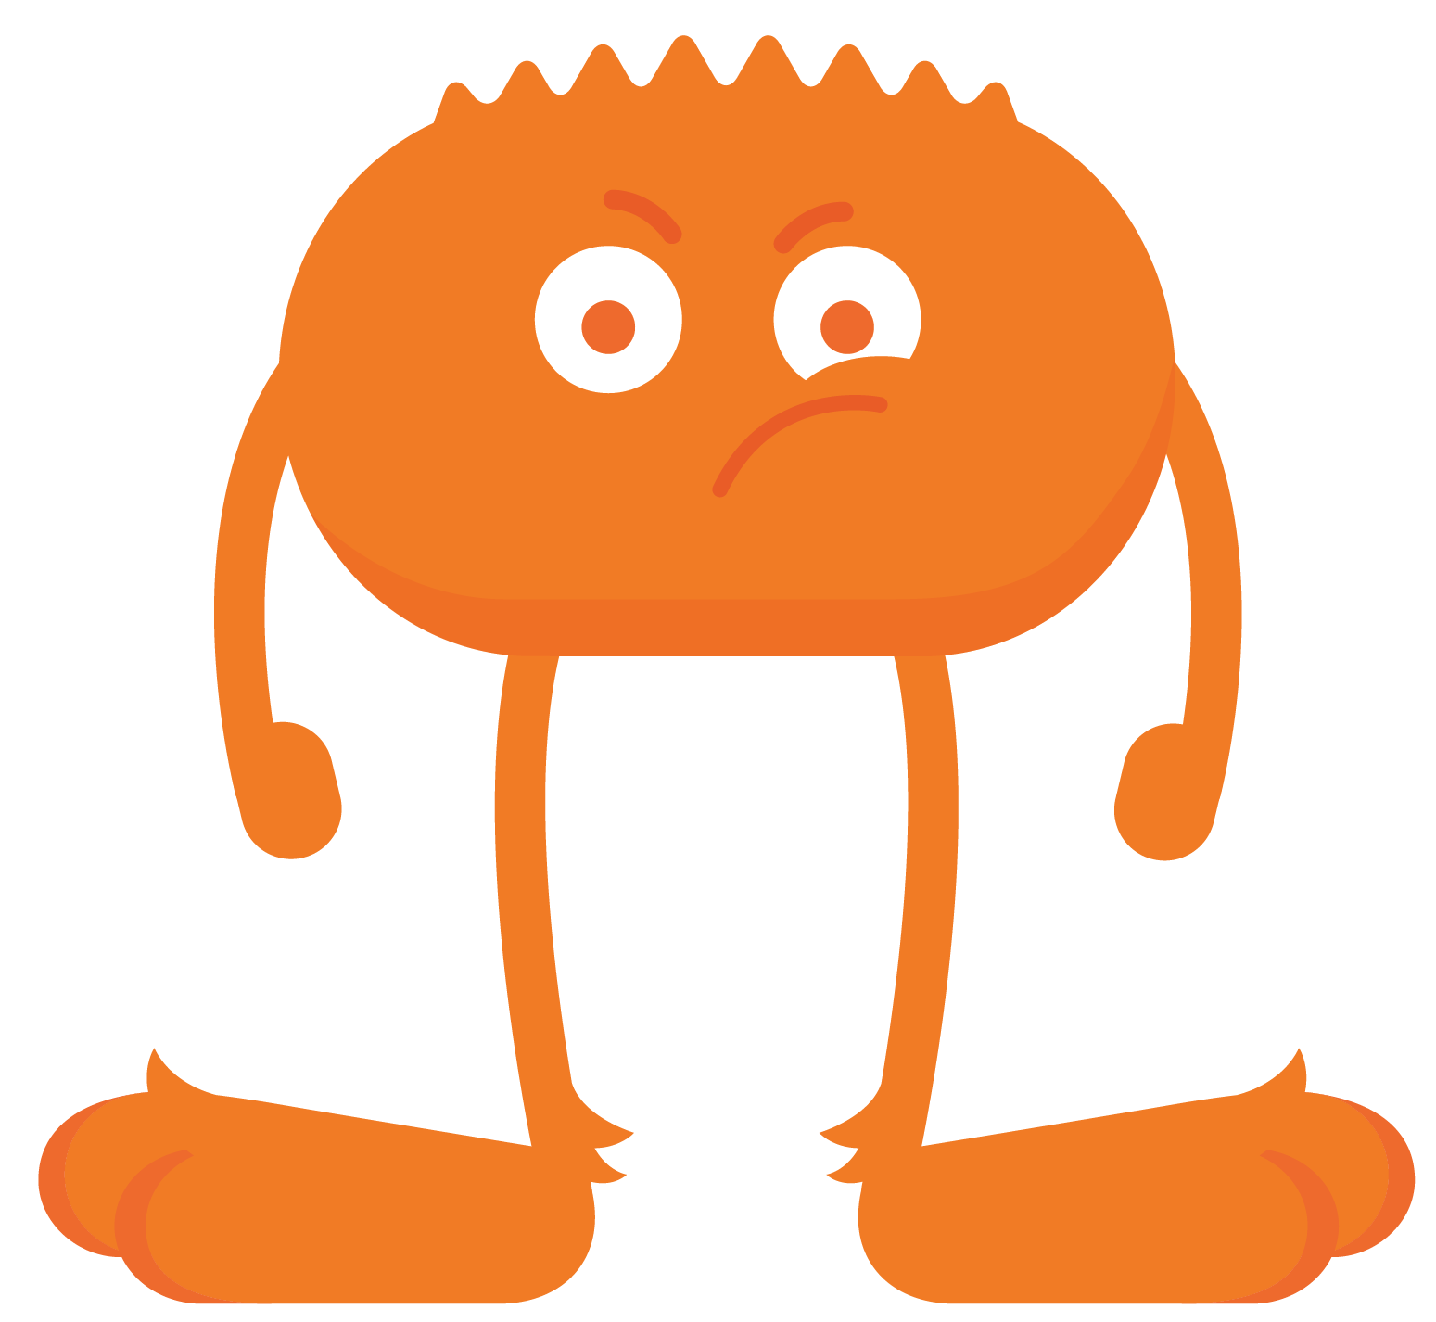
KEY VOCABULARY
Frustrated
Feeling annoyed

Slide 4
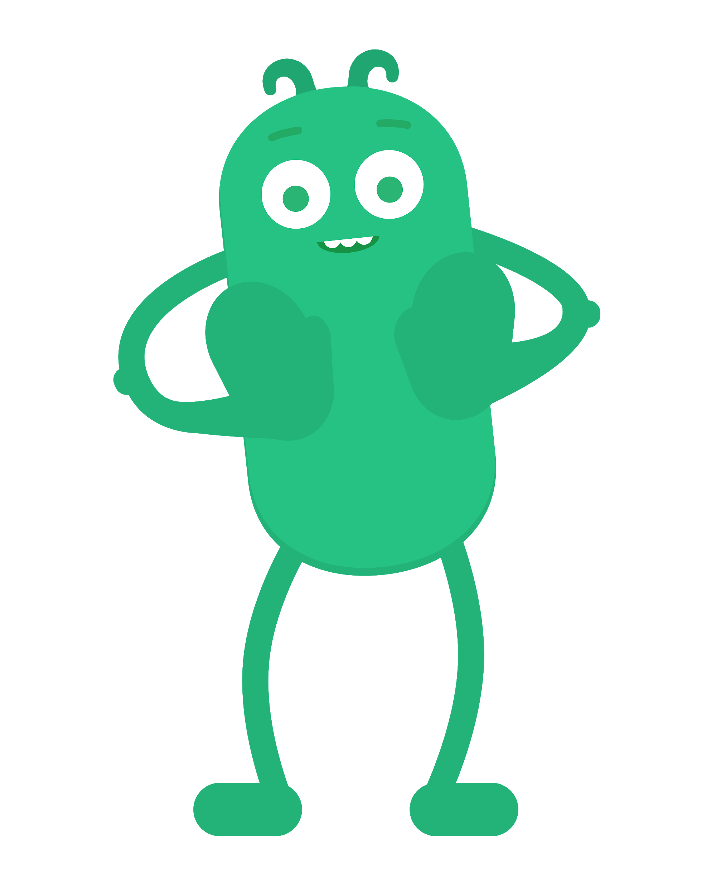
KEY VOCABULARY
Pause
To stop what you're doing or saying

Slide 5
KEY VOCABULARY
Device
An electronic piece of equipment like a phone, tablet, or laptop

Slide 6
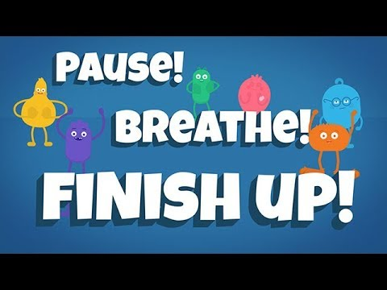
WATCH
To watch this video on the Common Sense Education site, click here.

Slide 7
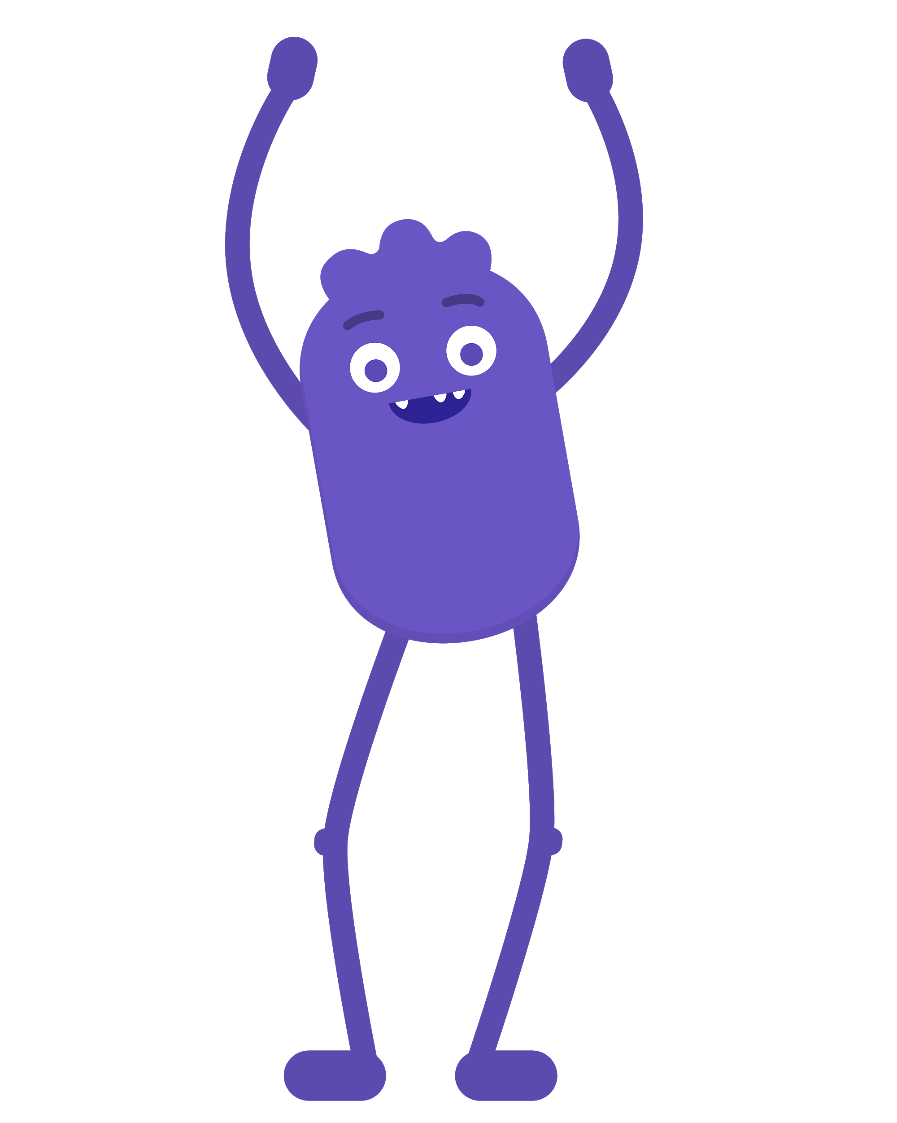
CHANT
Breathe!
Pause!
Finish up!

Slide 8
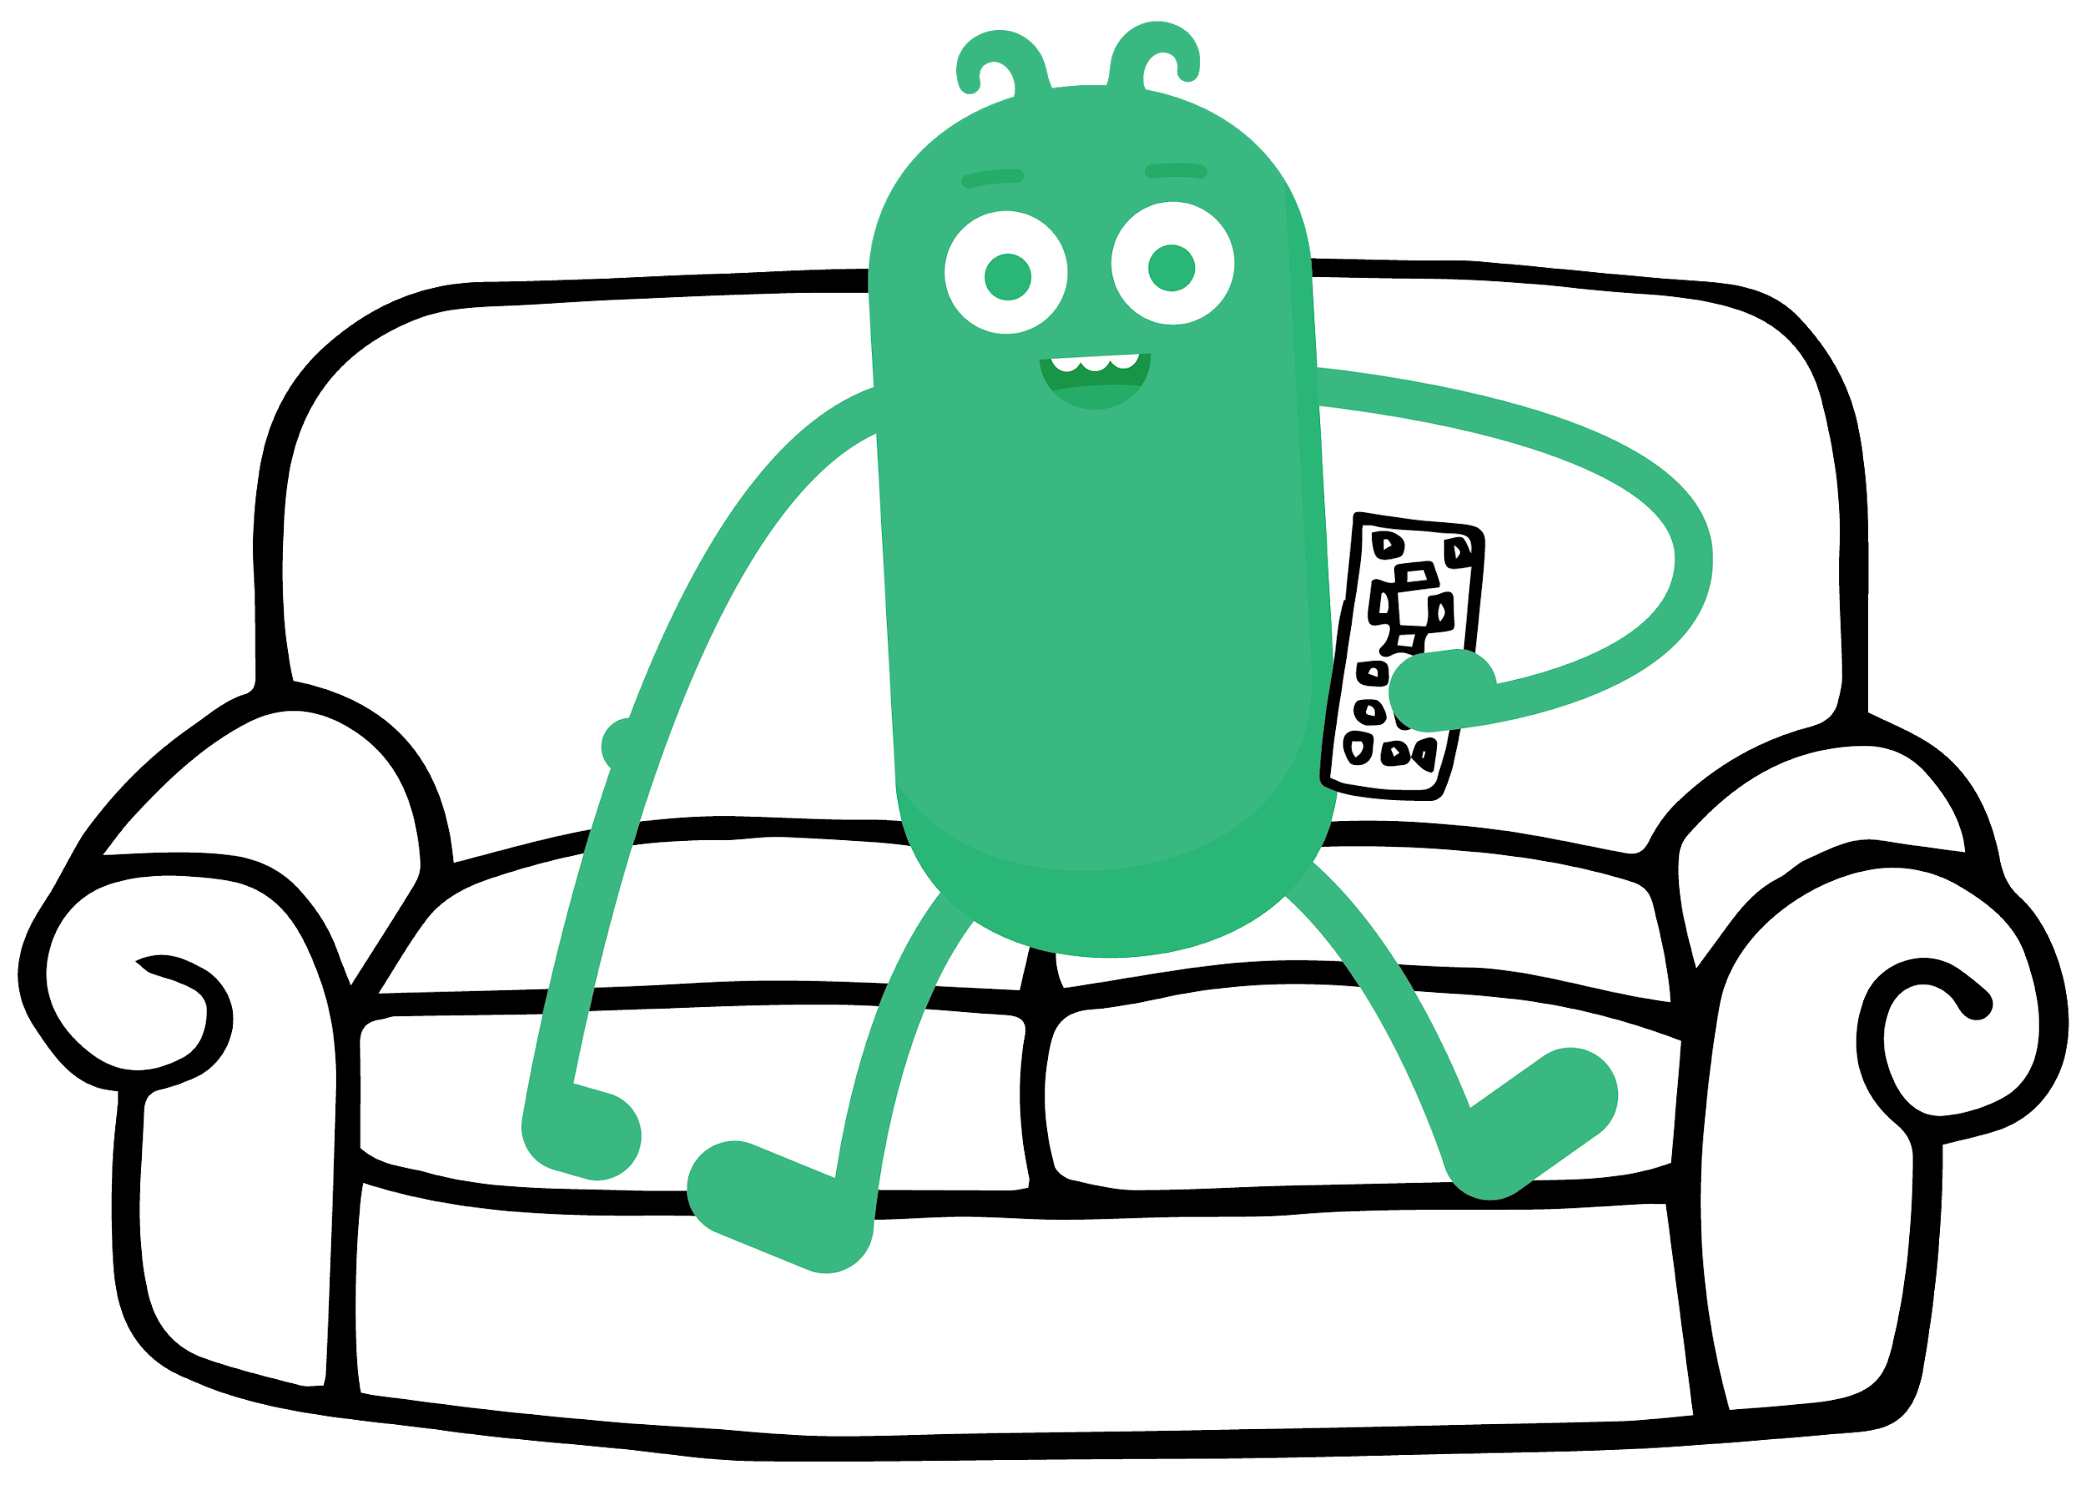
ACTIVITY
Time for school!
Scene 1
Arms is at home watching TV on the couch. Arms' mom comes in and asks Arms to turn it off because they need to leave for school.

Slide 9
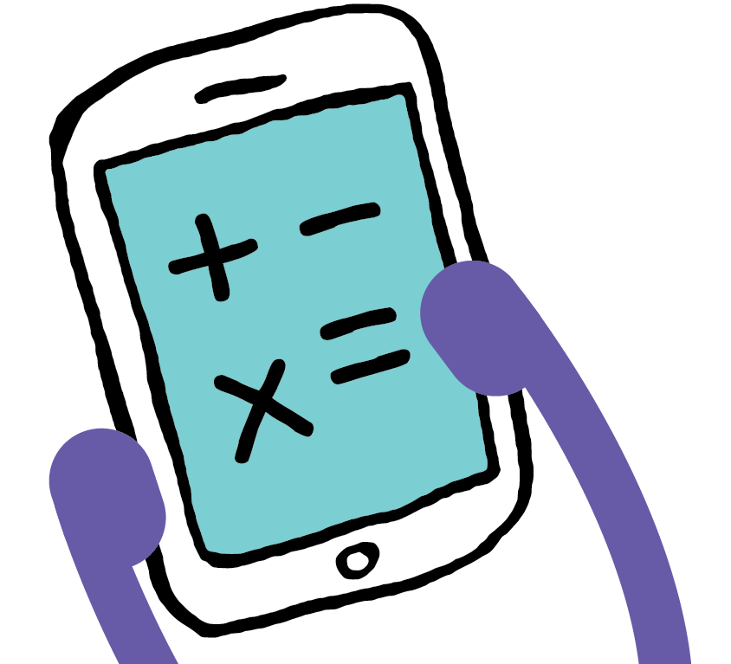
ACTIVITY
Time to clean up!
Scene 2
Legs is at school and is playing a math game on a tablet. Legs' teacher says it is time to clean up and get ready for recess.

Slide 10
ACTIVITY
Attention, please!
Scene 3
Feet is at school working on an art project on a computer. While working, Feet's teacher starts talking because he wants to remind students that when they are done, they should print it out and place it in their folder.

