Slide 1
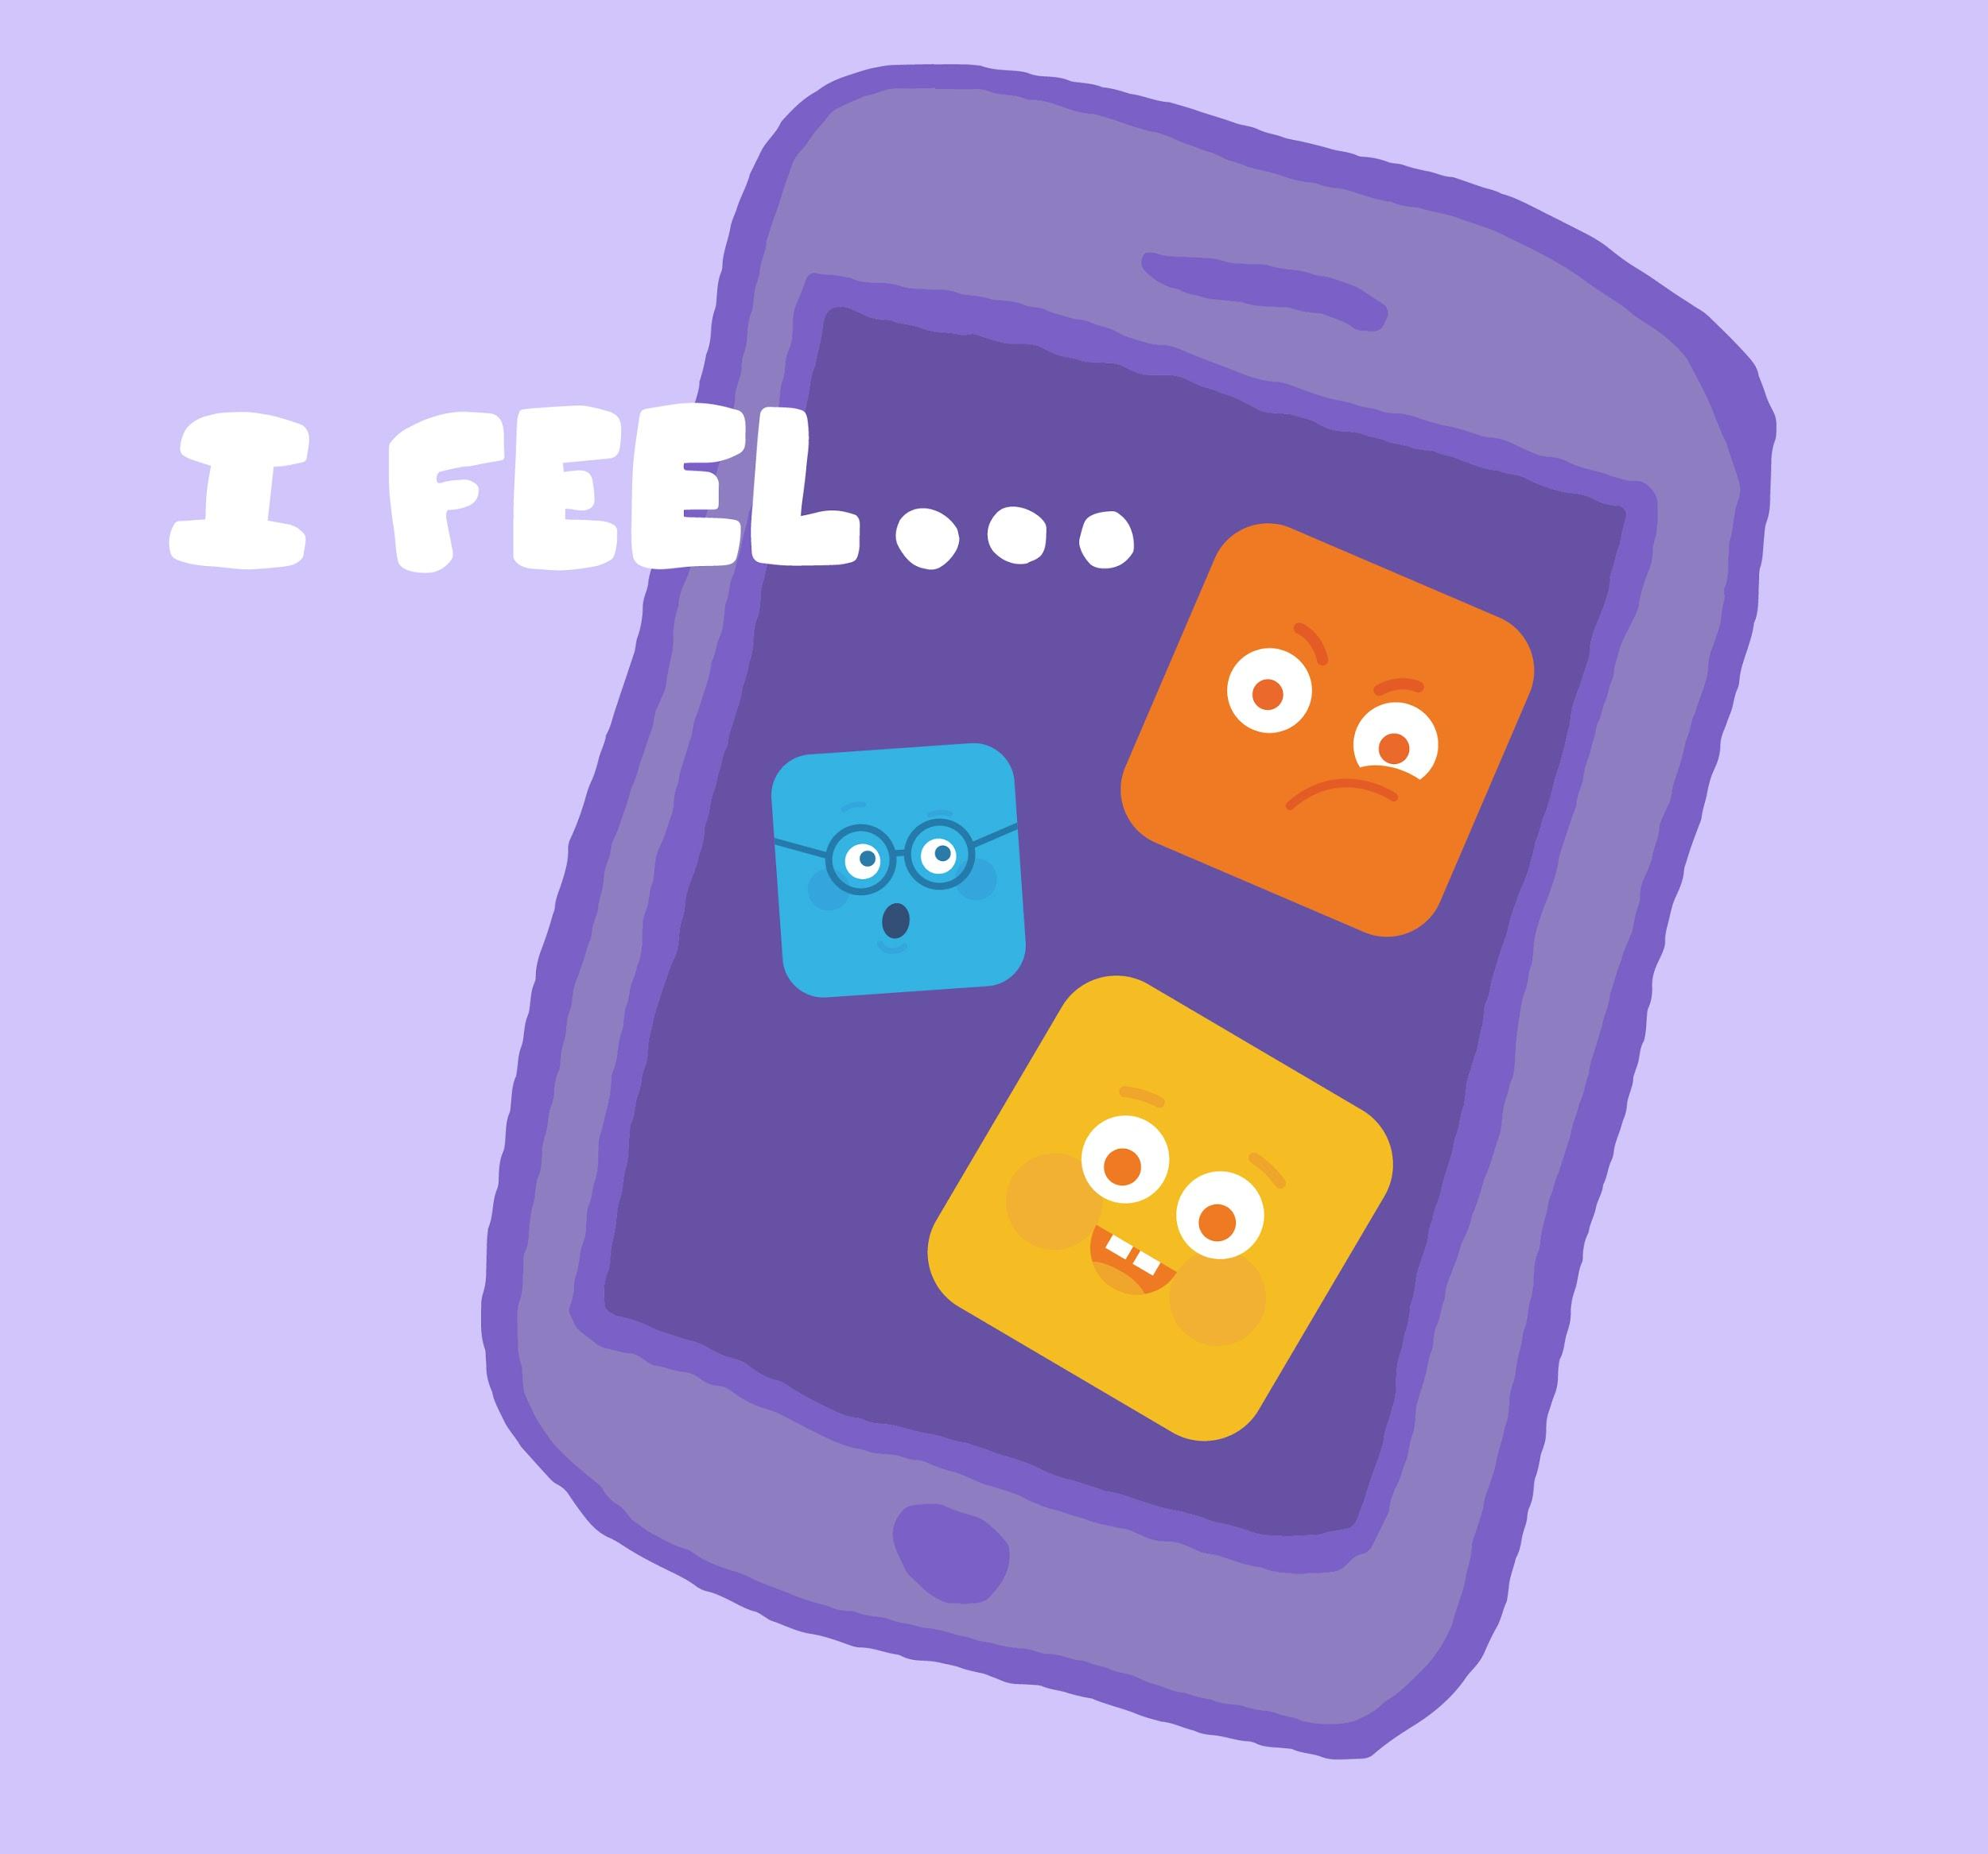
DIGITAL CITIZENSHIP | GRADE 1
How Technology Makes You Feel

Slide 2
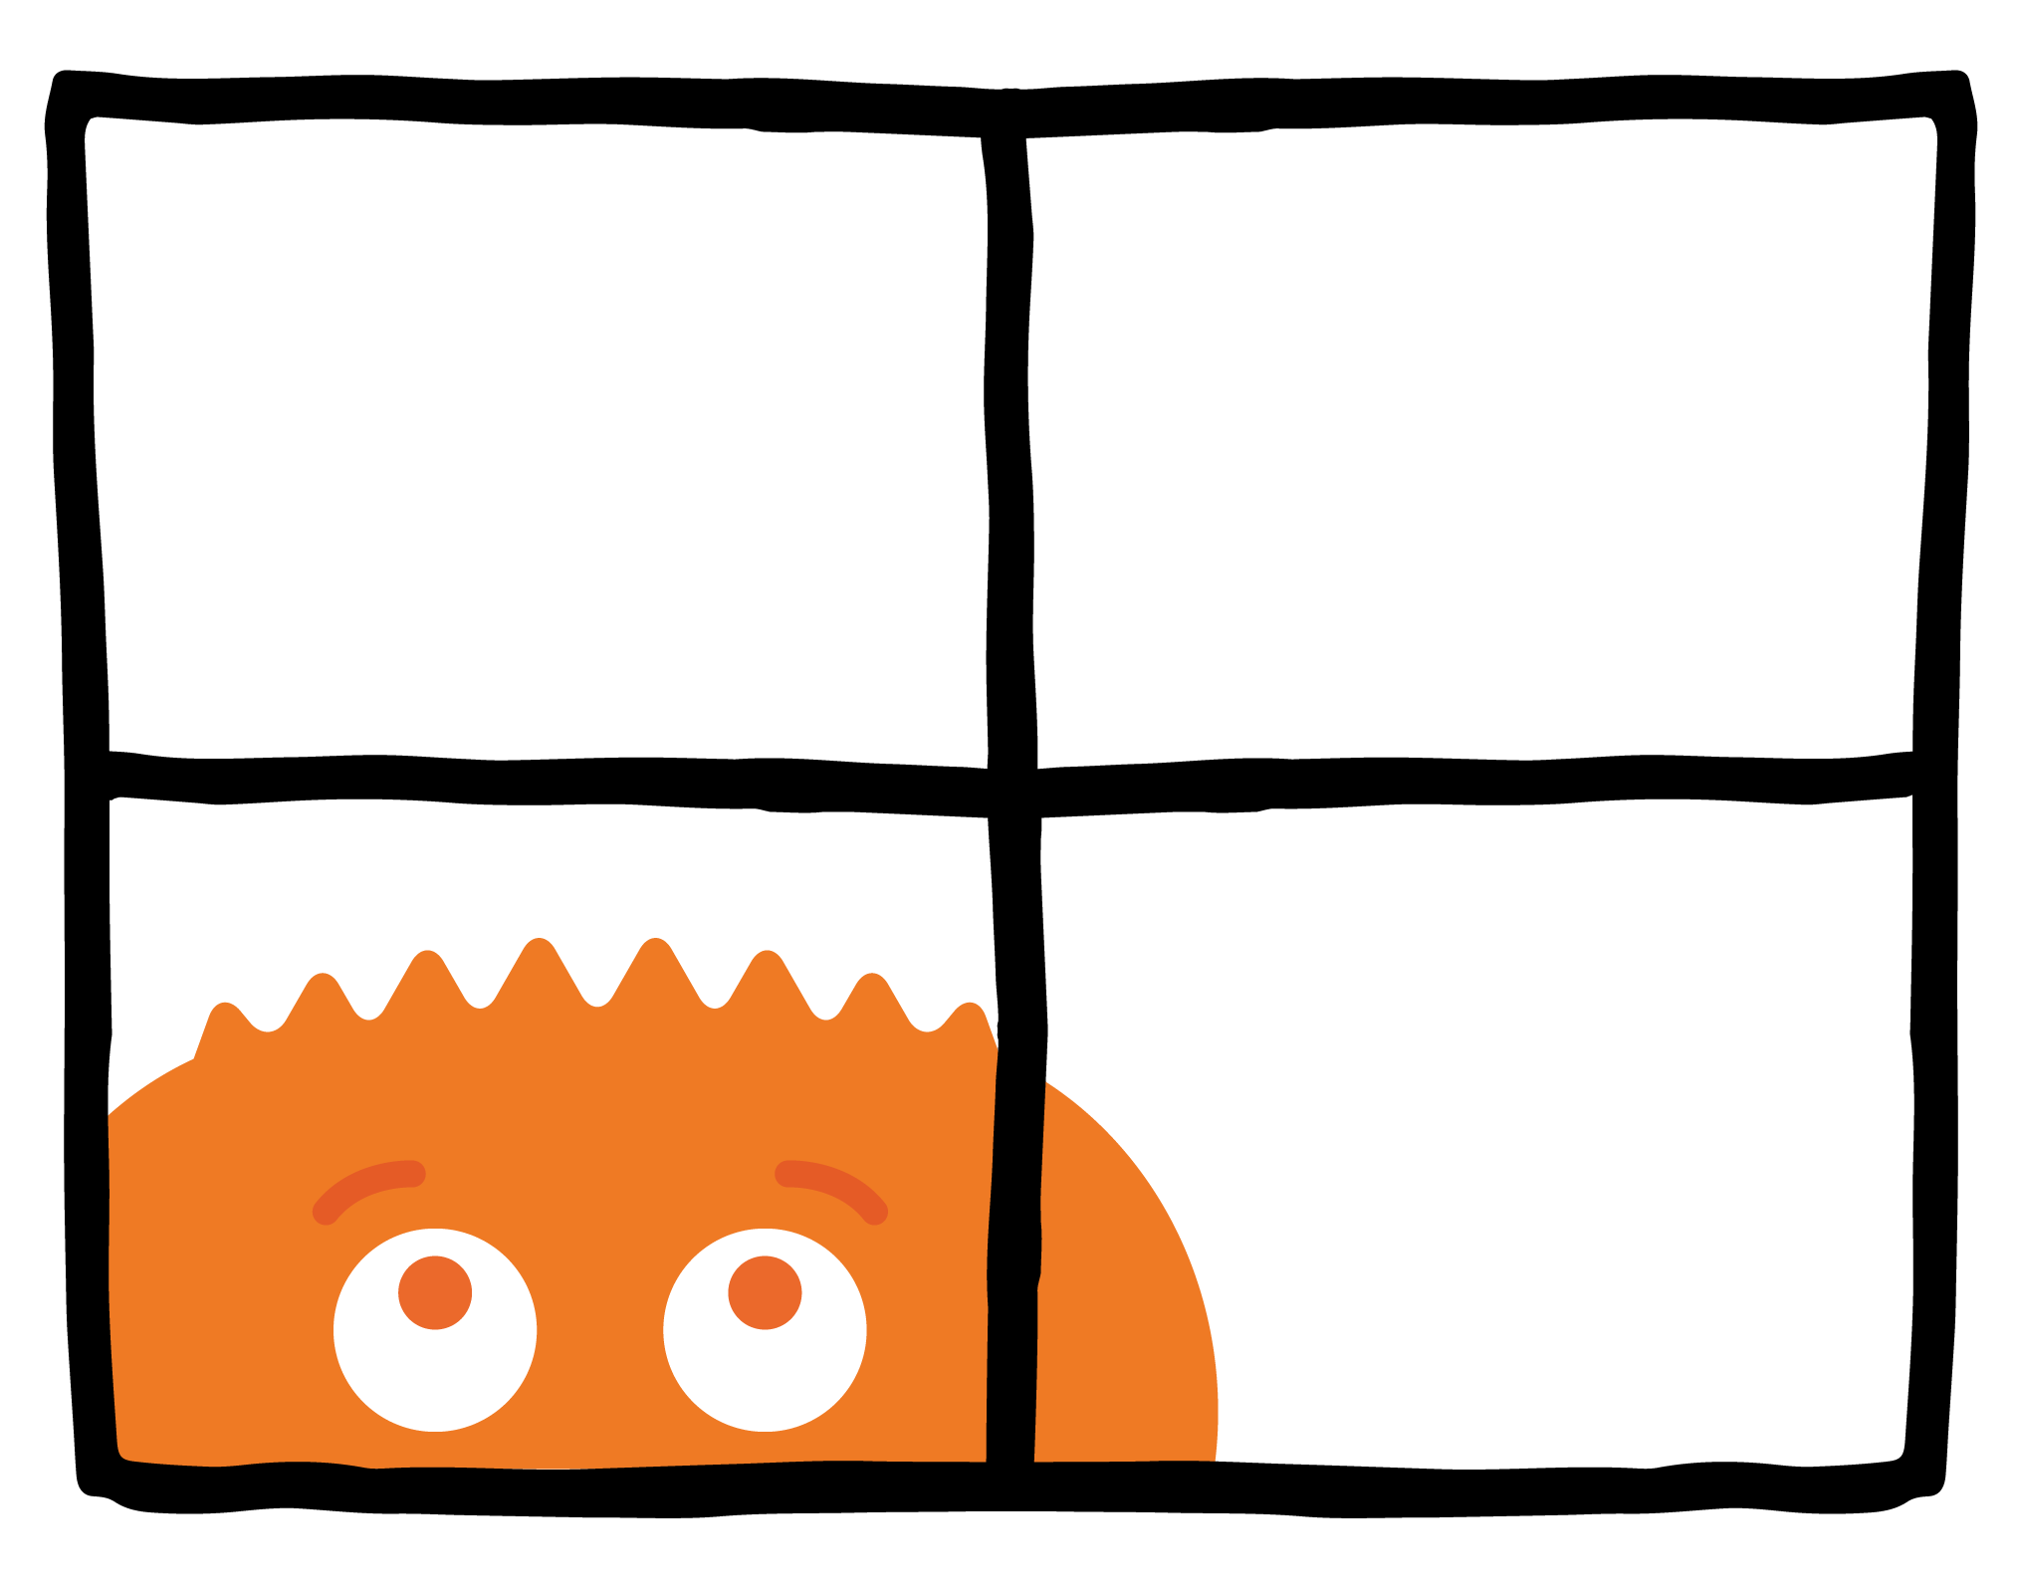
WARM UP
How do you feel when you've spent too much time inside on a rainy day?

Slide 3
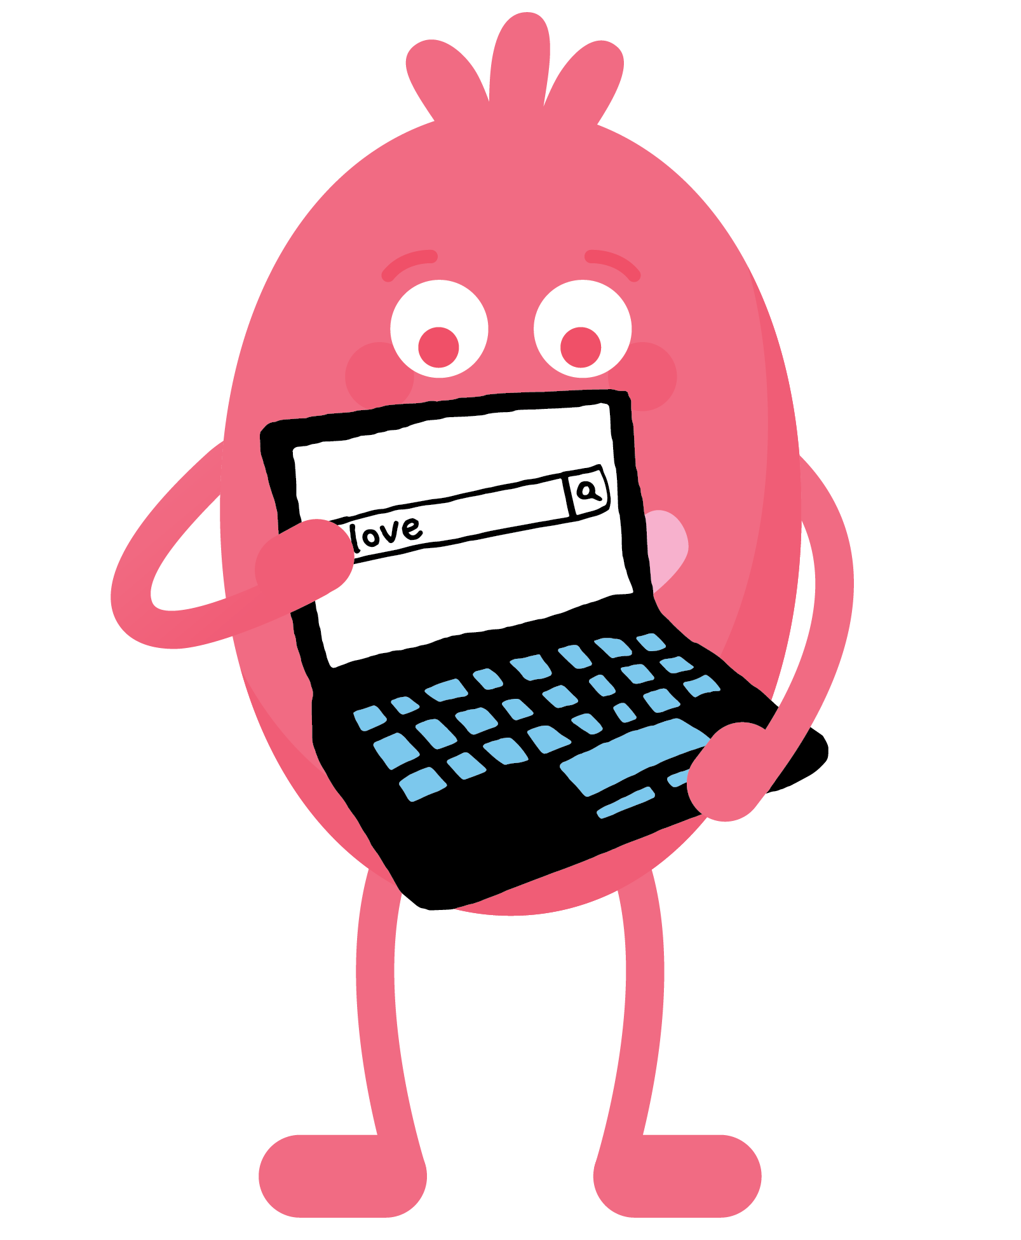
PAIR-SHARE
You are looking for pictures of hearts, so you search "love." But you end up on a site that looks like it's for grown-ups.
How do you feel? What should you do?

Slide 4
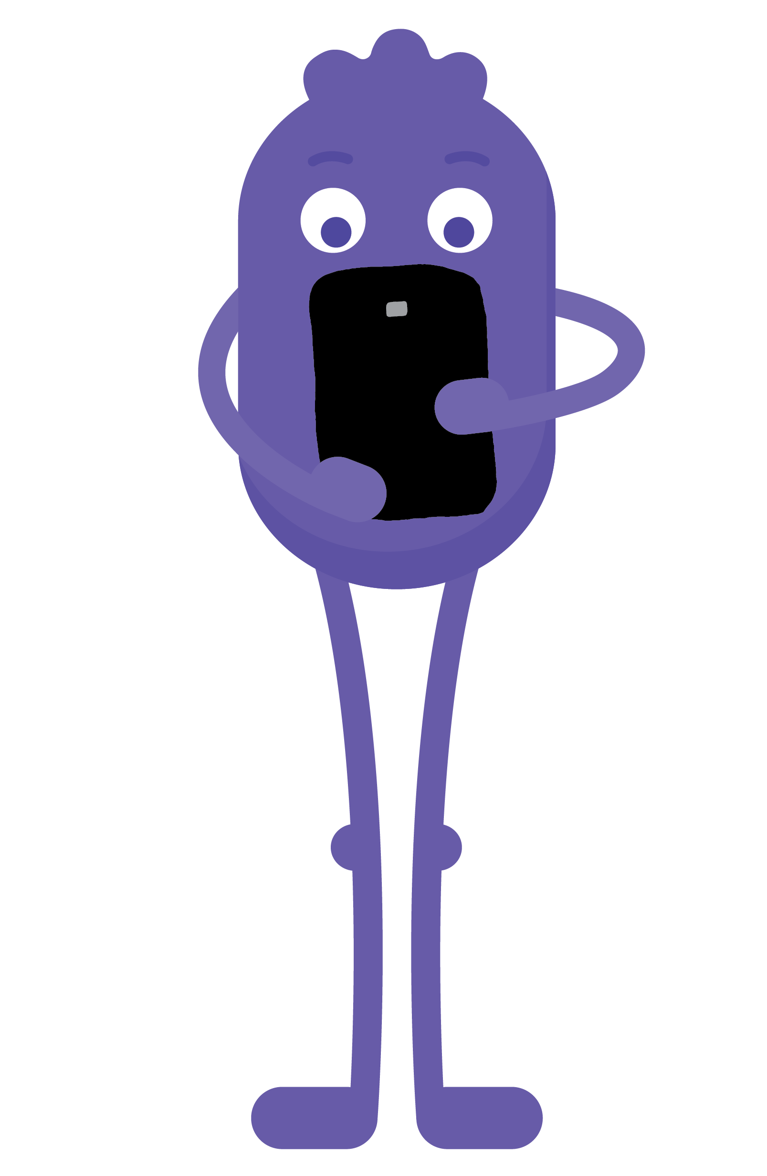
PAIR-SHARE
You're watching a show that is supposed to be for kids. But there is a really scary character that you don't like.
How do you feel? What should you do?

Slide 5
KEY VOCABULARY
Uncomfortable
Causing a feeling of hurt or worry

Slide 6
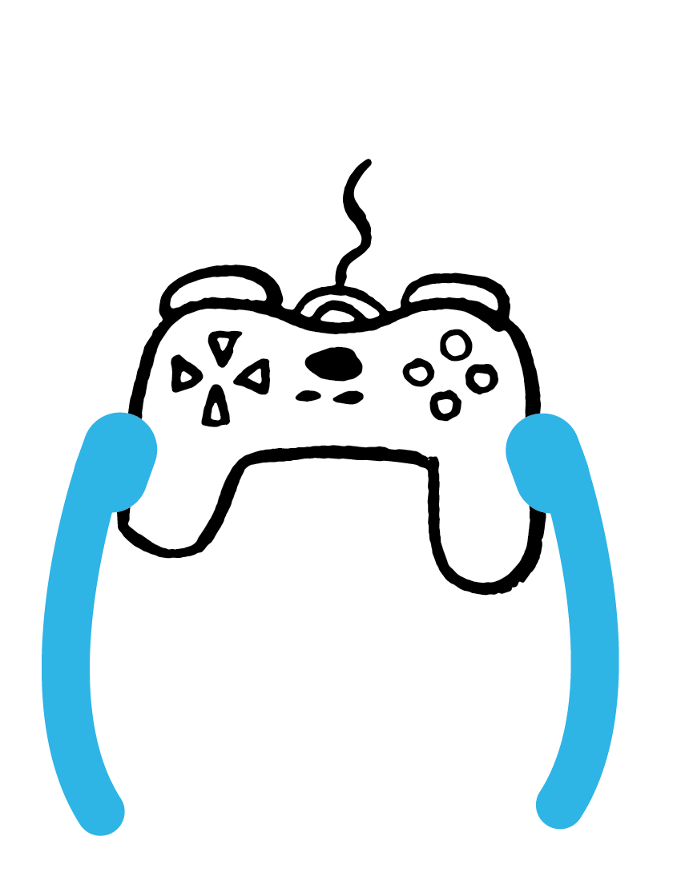
PAIR-SHARE
How do you feel after you are done using technology?

Slide 7
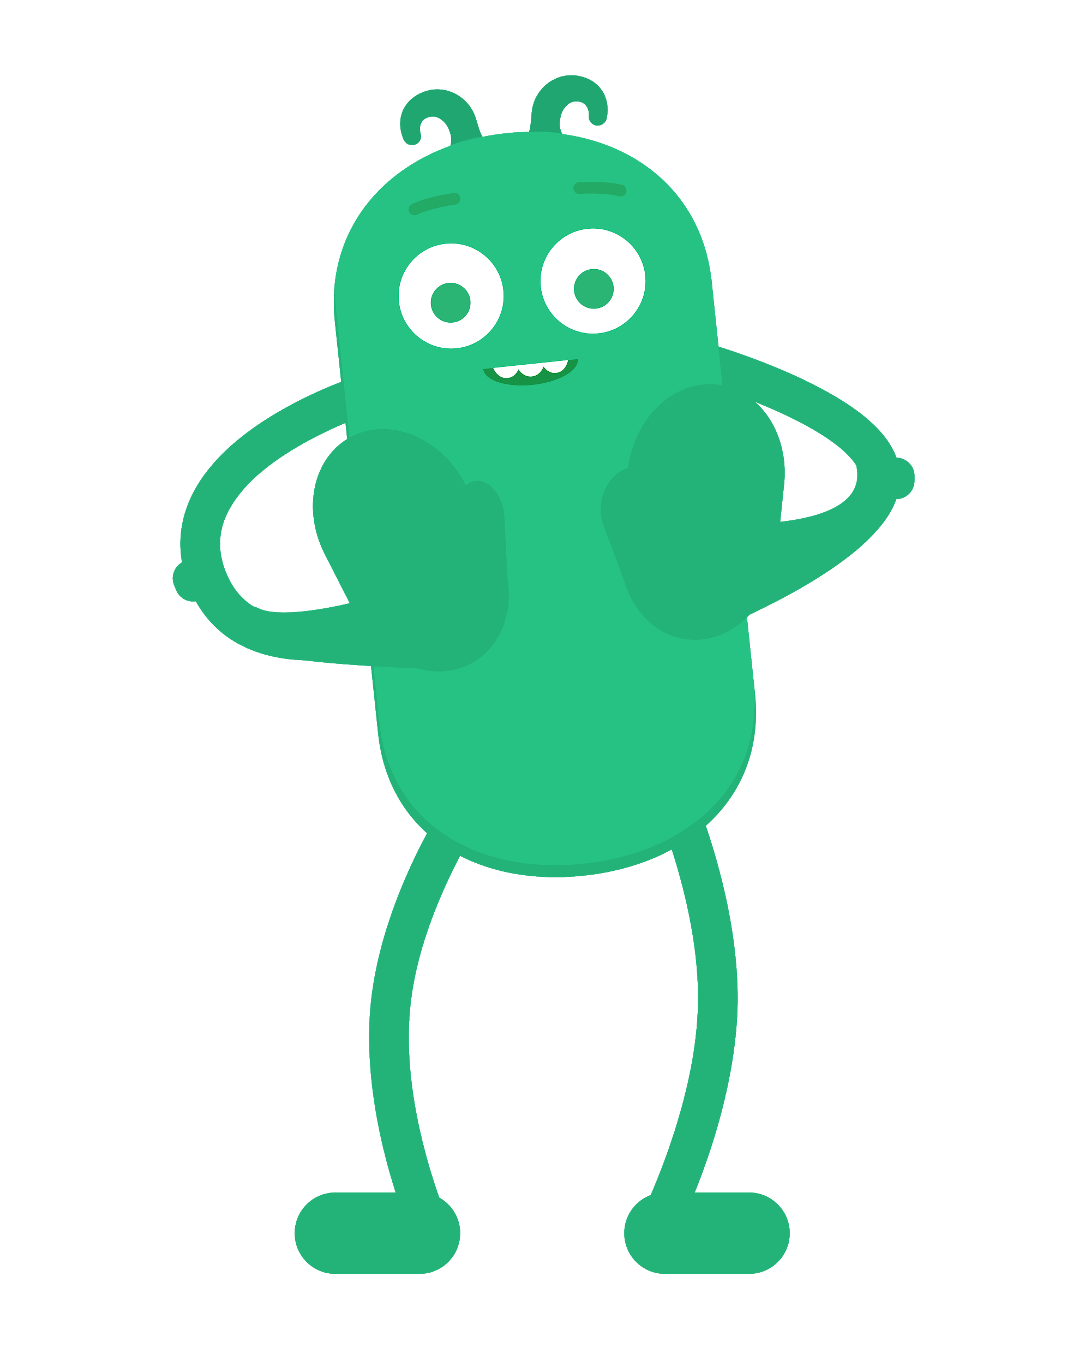
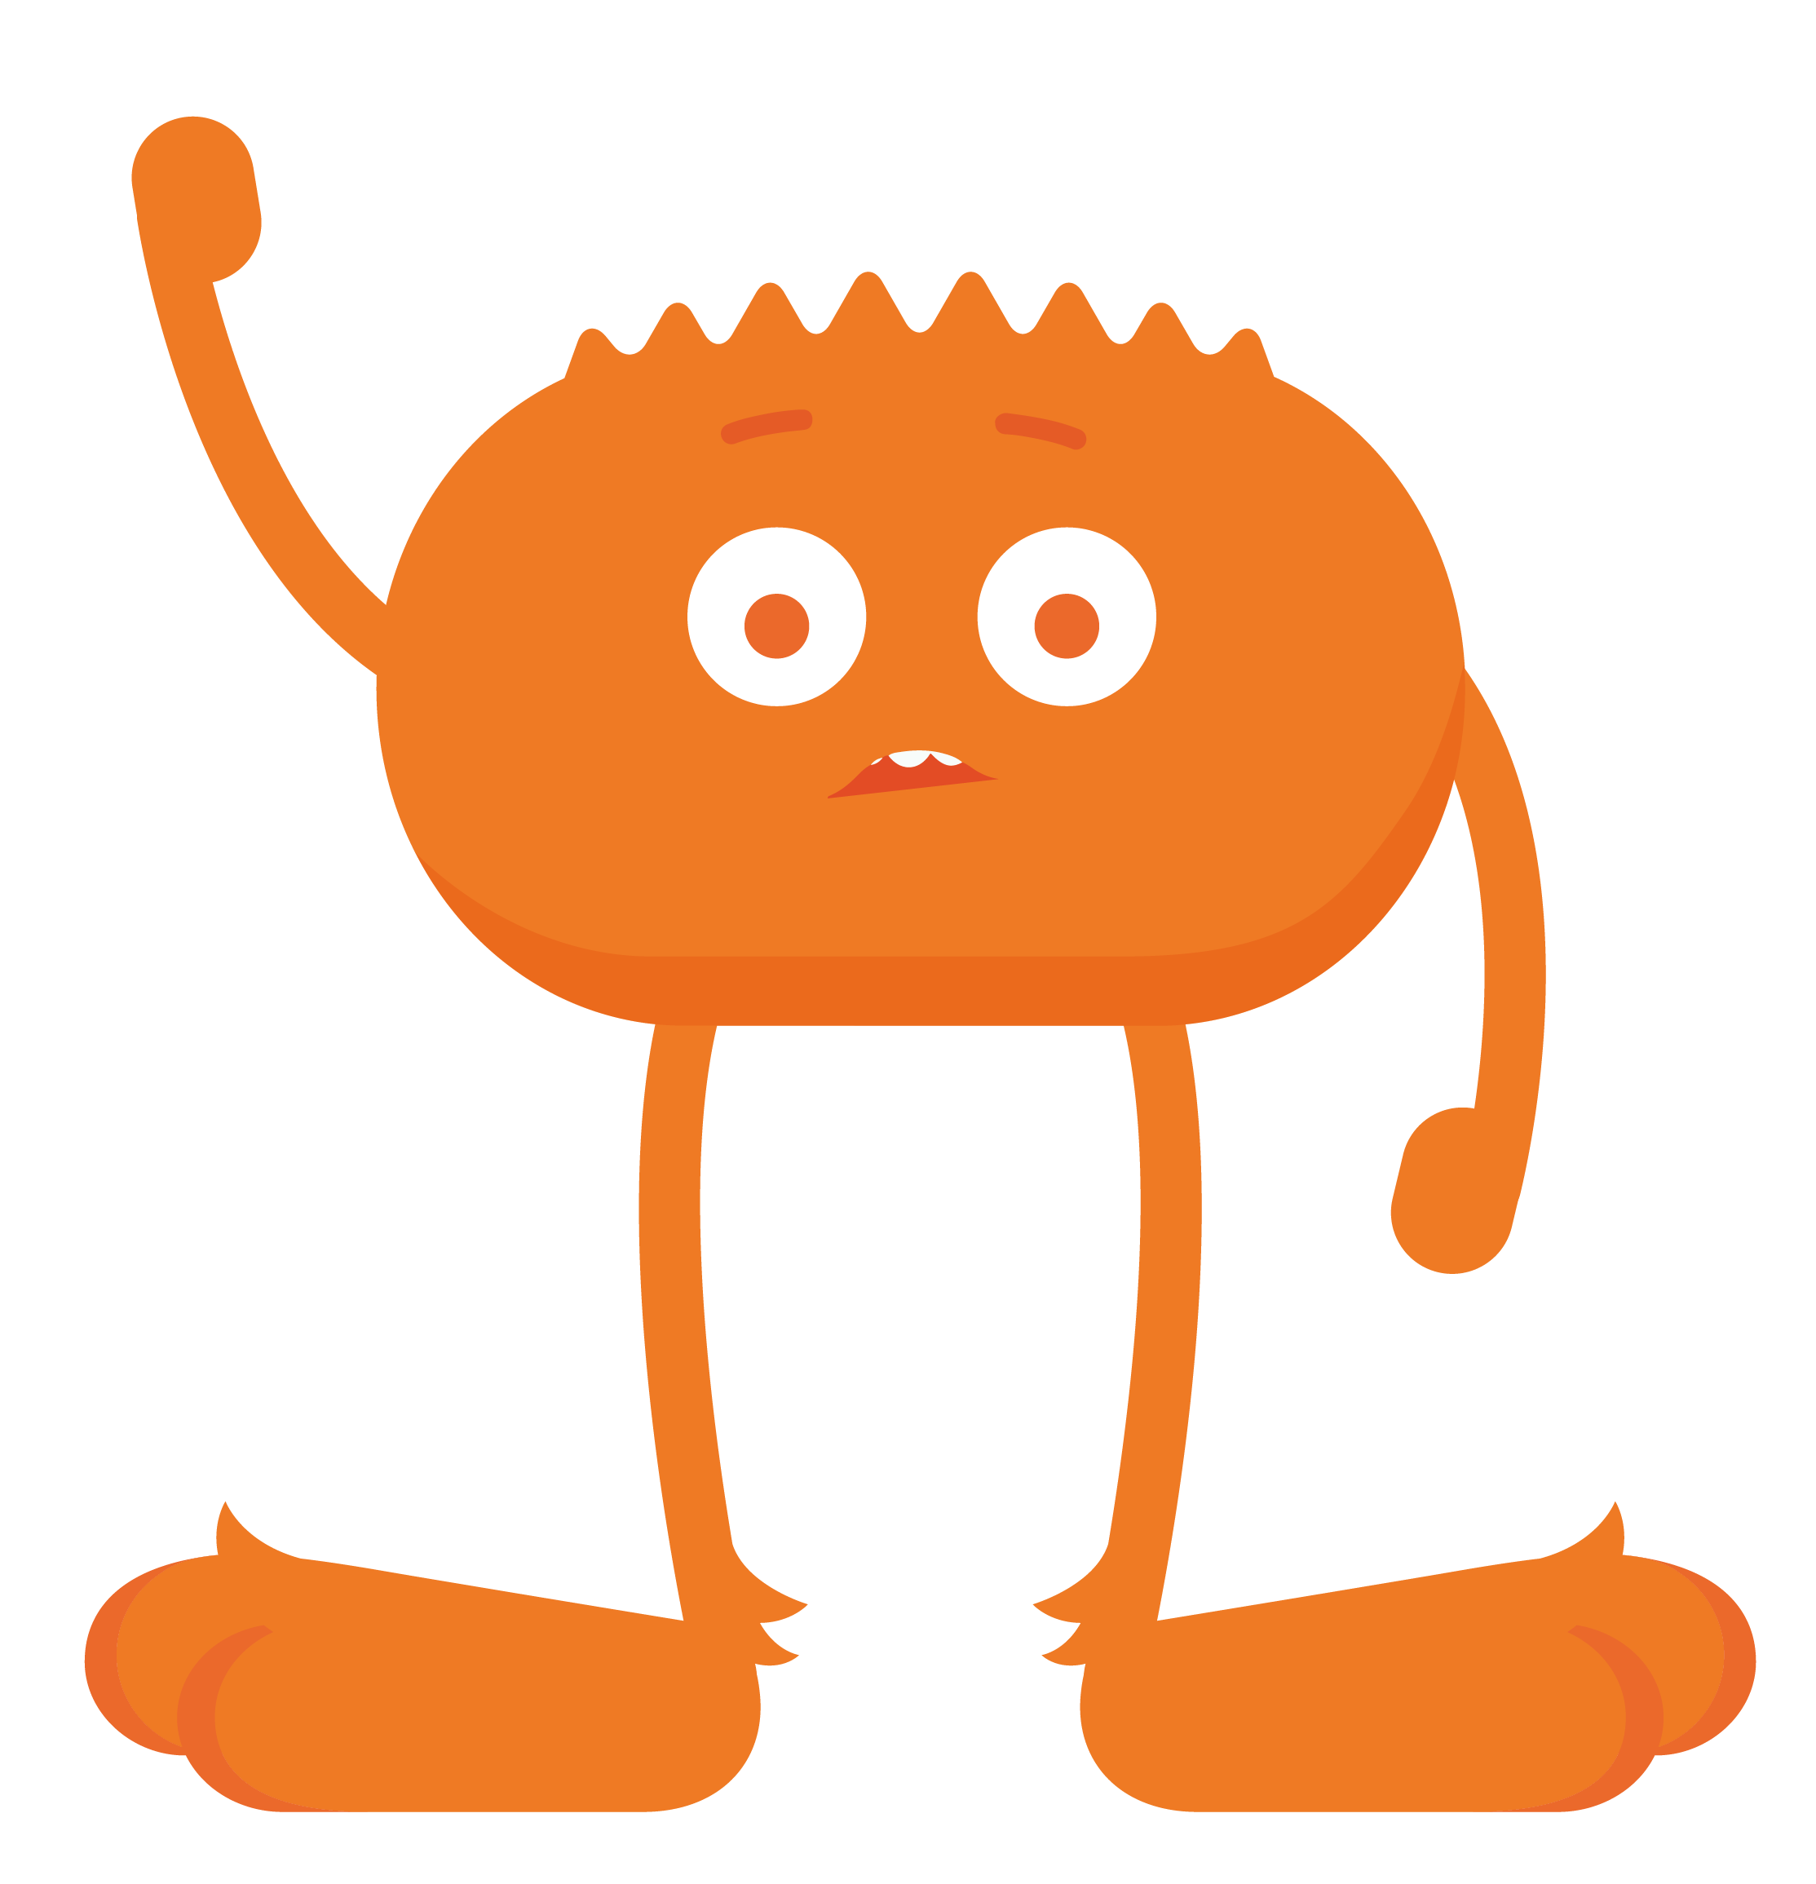
REVIEW
Pause, Think, Ask!
Pause
Think
Ask
When you have a feeling, stop and take a moment to notice it.
Notice your feelings and think about what to do next.
If you're feeling unsafe, unhappy, or unsure, get help from a grown-up.

Slide 8
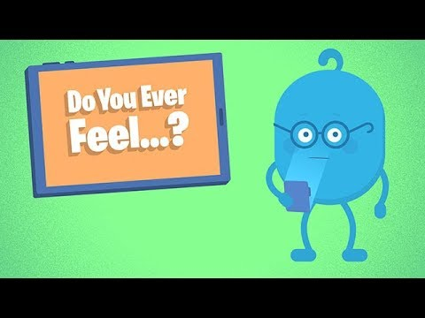
WATCH
To watch this video on the Common Sense Education site, click here.

Slide 9
EMOJI GAME
How do you feel?
What should you do?

Slide 10
ACTIVITY
Emojis
Frustrated
1
4
Happy
Uncomfortable
3
2
Curious

