Slide 1

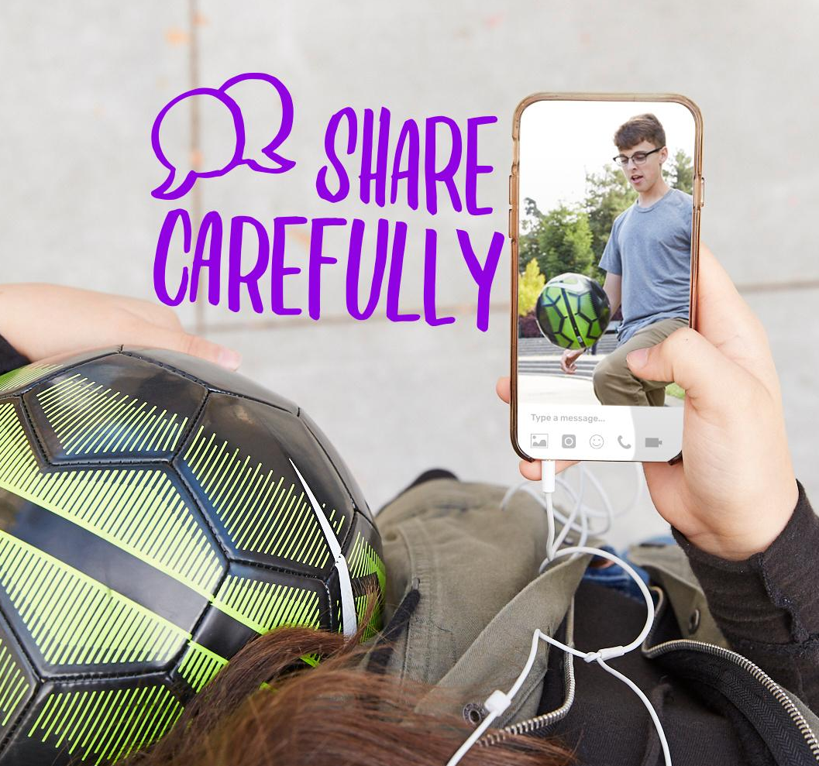
DIGITAL CITIZENSHIP | GRADE 6
Chatting Safely Online

Slide 2

Essential Question
How do you chat safely with people you meet online?

Slide 3


KEY VOCABULARY
Risky
Potentially harmful to one's emotional or physical well-being

Slide 4
KEY VOCABULARY
Sara’s Chats – Scenario 2
Sara loves taking pictures and posting them to Instagram. A few months ago, she noticed alex_eastwest13 liked several of her photos and commented "you are so talented!" Sara was flattered. Then she received a private message from alex_eastwest13 asking if she was a professional photographer or if she wanted to be one someday. Sara responded that it was her dream to be one when she grew up. Now, they talk a lot through private messaging. Sara also posts comments on alex_eastwest13's photos, which are mostly of random objects and nature scenes. Last week, alex_eastwest13 asked if she would post more selfies because "i think u r beautiful." Alex_eastwest13 also messaged her a cell number so she could send more personal pictures. "Just don't tell anyone I gave you this," alex_eastwest13 commented.

Slide 5
Red flag feeling
KEY VOCABULARY
When something happens on digital media that makes you feel uncomfortable, worried, sad, or anxious

Slide 6


Slow Down, Pause, and Remember F.I.R.E.
ANALYZE: RED FLAG FEELINGS
Feel. Take the pulse of your emotions. Are you feeling sad, anxious, jealous, excluded, or uncomfortable? If not, what emotion captures how you feel?
Identify. Think about what caused you to have this feeling. What happened? Was it something you—or someone else—said or did?
Reflect. Consider possible responses. What choices of action are available to you? What are the benefits or drawbacks—for you and for others—of each step you might take?
Enact. Take steps to act. How can you move forward to address the situation in a way that feels positive and productive—for you and for others?

Slide 7
ANALYZE: RED FLAG MOMENTS
Ways to Respond
Change the subject, make a joke, or say, "I don't want to talk about this."
Log off or quit.
Unfriend the person or block them; create a new account, or report the other user.
Never plan a face-to-face meeting with someone you do not know unless you take along a parent or guardian.
Ask a trusted adult for advice or help if you feel unsure or uncomfortable in any situation.

Slide 8
KEY VOCABULARY
Lola
Lola is friends with a boy she chats with in an online game. Lola only knows the boy by his screen name and avatar. He only knows her in the same way. Lola is careful to make good choices when talking to someone online, even someone she thinks she knows well. The boy asks her the following questions in a recent chat room meet-up. Which questions should she NOT answer?
What kind of music do you listen to?
What is your favorite subject?
What is your favorite video game?
What’s your real name?

Slide 9
KEY VOCABULARY
Lola
Lola is friends with a boy she chats with in an online game. Lola only knows the boy by his screen name and avatar. He only knows her in the same way. Lola is careful to make good choices when talking to someone online, even someone she thinks she knows well. The boy asks her the following questions in a recent chat room meet-up. Which questions should she NOT answer?
What kind of music do you listen to?
What is your favorite subject?
What is your favorite video game?
What’s your real name?

Slide 10
KEY VOCABULARY
Vince
Vince has many online friends. Some he knows in real life, and some he has connected with through group chats, friends or friends, and common-interest boards. Recently, several friends were posting in a group chat about a movie they had all seen. One person that Vince had never met began using bad language. The person was also attacking the opinions of others. Vince felt uncomfortable about what was happening but likes talking to the other friends in this group. What advice could you give Vince?
Vince could change the subject and talk about something other than the movie.
Vince could gang up with his friends and collectively attack the mean person in the chat room.
Vince could start complaining about the mean person to make them feel guilty.

Slide 11
KEY VOCABULARY
Vince
Vince has many online friends. Some he knows in real life, and some he has connected with through group chats, friends or friends, and common-interest boards. Recently, several friends were posting in a group chat about a movie they had all seen. One person that Vince had never met began using bad language. The person was also attacking the opinions of others. Vince felt uncomfortable about what was happening but likes talking to the other friends in this group. What advice could you give Vince?
Vince could change the subject and talk about something other than the movie.
Vince could gang up with his friends and collectively attack the mean person in the chat room.
Vince could start complaining about the mean person to make them feel guilty.

Slide 12
KEY VOCABULARY
Sydney
Sydney is friends with shaj205 on Instagram. She has never met shaj205 in person, but they message often and comment on each other’s photos. Sydney feels like she knows shaj205 well because she follows his posts. She feels secure that she is talking to a real person. In a recent conversation, Sydney mentions that her birthday is coming up. Shaj205 asks Sydney for her address so he can send her a gift. If they are friends, why might Sydney feel uncomfortable sharing her information?
Sydney doesn’t think shaj205 is going to get her something she will like.
Even though Sydney feels like she knows shaj205 well, she has not met him in person and does not know how he truly plans to use her information.
Sydney doesn’t want the birthday gift delivered to her home because she did not get him anything for his birthday.

Slide 13
KEY VOCABULARY
Sydney
Sydney is friends with shaj205 on Instagram. She has never met shaj205 in person, but they message often and comment on each other’s photos. Sydney feels like she knows shaj205 well because she follows his posts. She feels secure that she is talking to a real person. In a recent conversation, Sydney mentions that her birthday is coming up. Shaj205 asks Sydney for her address so he can send her a gift. If they are friends, why might Sydney feel uncomfortable sharing her information?
Sydney doesn’t think shaj205 is going to get her something she will like.
Even though Sydney feels like she knows shaj205 well, she has not met him in person and does not know how he truly plans to use her information.
Sydney doesn’t want the birthday gift delivered to her home because she did not get him anything for his birthday.

