Slide 1
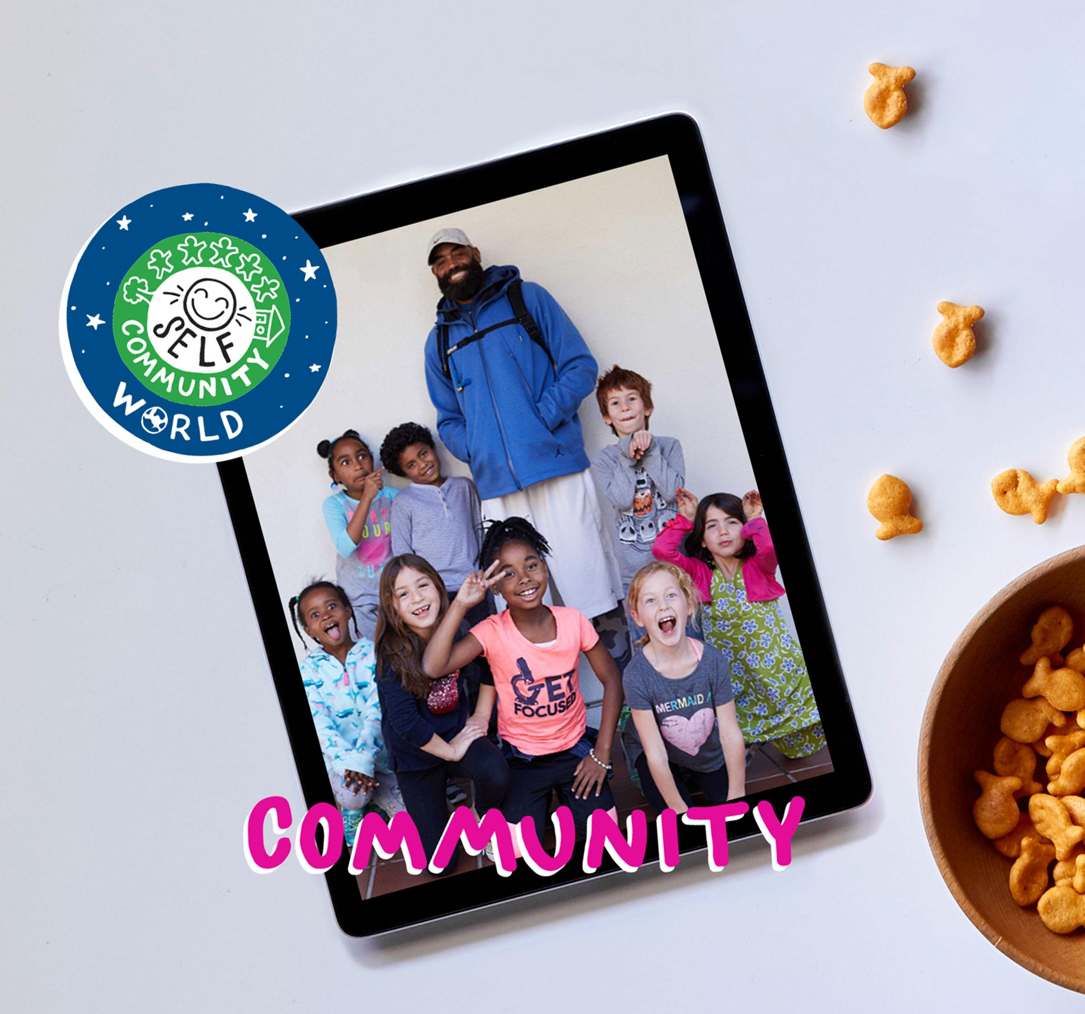
DIGITAL CITIZENSHIP | GRADE 3
Your Rings of Responsibility

Slide 2
Essential Question
How do good digital citizens take responsibility for themselves, their communities, and their world?

Slide 3
KEY VOCABULARY
Responsibility
A duty you have to yourself or others

Slide 4
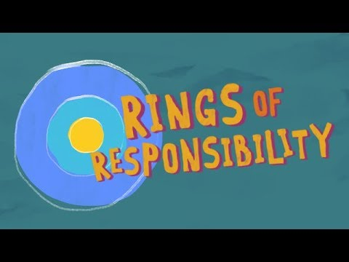
WATCH + DISCUSS
Discuss:
How could throwing a bottle out of your window be similar to something you do online?
To watch this video on the Common Sense Education site, click here.

Slide 5
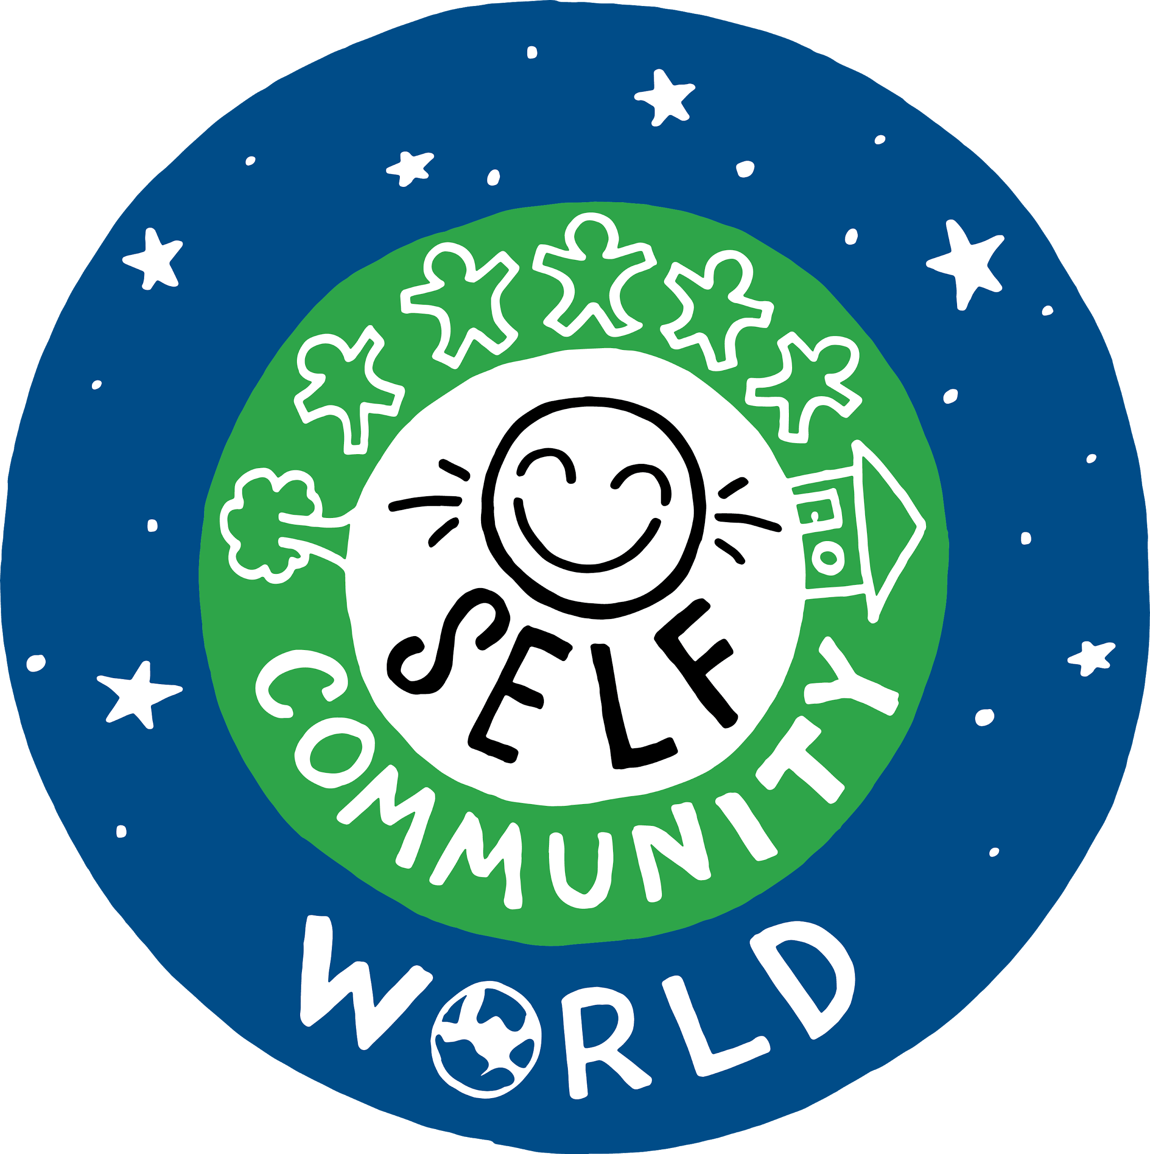
OBSERVE + ANALYZE IMAGE
The Rings of Responsibility
What responsibilities do you have to yourself?
What responsibilities do you have to your community?
What responsibilities do you have to your world?

Slide 6
KEY VOCABULARY
Digital Citizen
Someone who uses technology responsibly to learn, create, and participate

