Slide 1
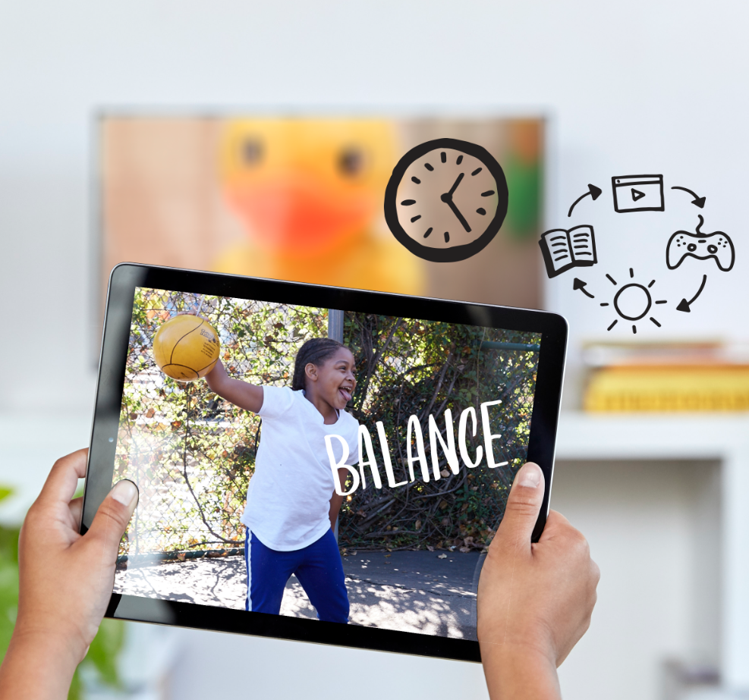
DIGITAL CITIZENSHIP | GRADE 4
My Media Choices

Slide 2
Essential Question
What makes a healthy media choice?

Slide 3
WARM UP: THINK, PAIR, SHARE
What do you think the word "media" means?
What are some examples?

Slide 4
KEY VOCABULARY
Media
All the ways that large groups of people get and share information (TV, books, the internet, newspapers, phones, etc.)

Slide 5
KEY VOCABULARY
Media Choices
Time spent watching, listening to, reading, or creating media

Slide 6
KEY VOCABULARY
Media Balance
Using media in a way that feels healthy and in balance with other life activities (family, friends, school, hobbies, etc.)

Slide 7
What makes a healthy media choice?
What?
When?
How much?
What are the media you're consuming (or creating)?
What platforms are you using to consume the media (i.e., a streaming platform like Netflix)?
or …
What device(s) are you using to consume (or create) the media?
When are you consuming (or creating) the media?
What time of day? What day of the week?
What else is happening at this time (i.e., is it during dinner time, right before bed, etc.)?
How much media are you consuming?
How long are you spending with the media at one time?
How often are you consuming the media?

Slide 8
What? | When? | How Much?
I watched YouTube cat videos on my mom’s iPhone. | Monday morning, before school | For about 20 minutes

Slide 9
What? | When? | How Much?
I watched Trollhunters on Netflix (on my iPad). | Late on Wednesday night, in bed, until I fell asleep | For two and a half hours

Slide 10
What? | When? | How Much?
I played an online game (Fortnite) on my parents’ computer. | On Saturday, pretty much all day | Probably about six hours

Slide 11
What? | When? | How Much?
I talked to my grandma on FaceTime (on my dad’s iPhone). | Tuesday evening, right before dinner | For about 10 minutes

Slide 12
What? | When? | How Much?
I went on musical.ly and created some cool videos to send to my friends. | Thursday afternoon, after school | For about 45 minutes

Slide 13
What? | When? | How Much?
I read a book that I’m really into right now (Wonder). | Tuesday evening, after dinner | For about an hour

