Slide 1
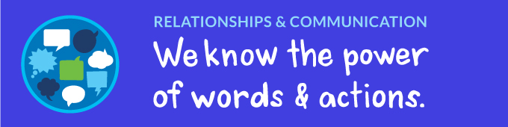

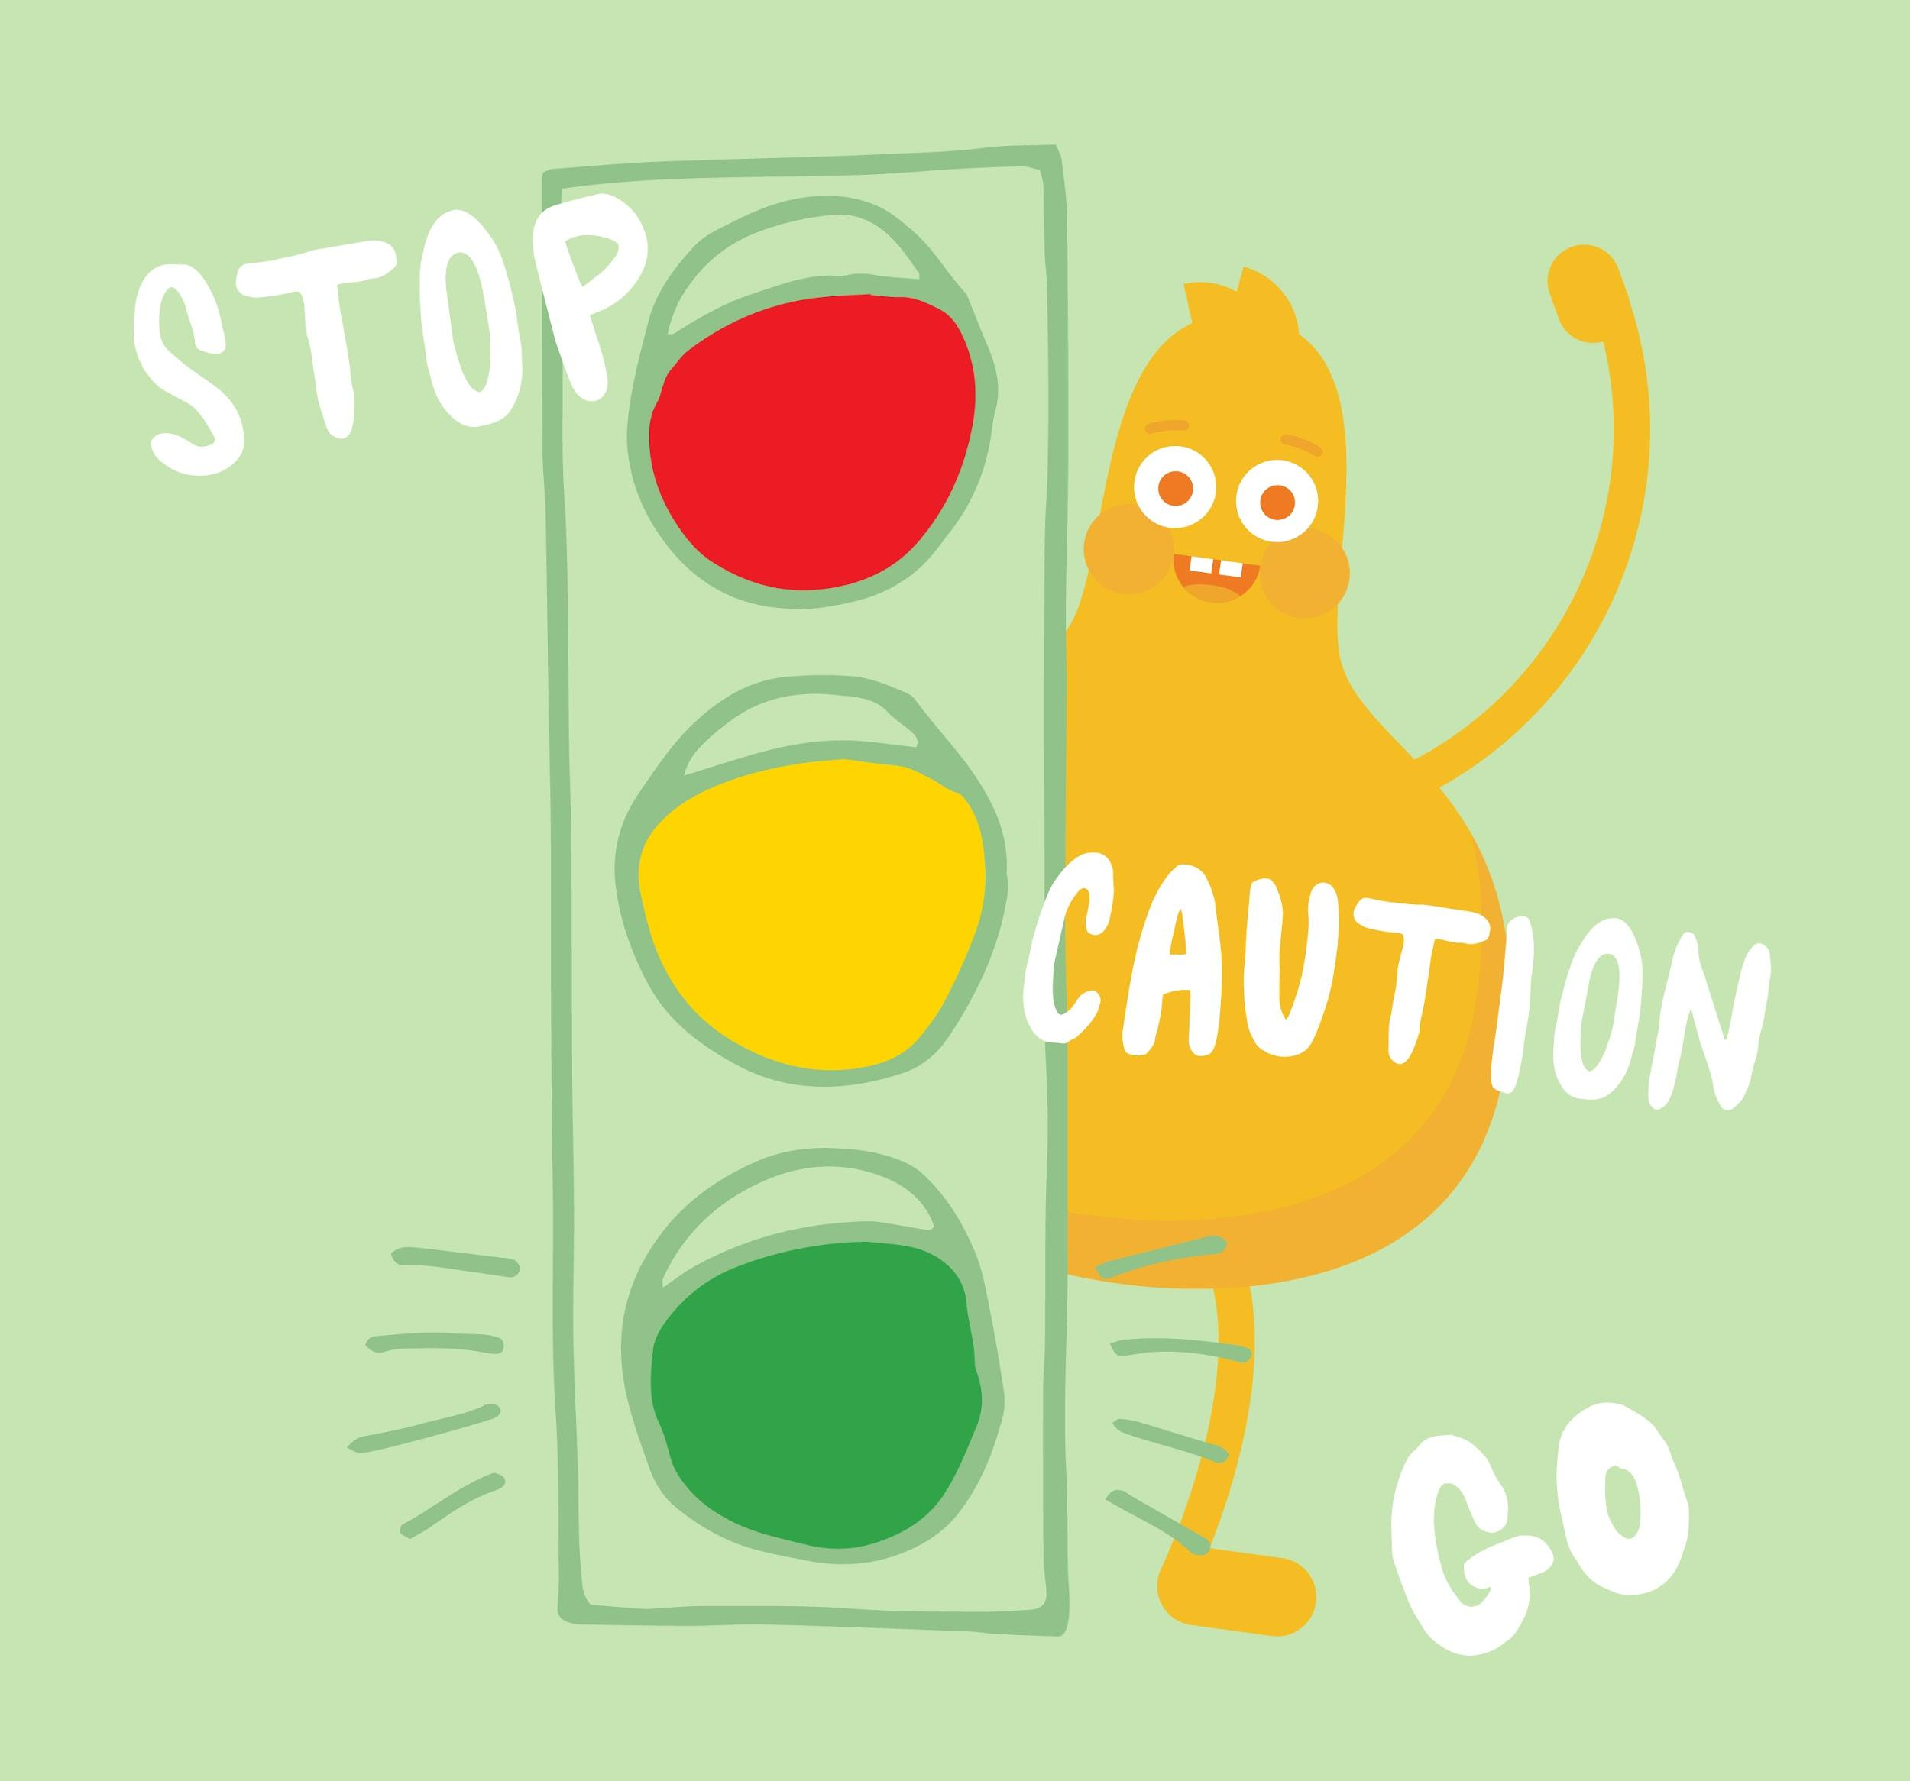
DIGITAL CITIZENSHIP | GRADE 1
Internet Traffic Light

Slide 2
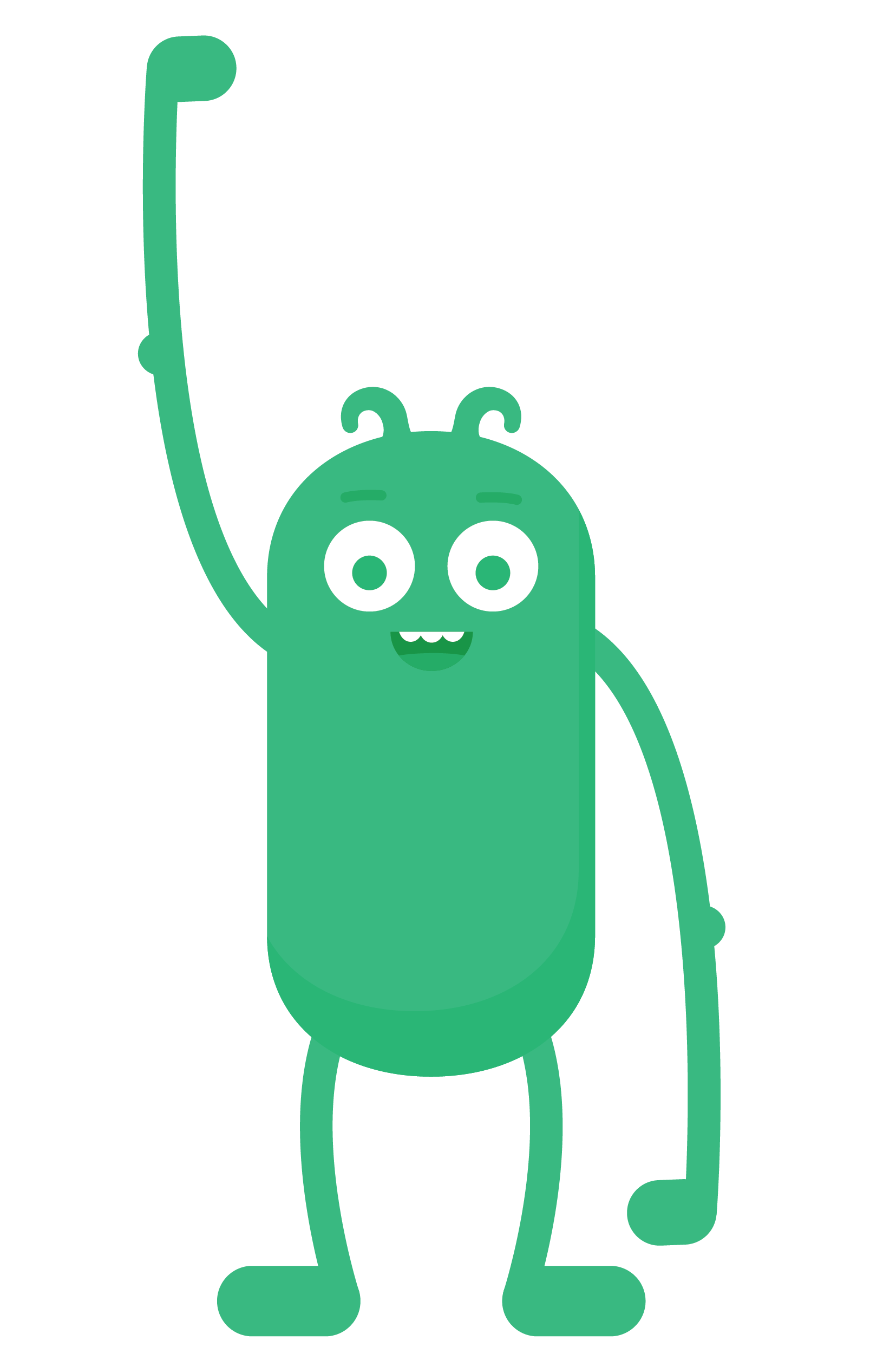

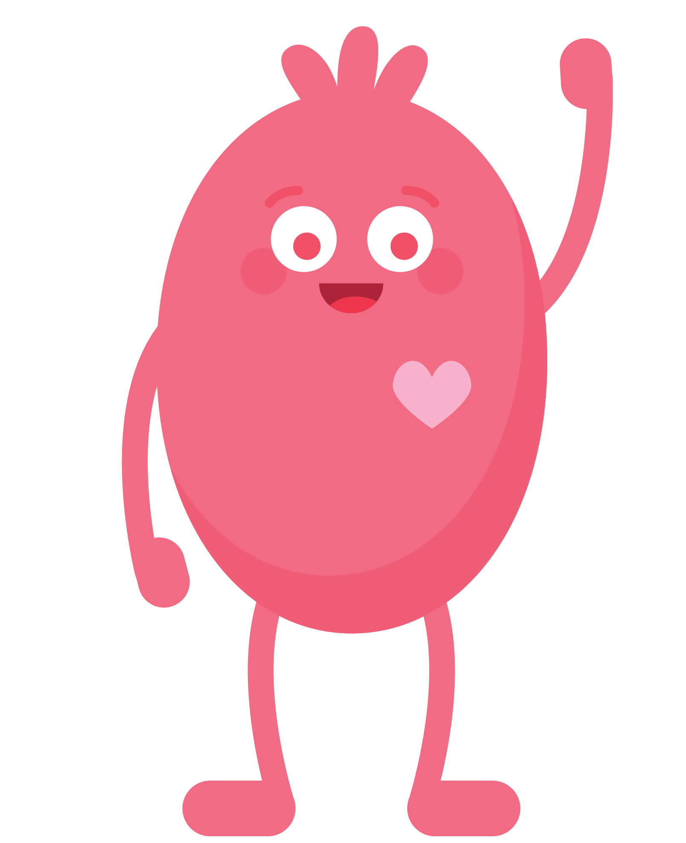
WARM UP
When you play outside without
a grown-up, what are some of the
things you do to stay safe?

Slide 3
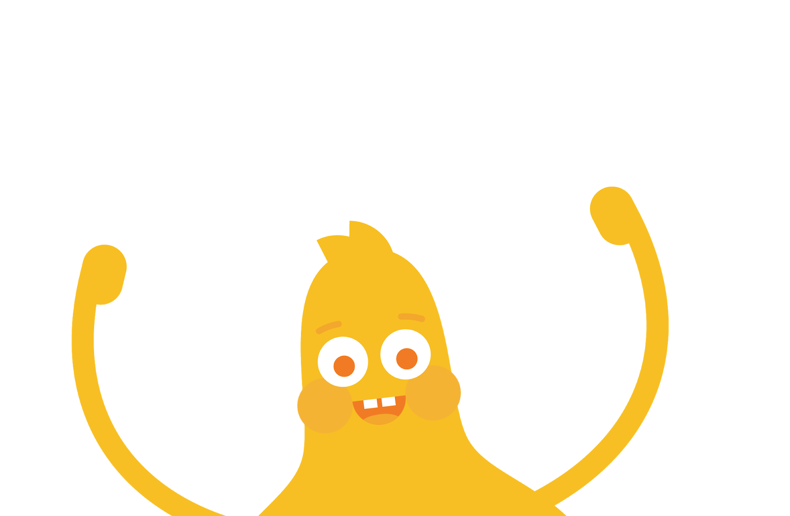

How do you stay
safe when visiting a website or app?

Slide 4

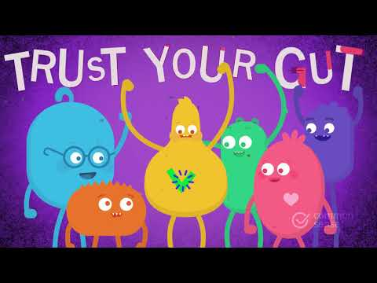
WATCH
To watch this video on Common Sense Education's site, click here.

Slide 5



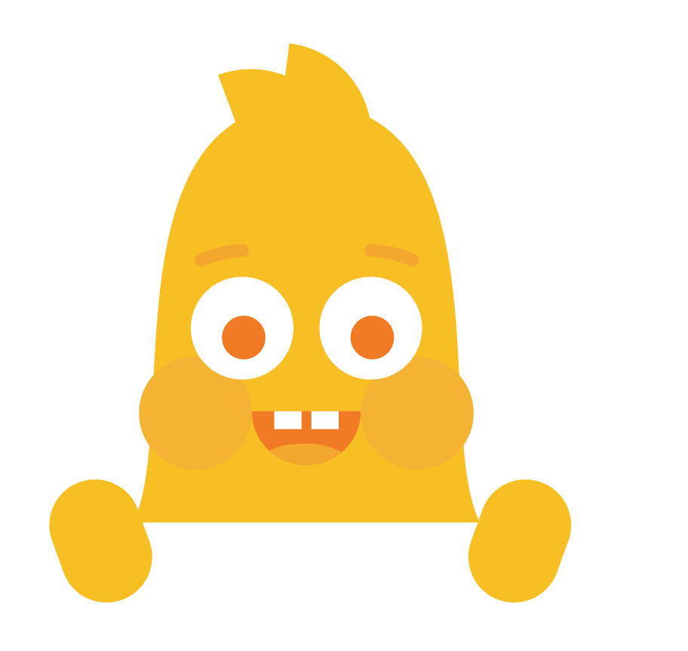

CLASS DISCUSSION
What is a GREEN website or app?
A site or app that is just right for you.
Fun, with things for you to do or see.
Has appropriate words.
GO!
KEY VOCABULARY
Just right: something that is appropriate or fitting

Slide 6
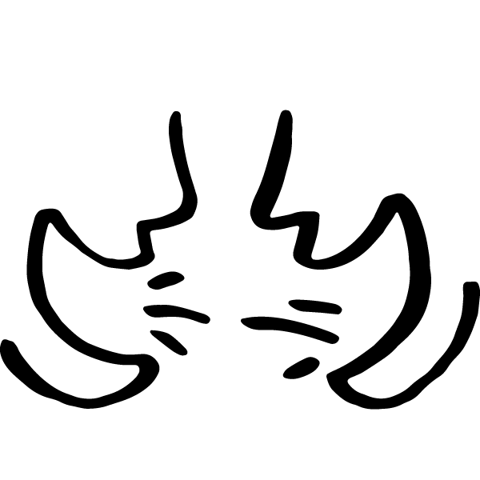
THINK-PAIR-SHARE
What are some "green" websites or apps you visit? How do you know they're safe and just right for you?

Slide 7

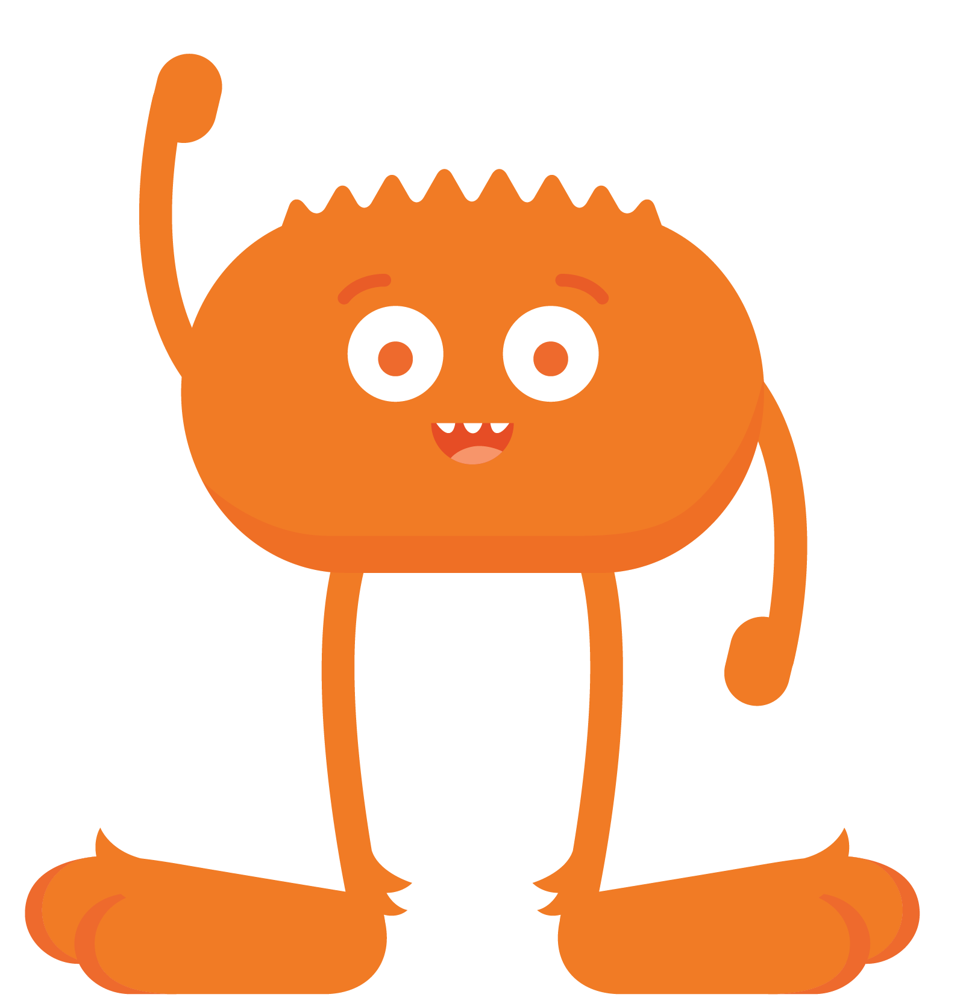
CLASS DISCUSSION
What is a YELLOW website or app?
A site you're not sure is "just right" for you.
The words are hard for you to read.
One that asks for information such as who
you are, where you live, or your phone number.
A site that has you fill out a form.
CAUTION!
KEY VOCABULARY
Caution: being careful

Slide 8

CLASS DISCUSSION
What is a RED website or app?
Has everything that a yellow site has.
A site that is clearly not "just right" for you.
A place you have gone by accident.
Filled with pictures, words, and videos that are for older kids or adults.
A place where you are allowed to chat with people you don't know.
STOP!

Slide 9
THINK-PAIR-SHARE
Have you ever been to a "red" website
or app? How did you know it was not right for you?

Slide 10
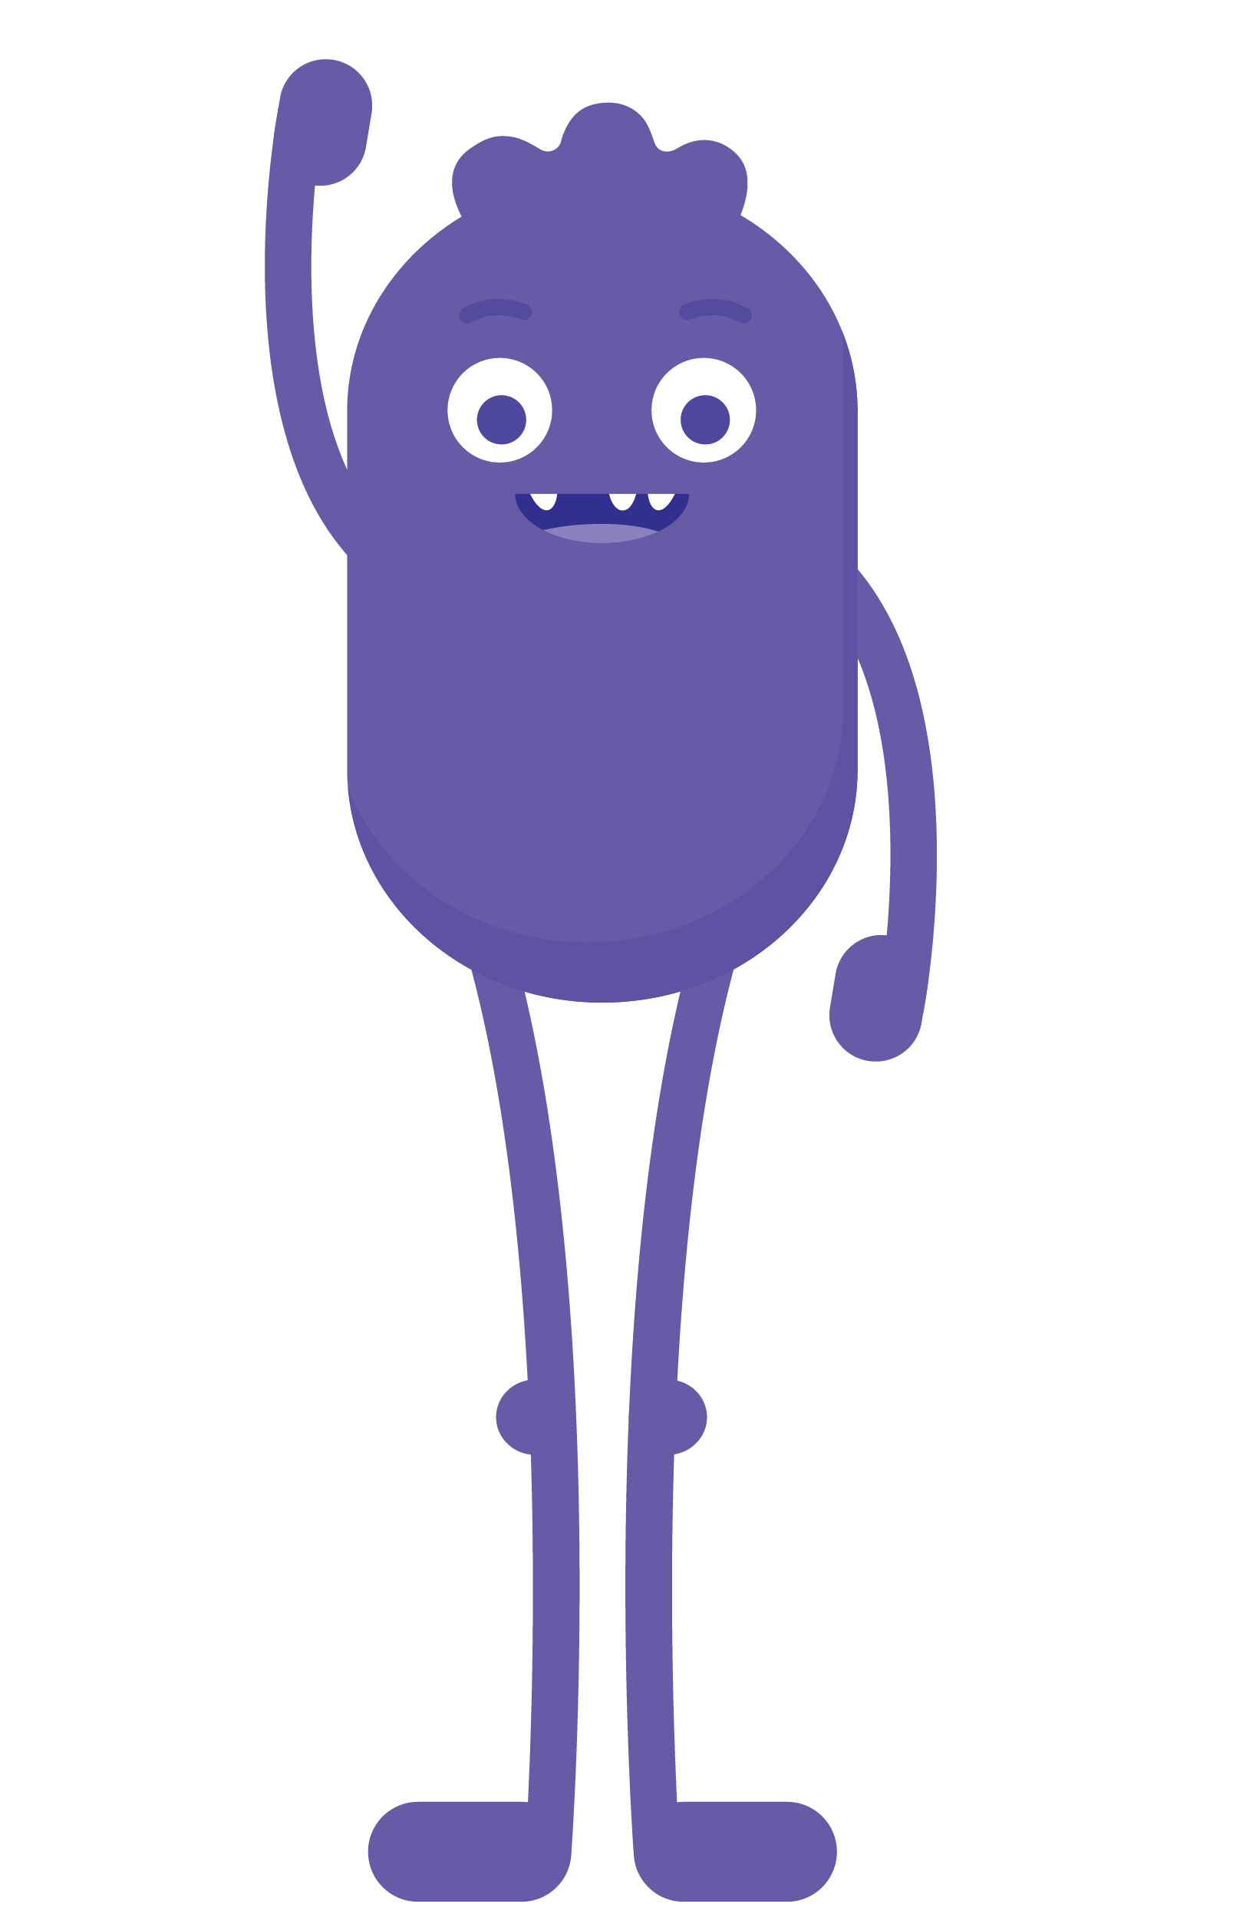
GAME
3 Rules
Green
Yellow
Red
2 steps forward
1 step forward
0 steps
If you get an answer wrong, take one step back!

