Slide 1

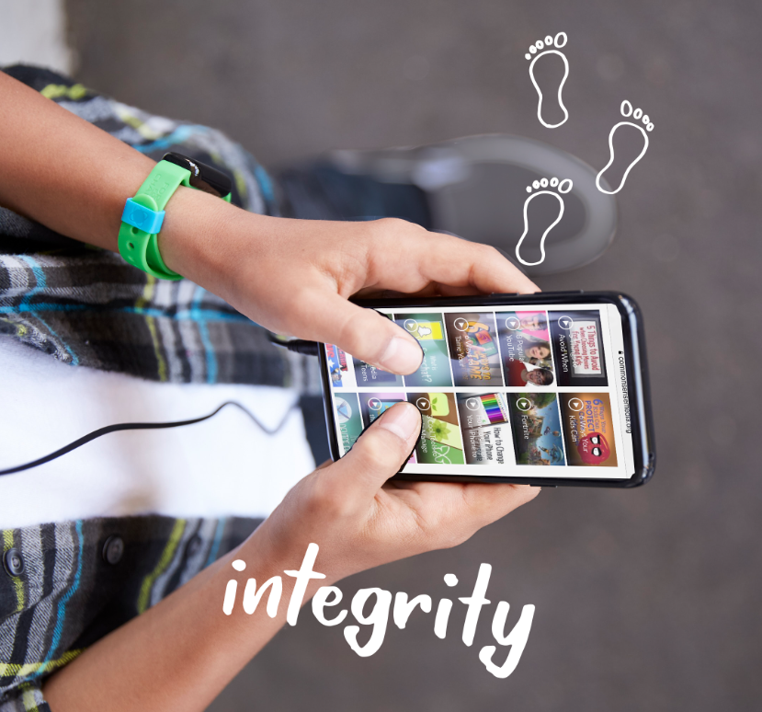
DIGITAL CITIZENSHIP | GRADE 4
Our Online Tracks

Slide 2

Essential Question
How does our online activity affect the digital
footprints of ourselves and others?

Slide 3

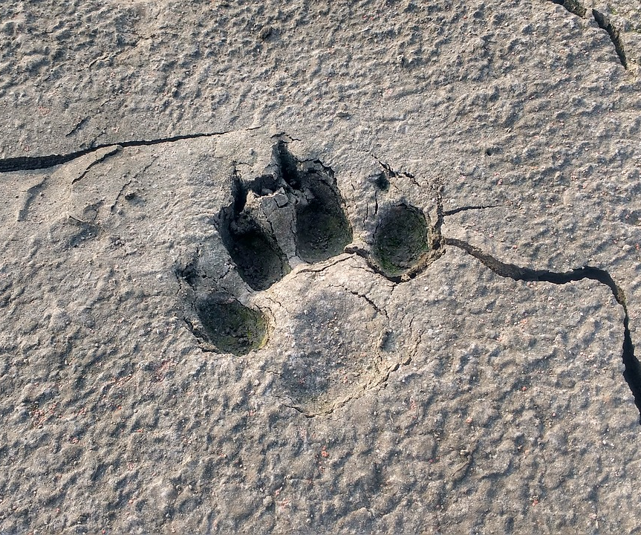
WARM UP: OBSERVE + ANALYZE IMAGE
What do you notice in this image?
What can you infer about the animal that left this?
1

Slide 4
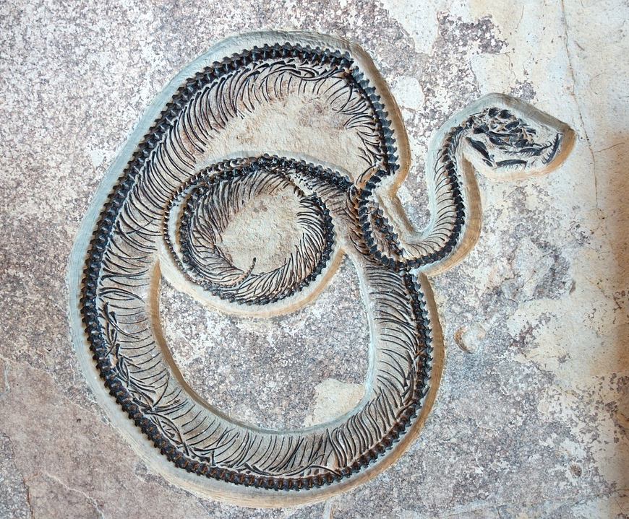
WARM UP: OBSERVE + ANALYZE IMAGE
What do you notice in this image?
What can you infer about this animal?
2

Slide 5


KEY VOCABULARY
Digital Footprint
A record of what you do online, including the sites you visit and the things you post. It can also include things that others post that involve you, such as pictures or comments.

Slide 6


PAIR WORK: WHO GOES THERE?
Camilla’s Footprint
Footprint activity | If you saw it, what might it tell you about Camilla? | Is Camilla in control of this? (Circle one.)
She appears in a video of the school play that her parents post on a video-sharing site.
She posts comments about dancing videos on YouTube.
She creates a wish list of things she wants for her birthday on her parent's online shopping account.
She appears on the top-scorers list of an online video game that she plays regularly.
She appears in a picture her friend posted on social media.
Camilla spends a lot of time online. For each activity, decide what it might tell you about her and whether she is in control of this activity.

Slide 7

THINK-PAIR-SHARE
What do you think are some of our responsibilities for being online? Both to ourselves and to others?

Slide 8


