Slide 1

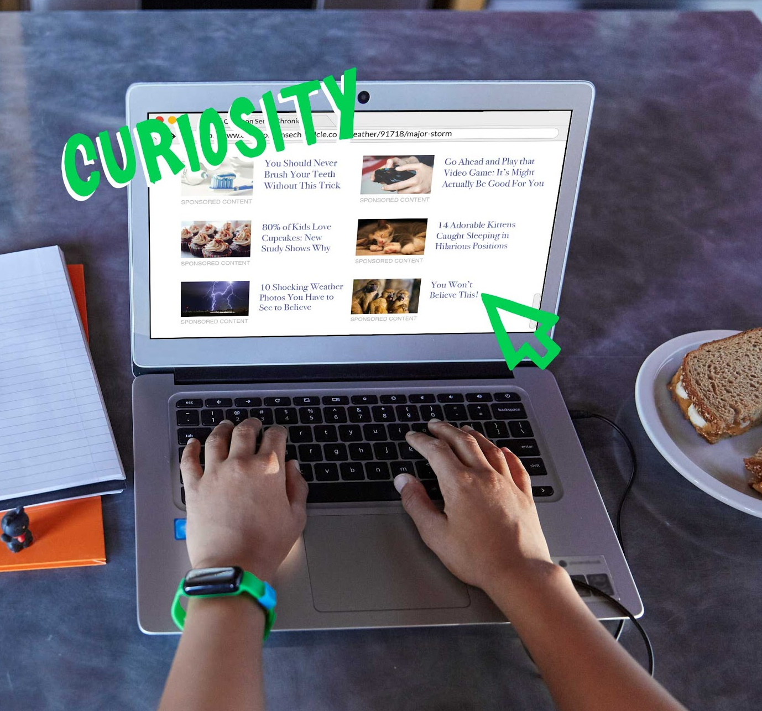
DIGITAL CITIZENSHIP | GRADE 5
You Won't Believe This!

Slide 2

Essential Question
What is clickbait, and how can you avoid it?

Slide 3


KEY VOCABULARY
Clickbait
An image or headline that tries to get you to click on it, usually for advertising purposes

Slide 4

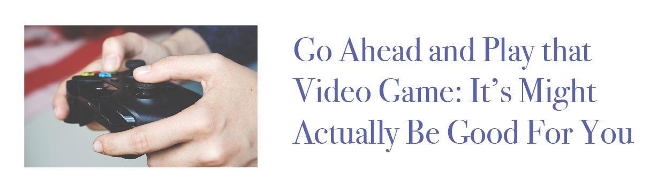
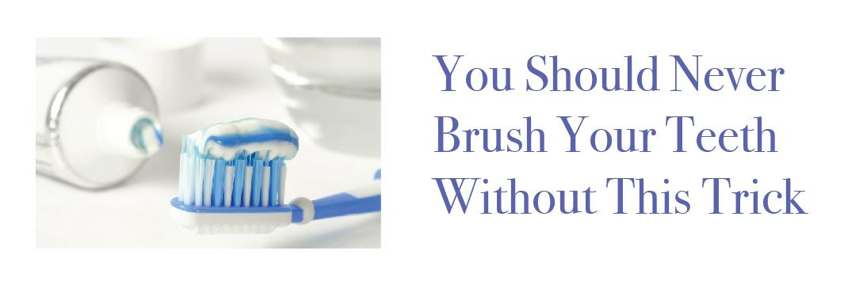
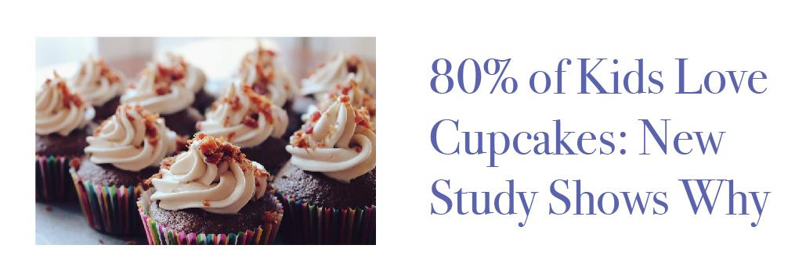
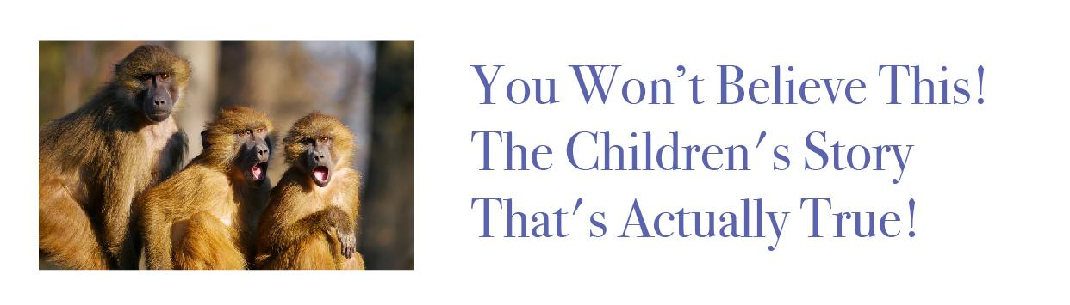
WARM UP: THINK, PAIR, SHARE
Which of these headlines would you click first? Why?

Slide 5
KEY VOCABULARY
The Curiosity Gap
The desire every person has to figure out
missing information

Slide 6
WARM UP: THINK, PAIR, SHARE
Which of these headlines would you click first? Why?

Slide 7

ACTIVITY: AVOIDING CLICKBAIT
Clue #1: It seems impossible or unbelievable.
FOR EXAMPLE: "Think Your Cat Loves You? It's Actually Plotting
to Make You Sick."
Clue #2: It tries to shock you.
FOR EXAMPLE: "You Won't Believe This!" or "The Answer Is Genius!"
Clue #3: It refers to a celebrity or popular topic.
FOR EXAMPLE: "Kylie Jenner Talks Selfies and Bubble Tea: You Won't Believe What She Says!"

Slide 9
