Slide 1
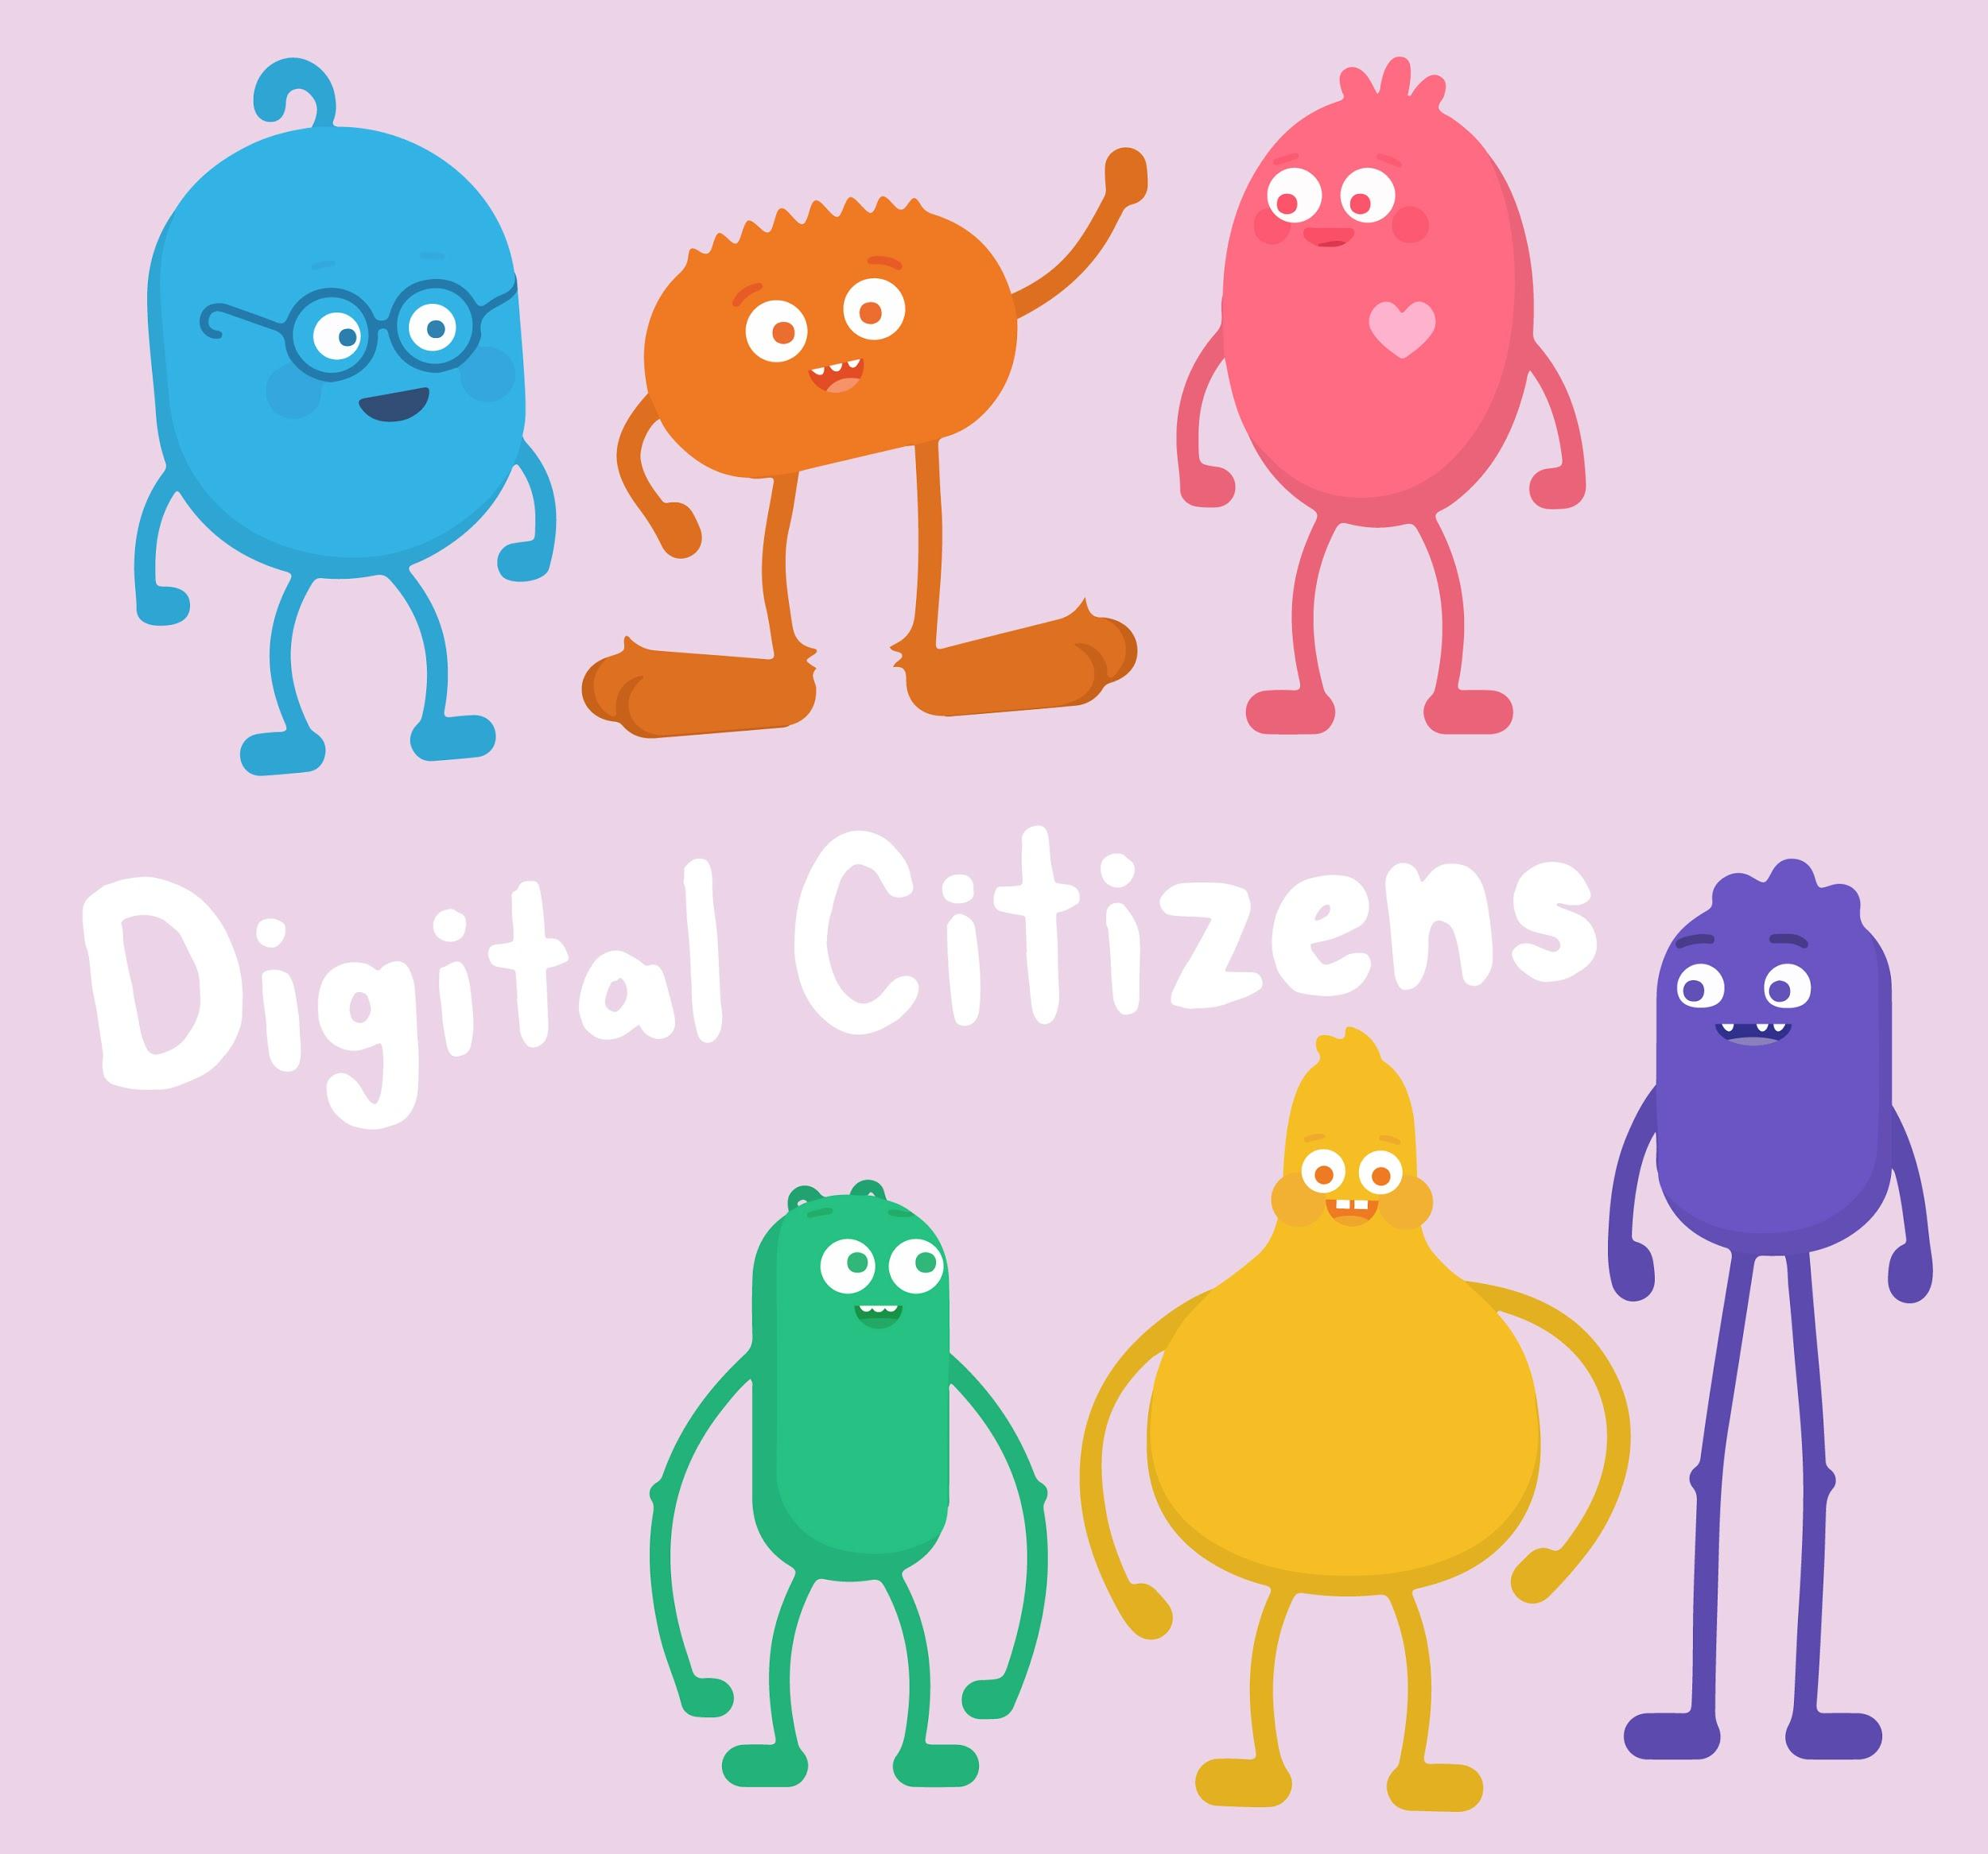
INTRODUCTORY SONG
DIGITAL CITIZENSHIP | GRADE 1
Pause & Think Online

Slide 2
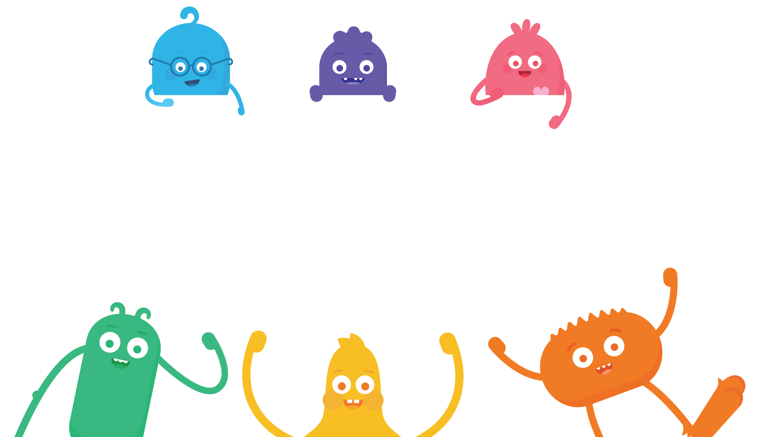
How can we be safe, responsible, and respectful online?

Slide 3
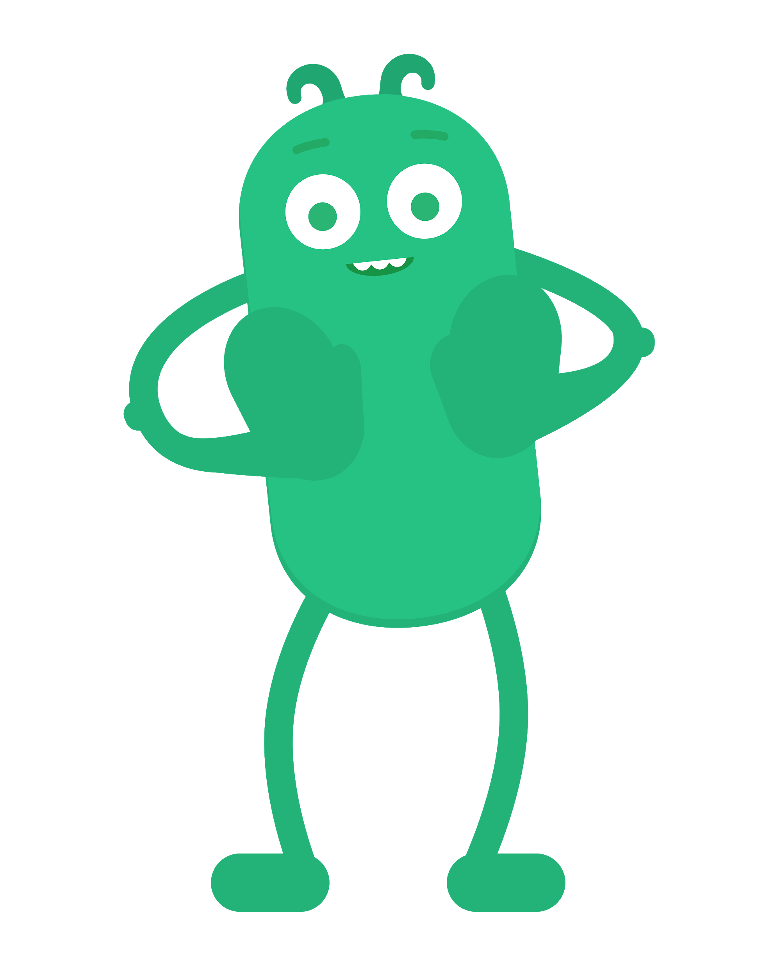
KEY VOCABULARY
Pause
To stop what you're doing or saying

Slide 4
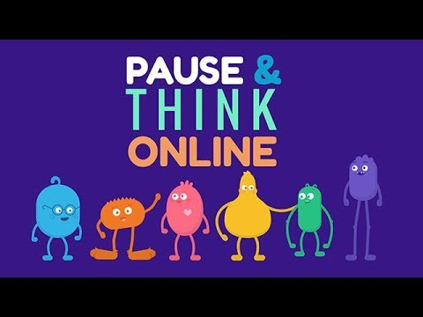
WATCH
To watch this video on the Common Sense Education site, click here.

Slide 5
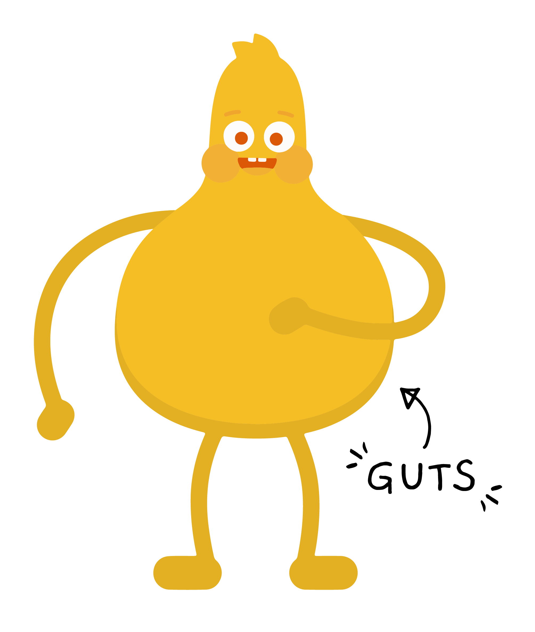
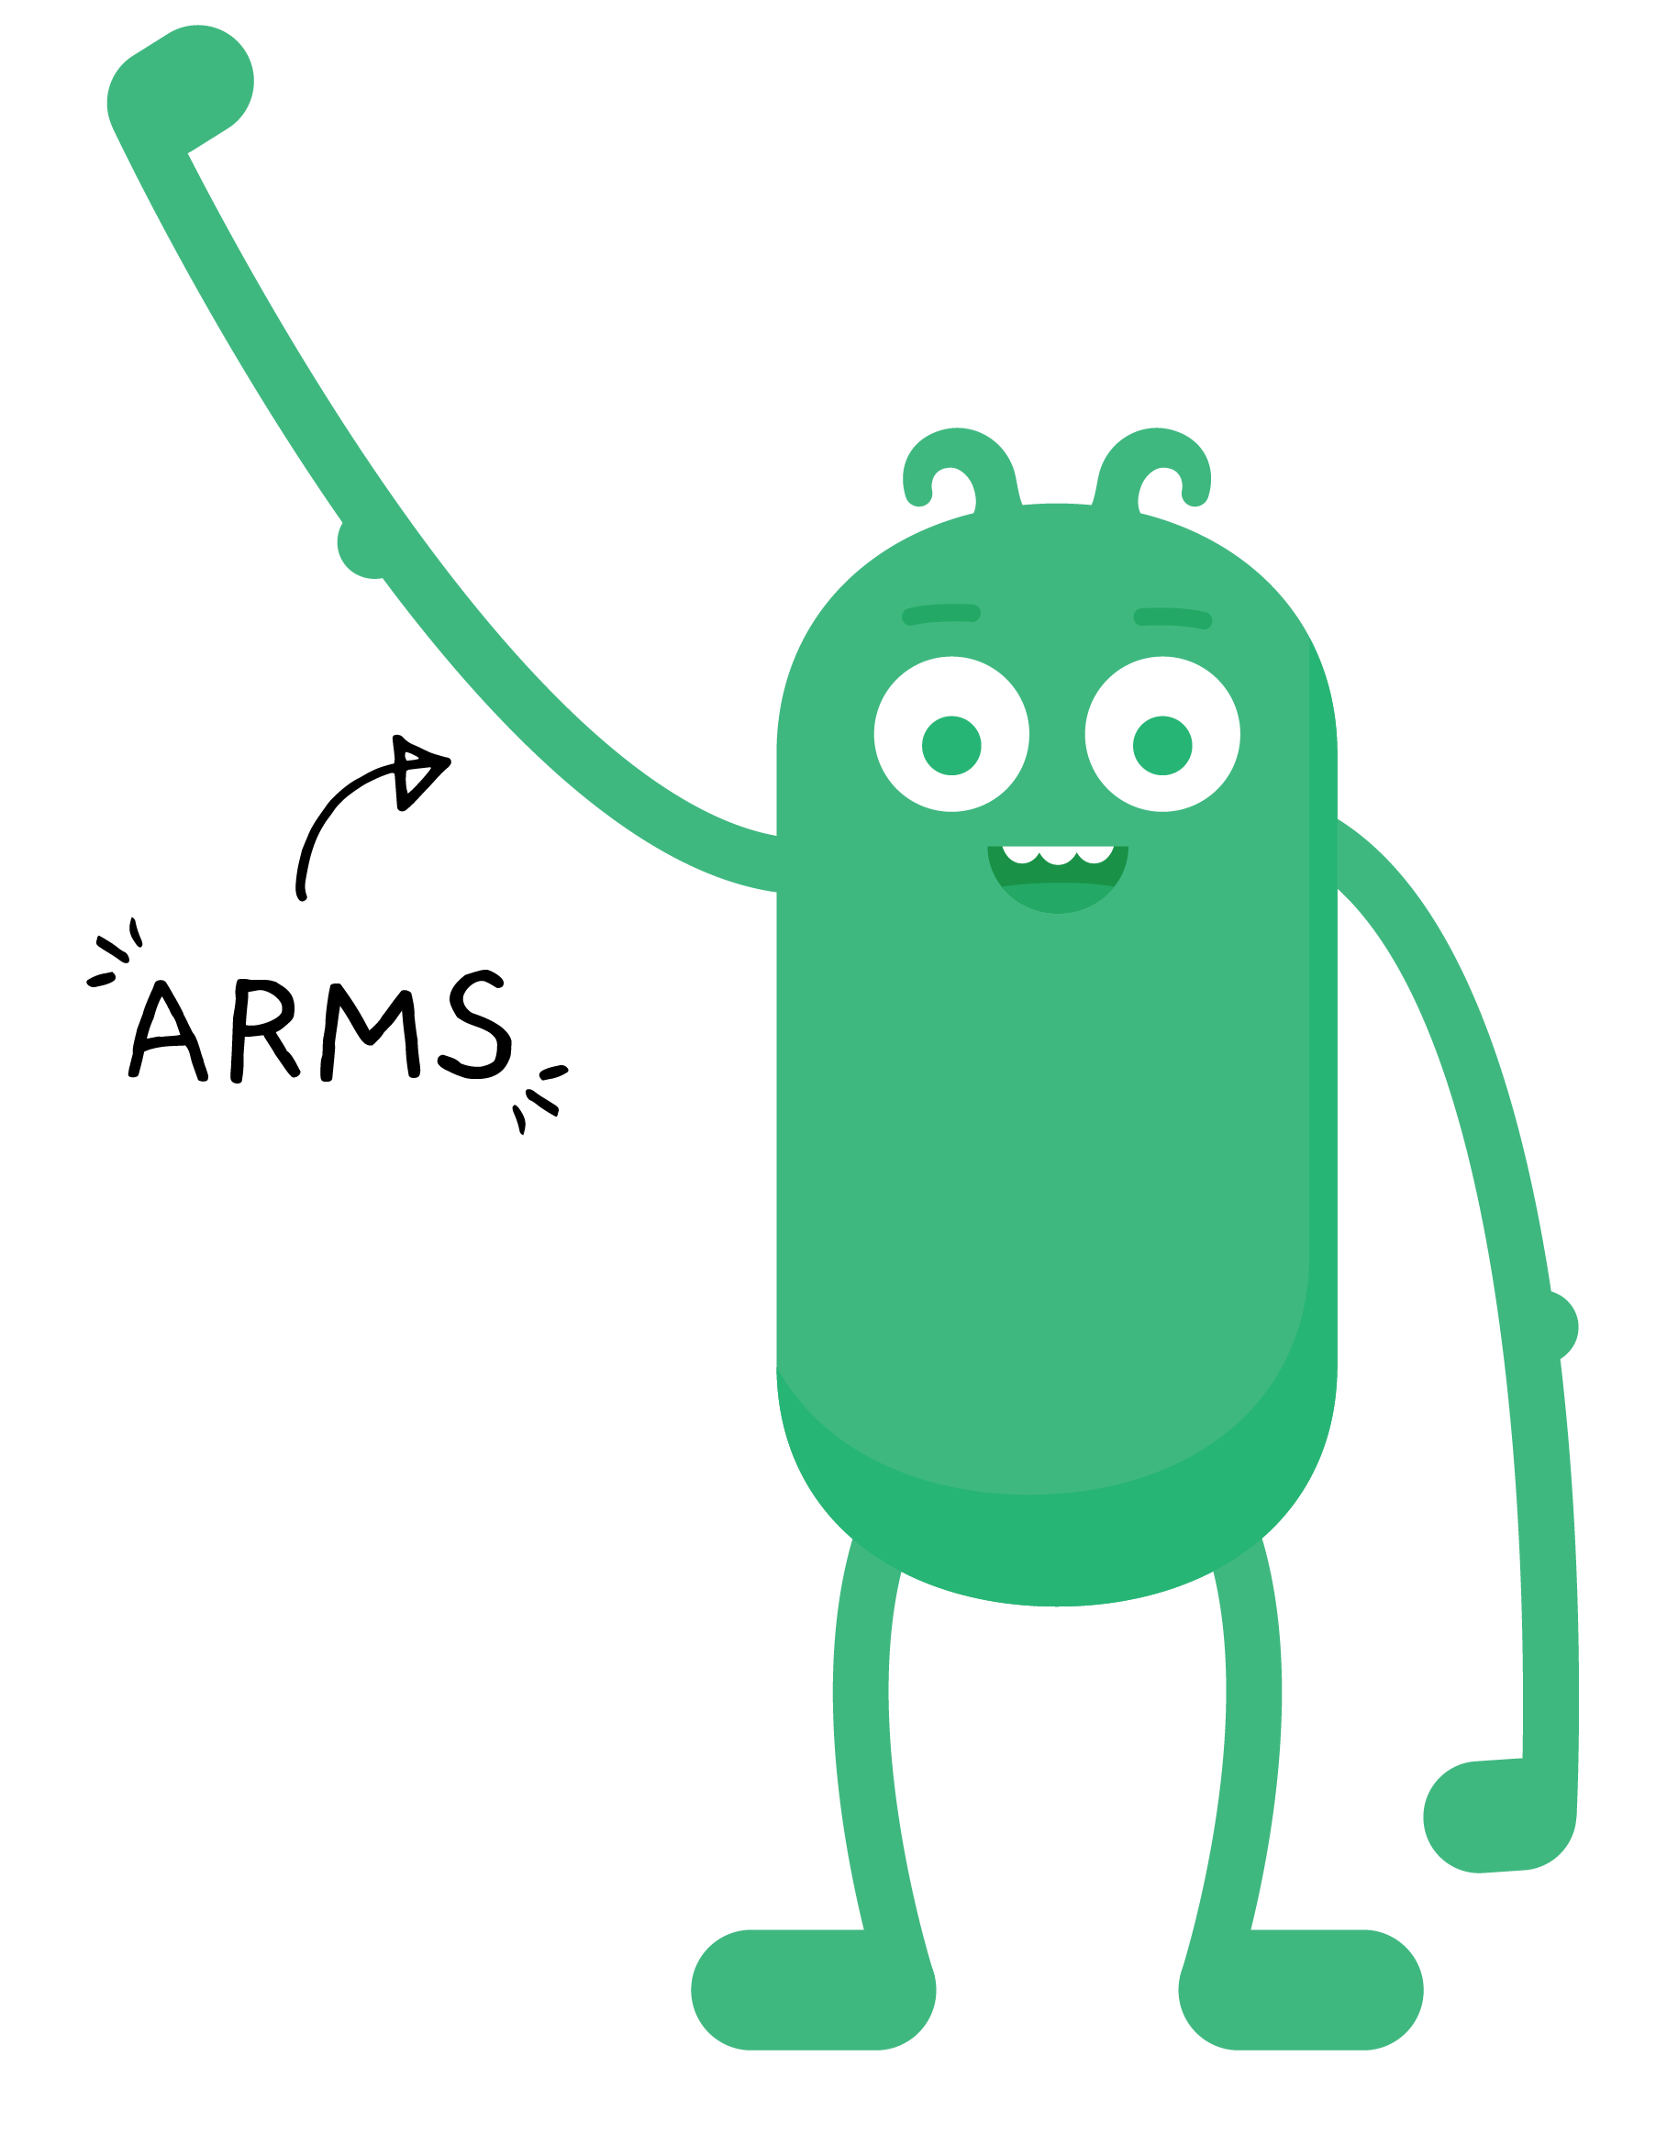
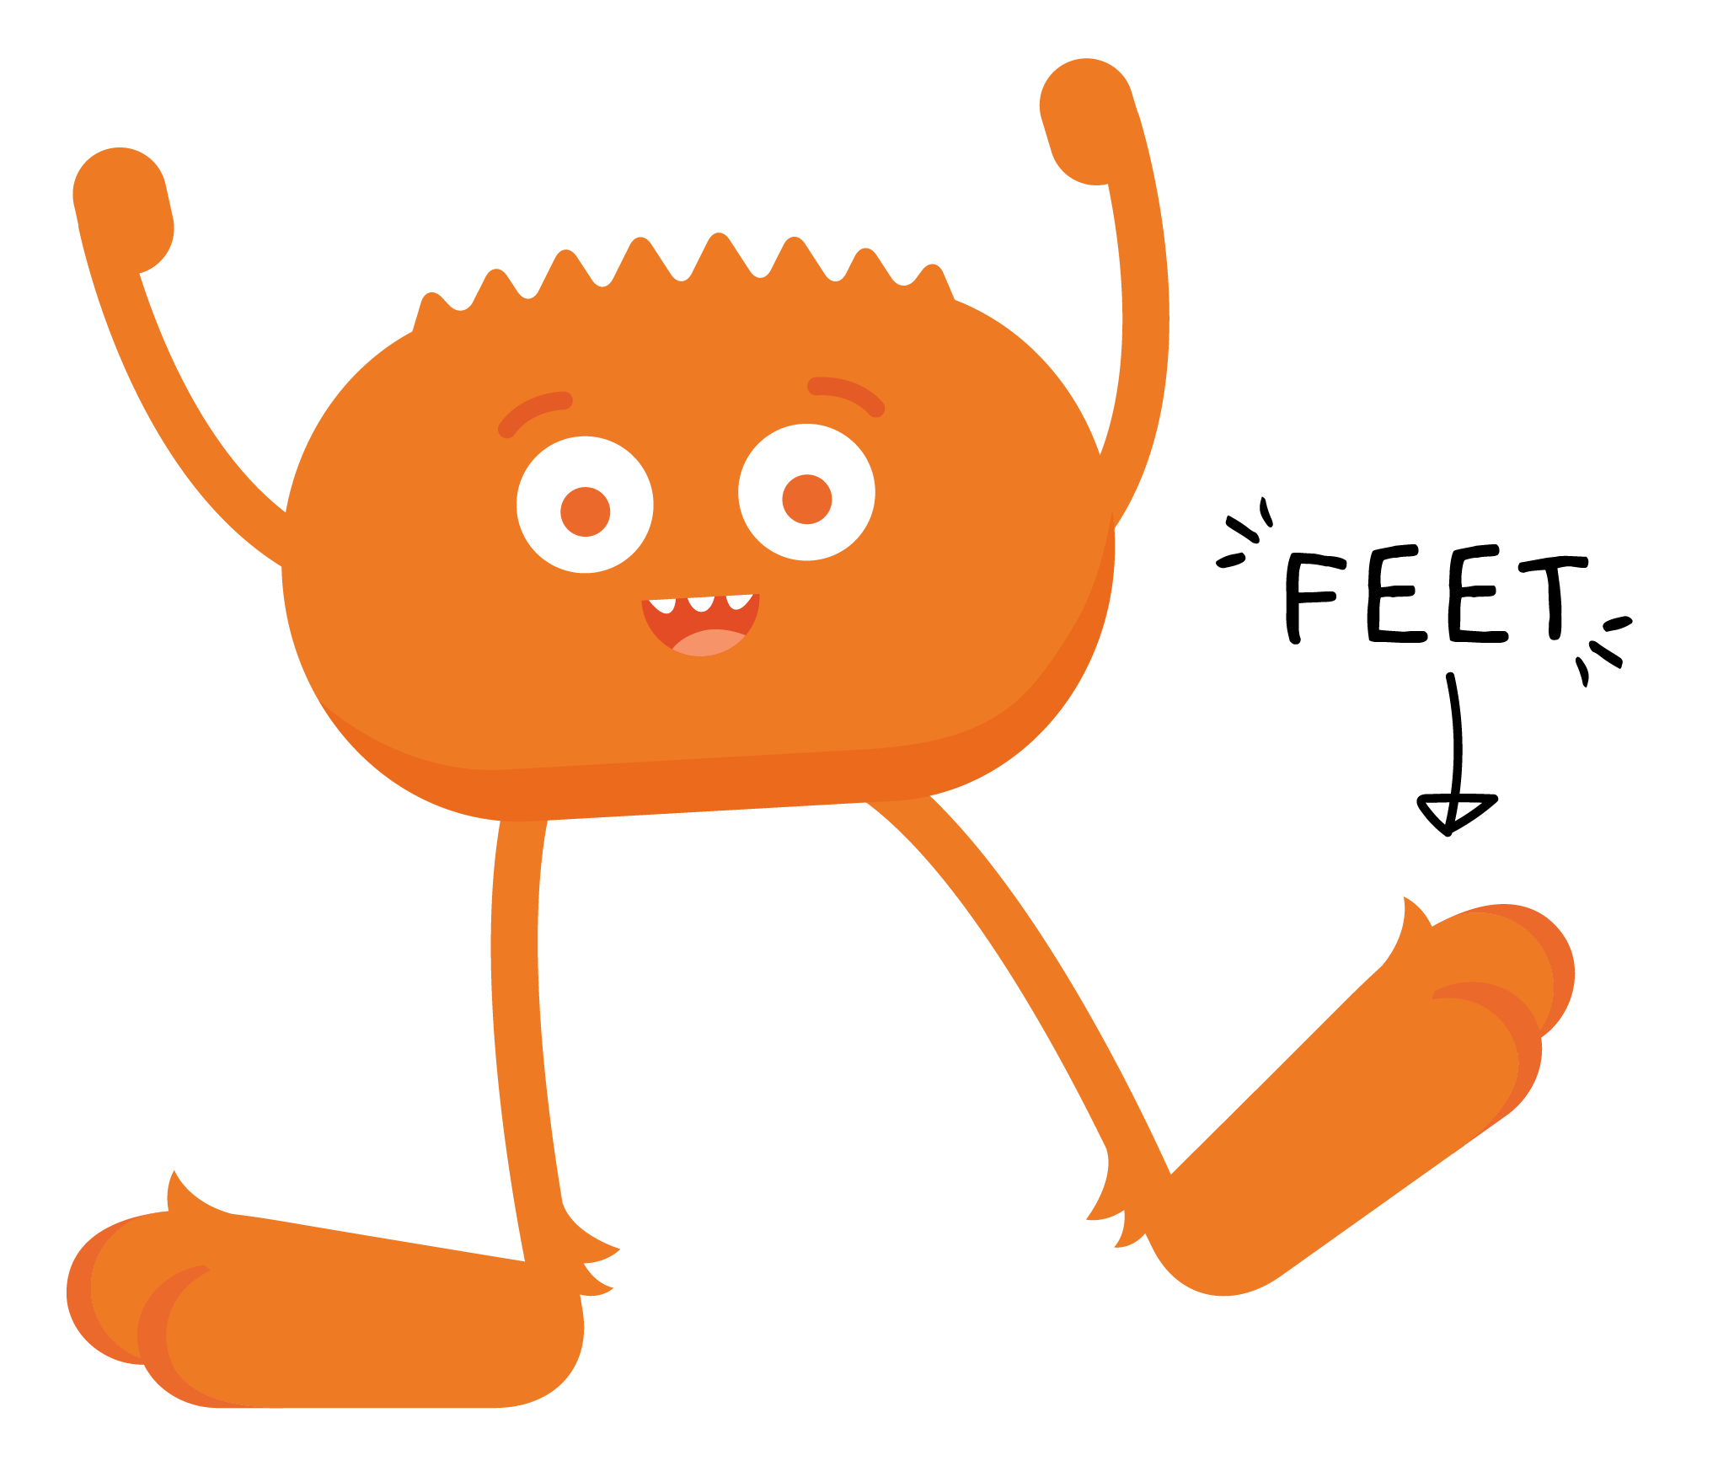
REVIEW

Slide 6
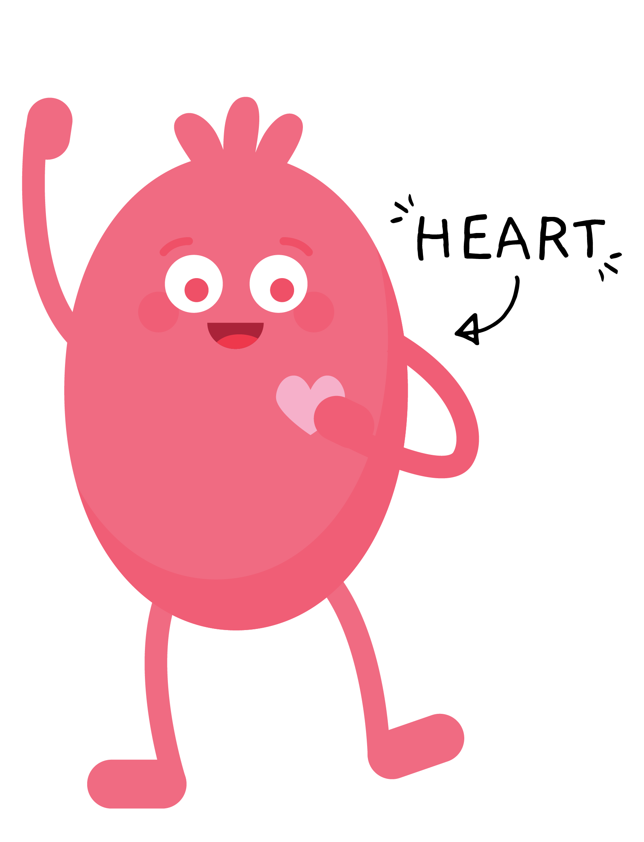
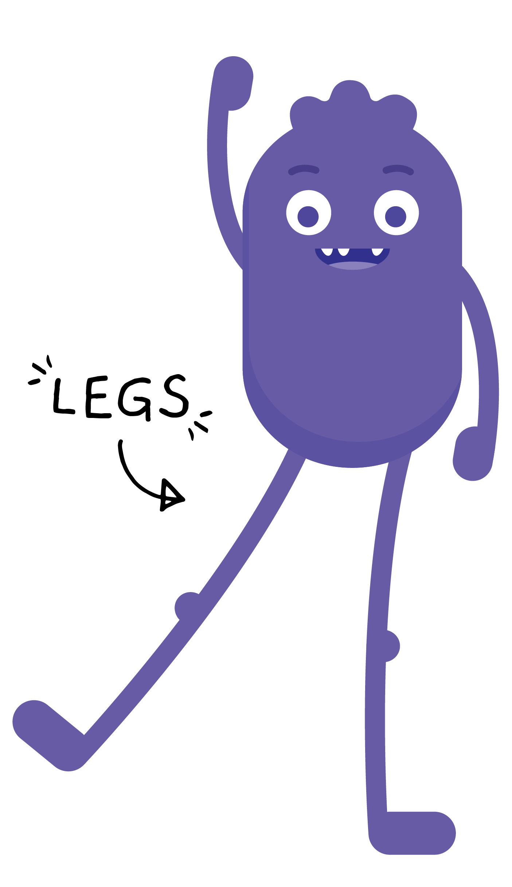
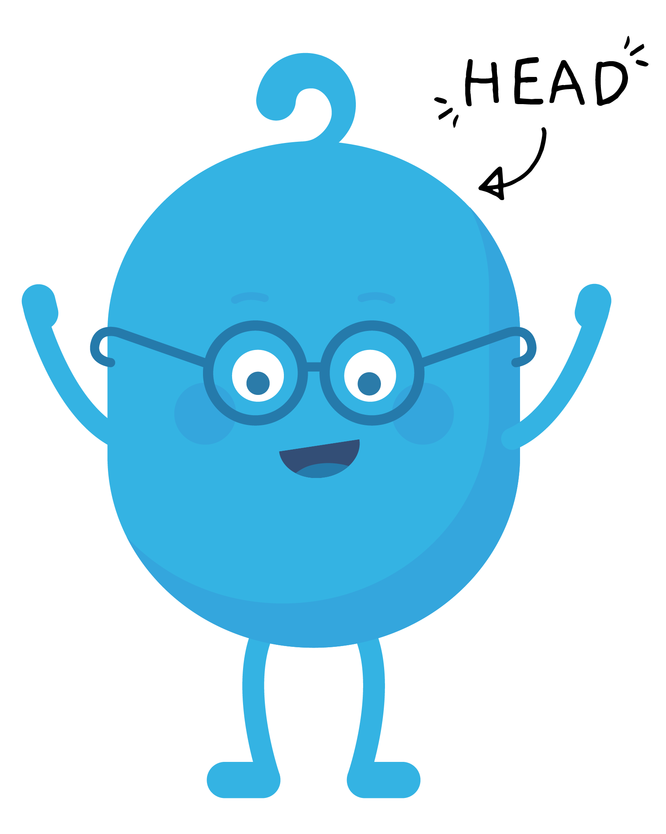
REVIEW

Slide 7
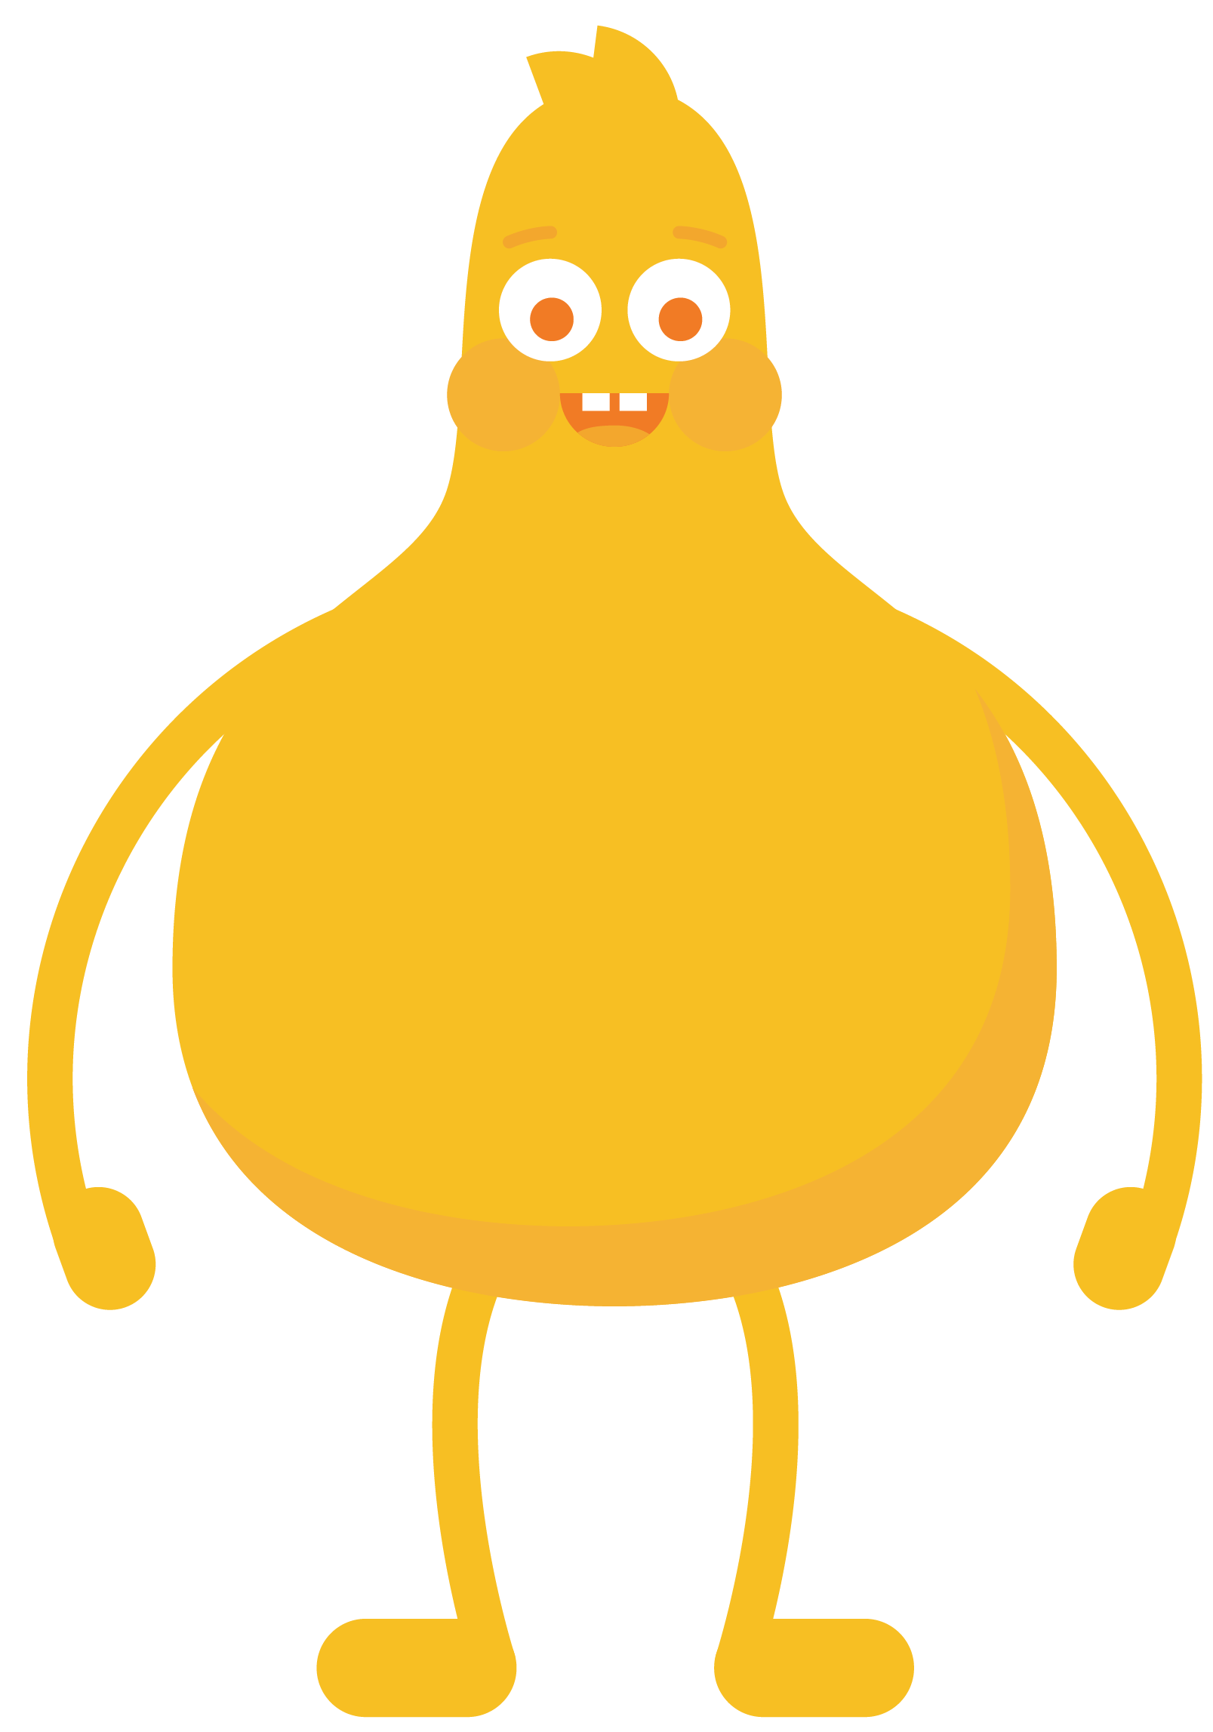
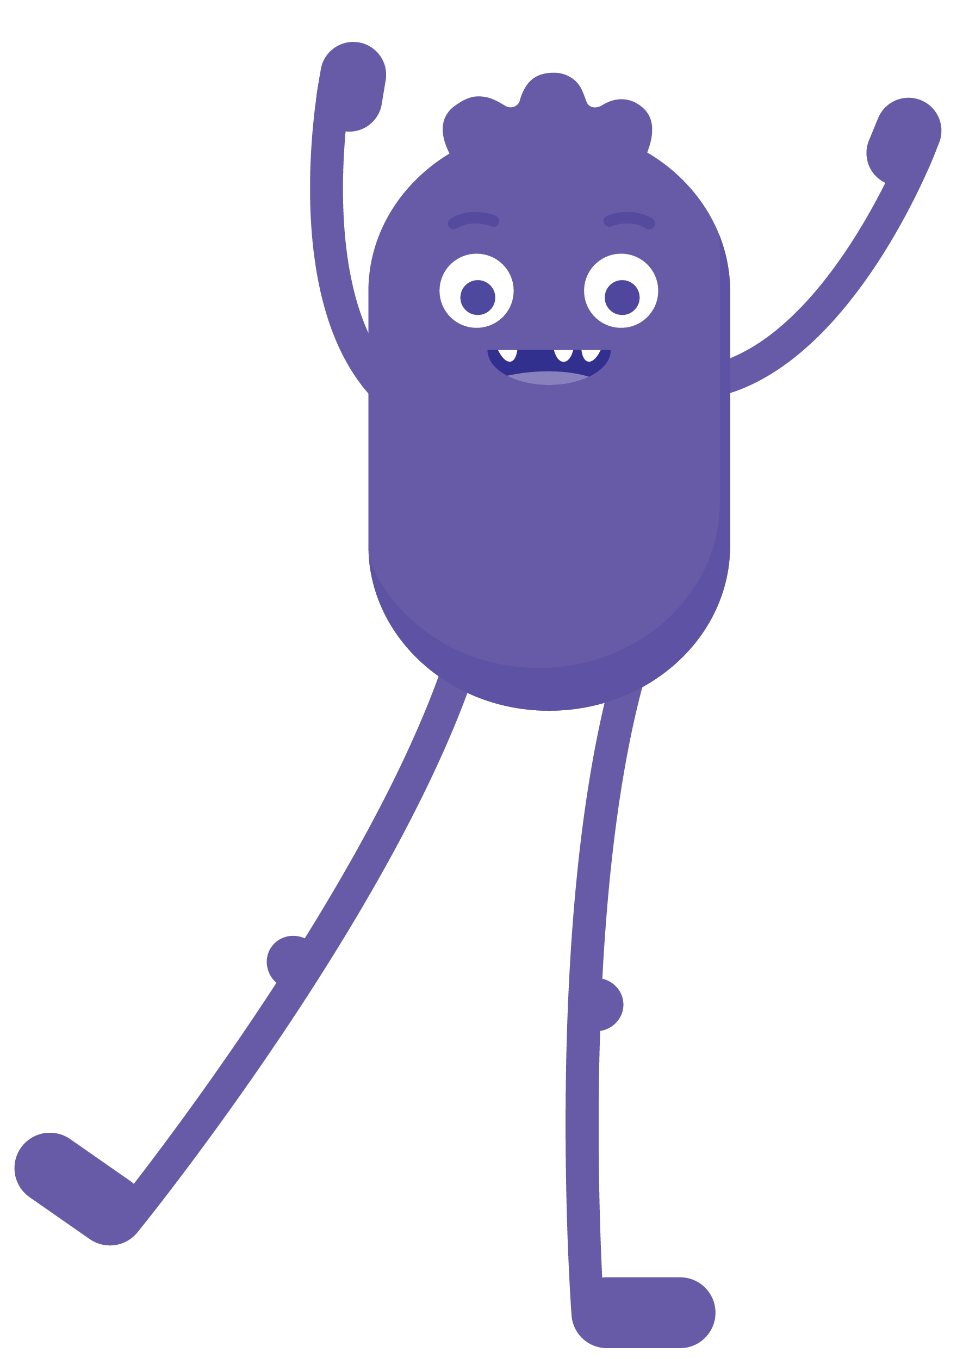
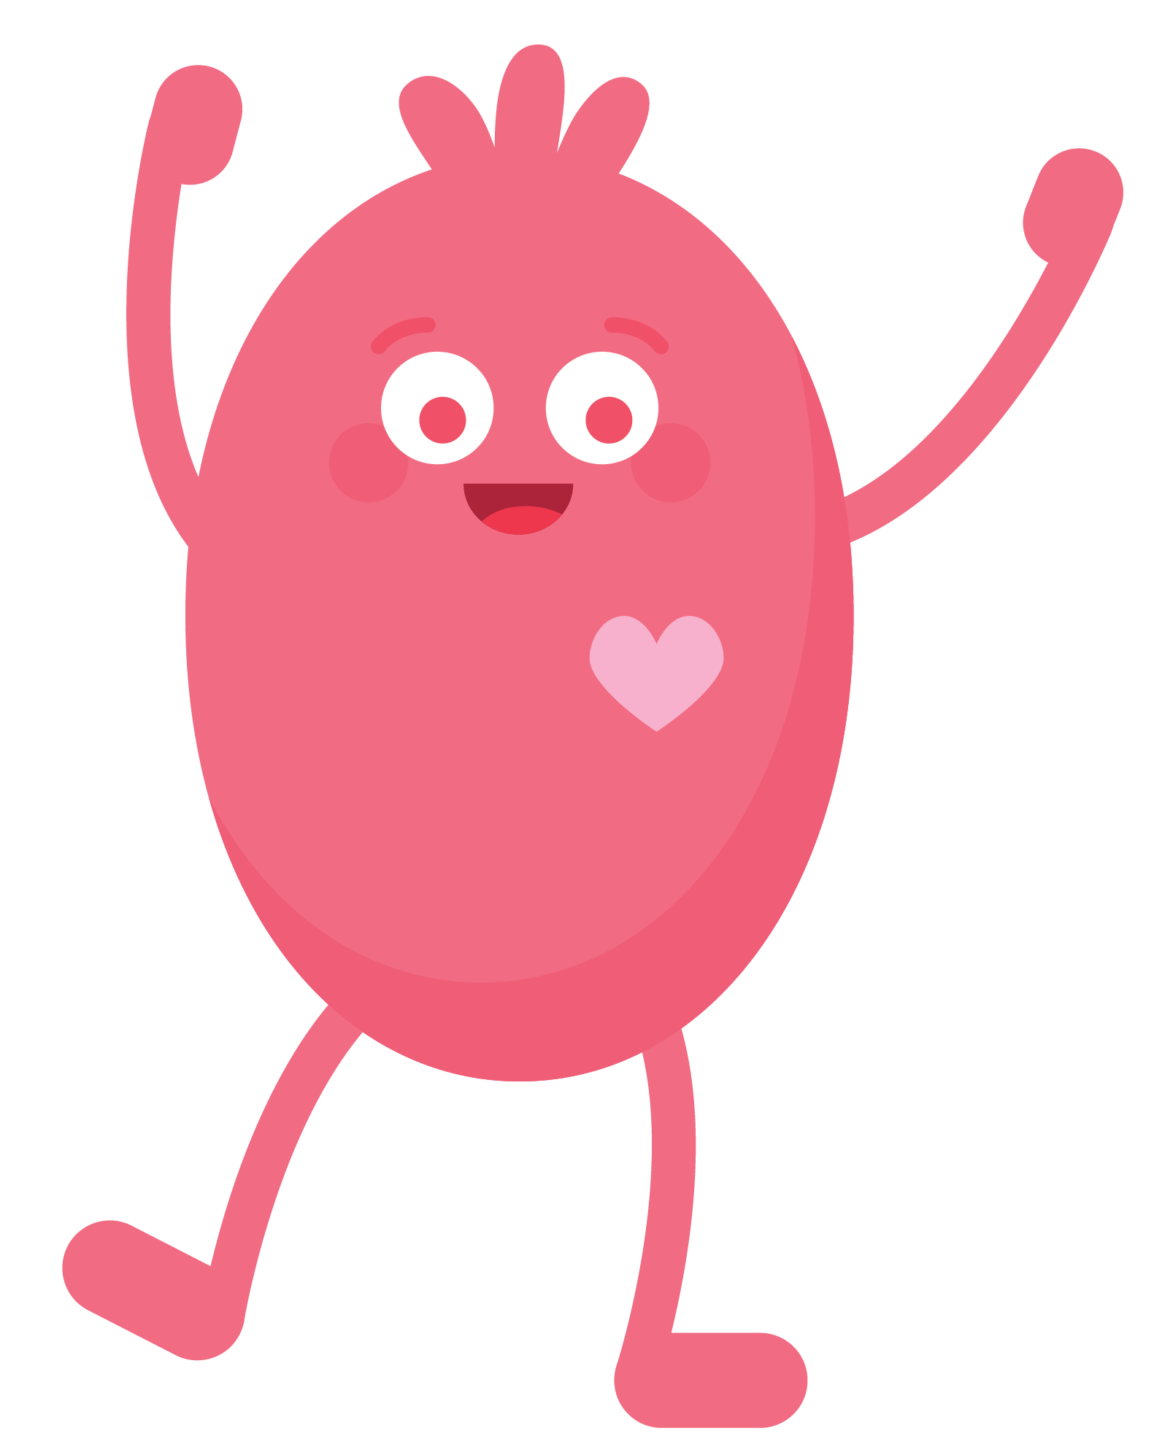
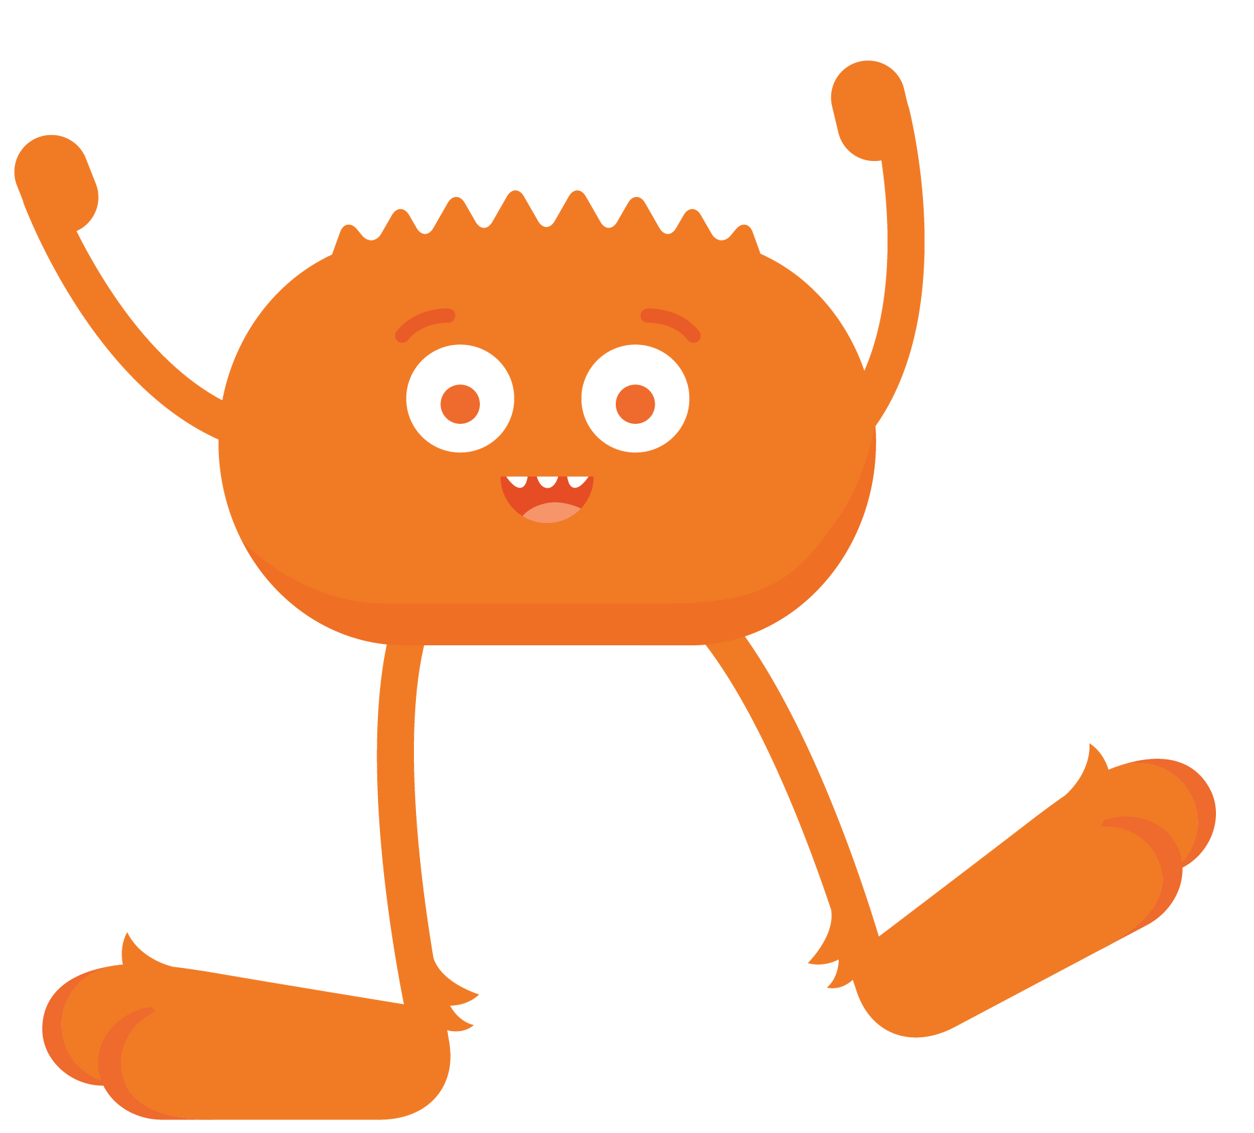
PAIR-SHARE
Which character do you relate to the most when you go online?

Slide 8
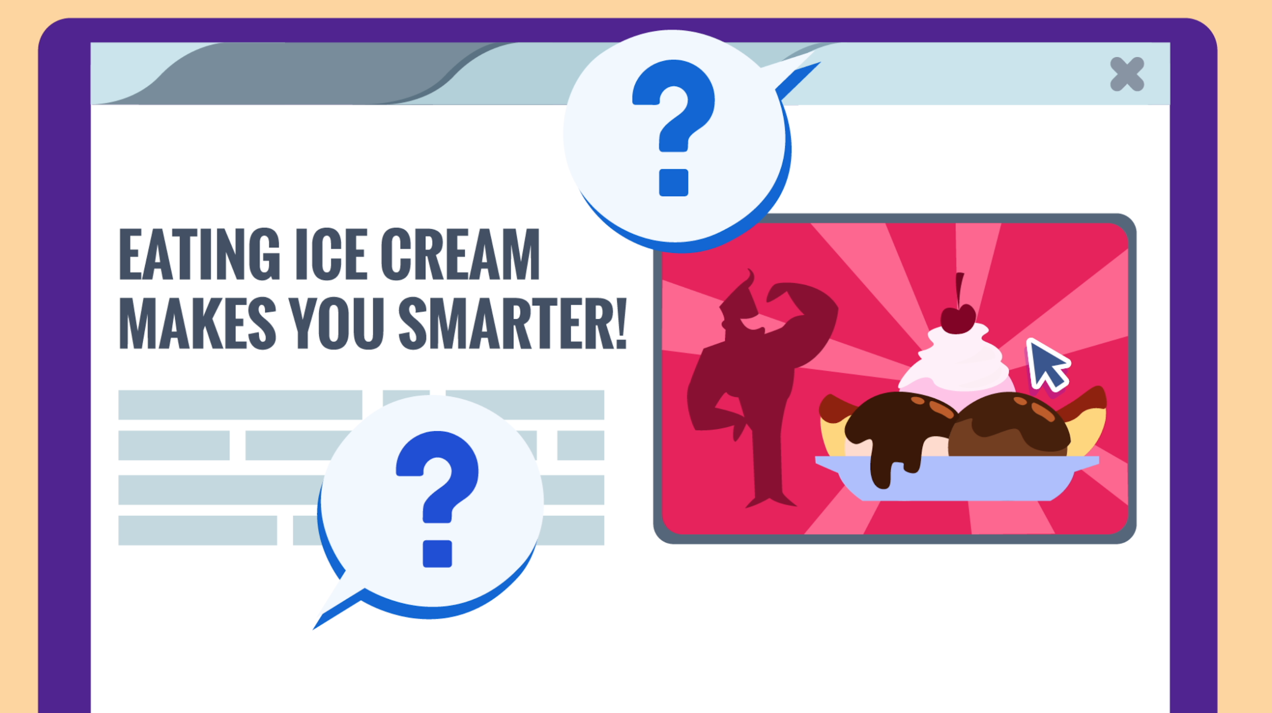
PAIR-SHARE
Do you believe everything you see on the internet?

Slide 9
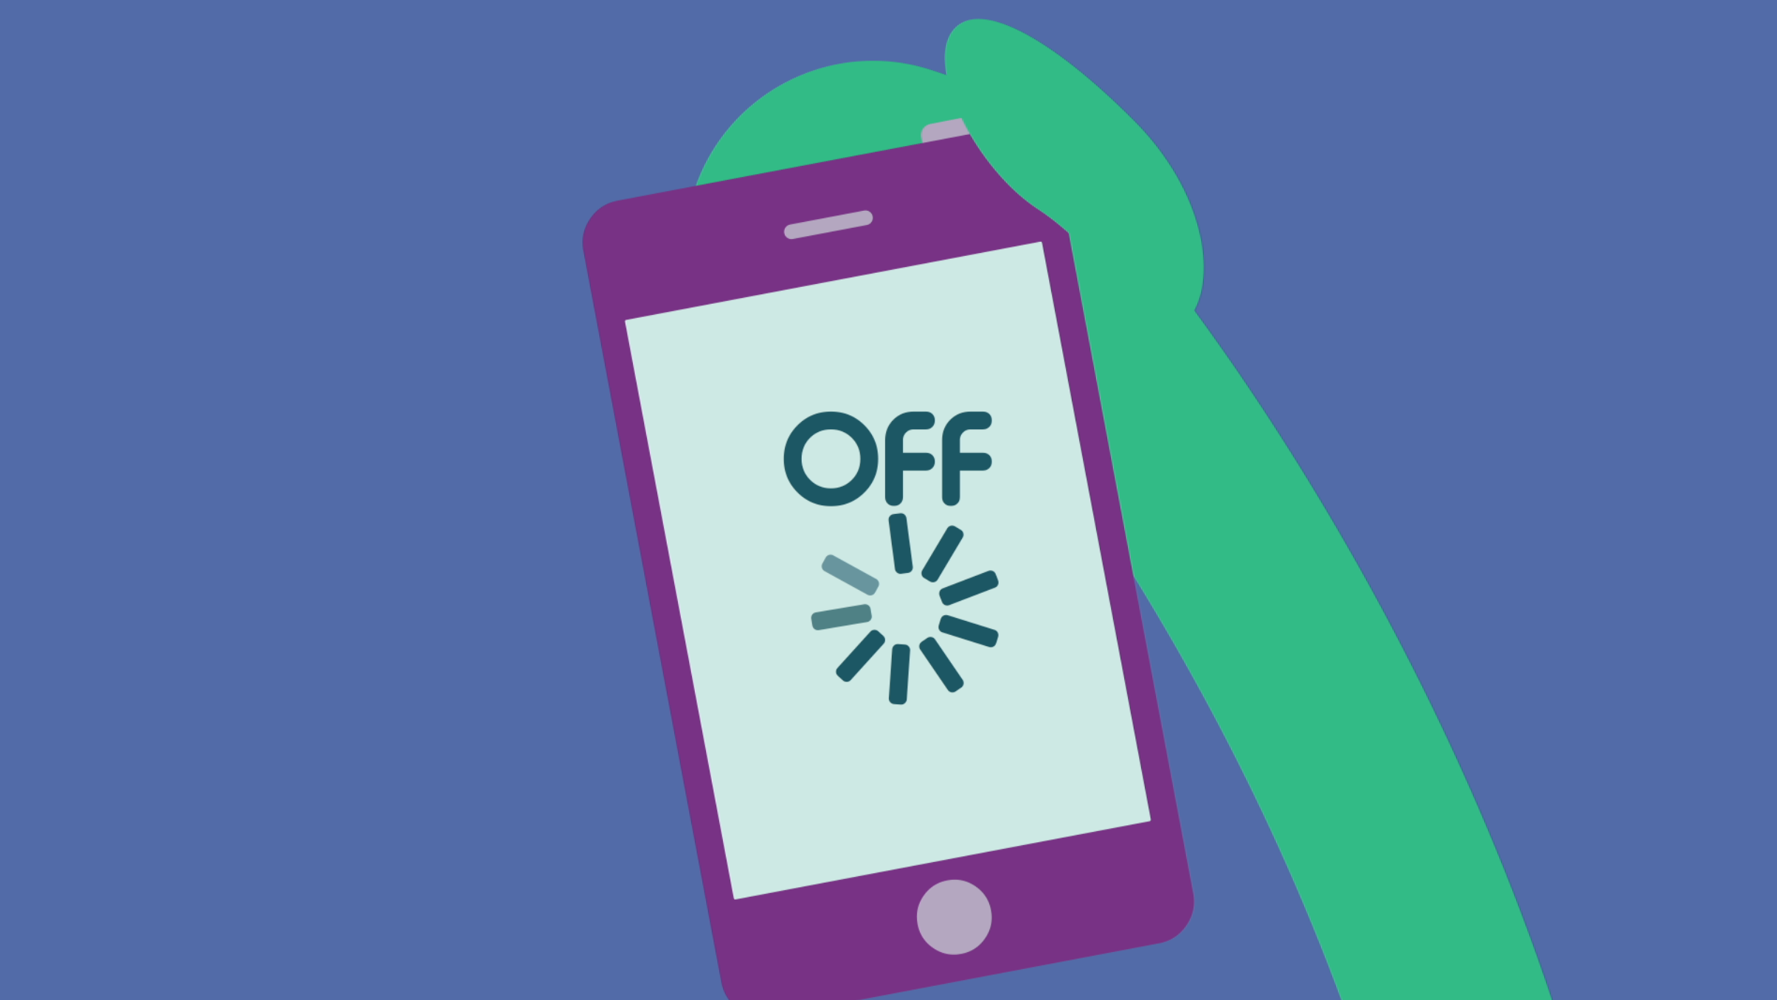
PAIR-SHARE
Why should we take a break from technology sometimes?

Slide 10
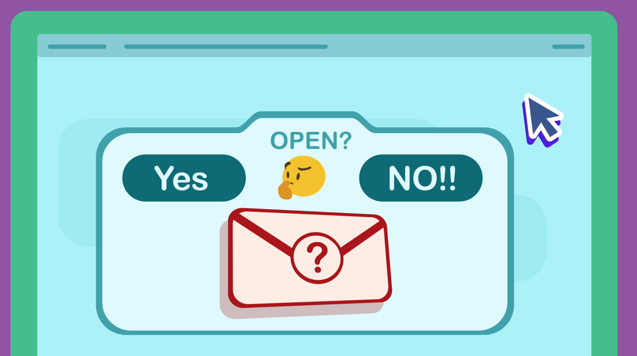
PAIR-SHARE
Why shouldn't you open a message from someone you don’t know?

Slide 11
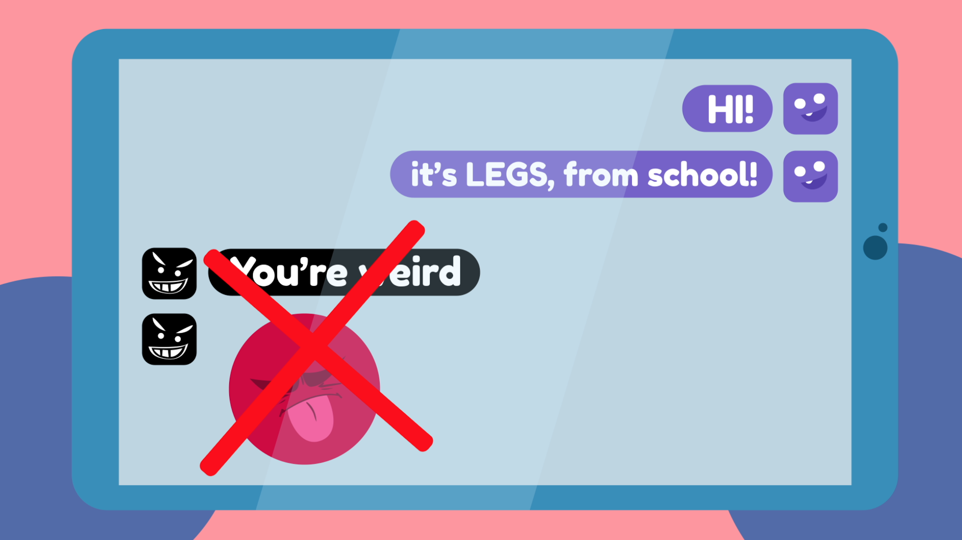
PAIR-SHARE
Why is it important to be kind online?

Slide 12
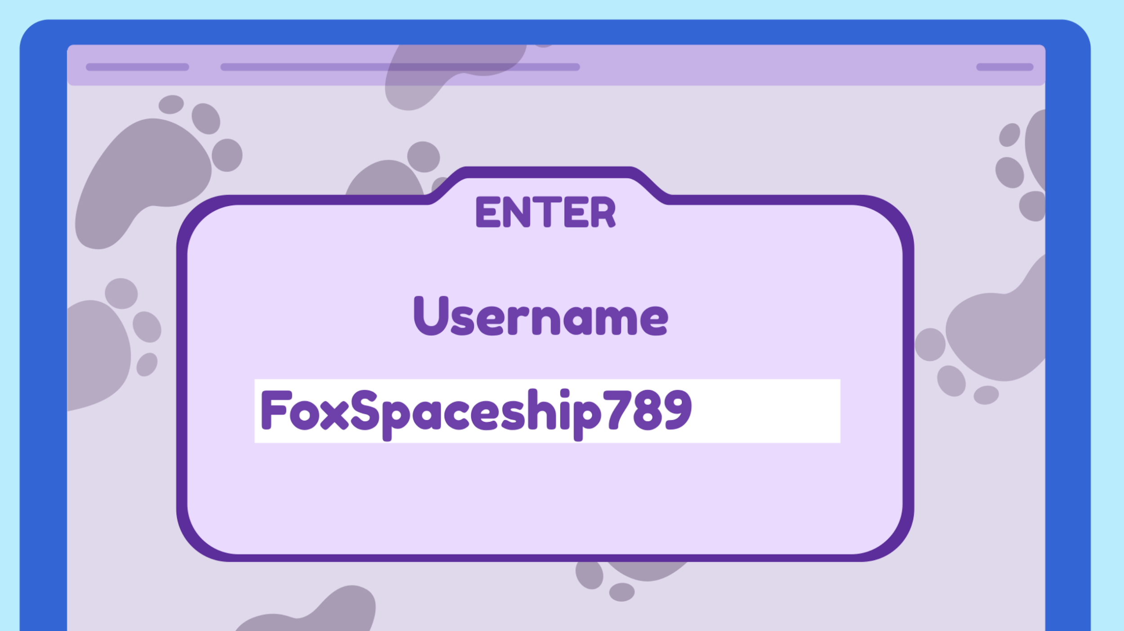
PAIR-SHARE
Why shouldn't you share your username and password with other people?

Slide 13
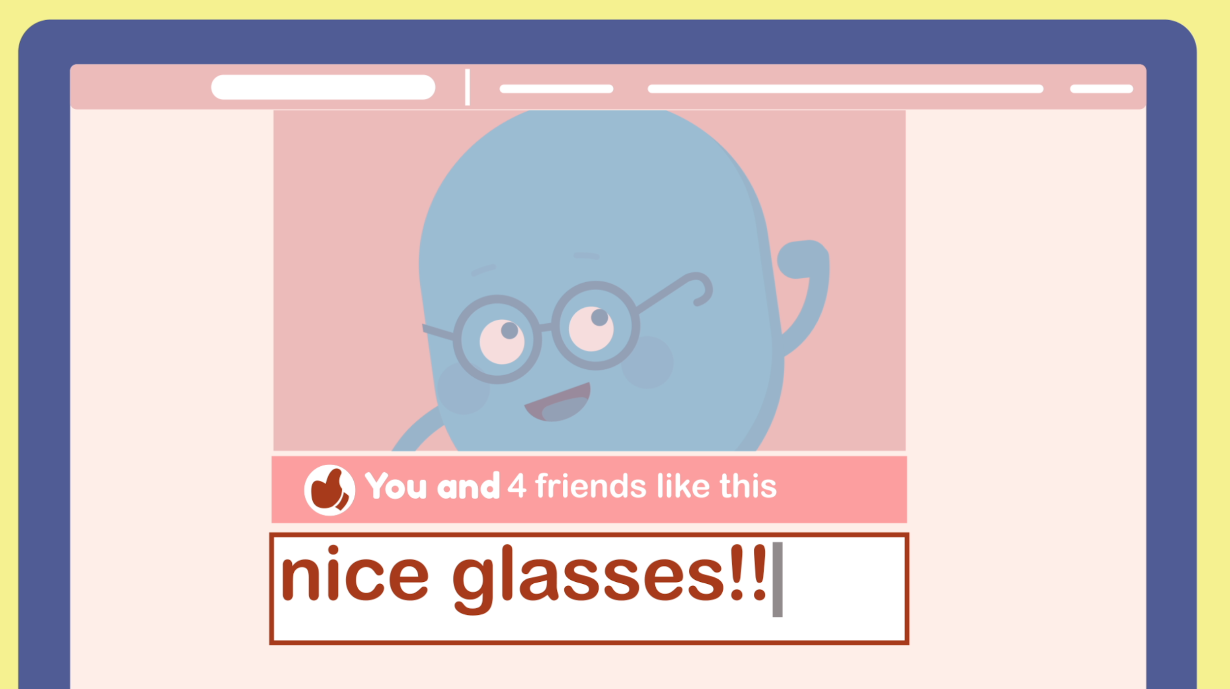
PAIR-SHARE
How do you communicate with friends and family online?

